Slide 1
Conference Committees
How do they work?
When do they meet?
How do I find them?
What now?!
Notes:
Conference Committees:
How do they work?
When do they meet?
How do I find them?
What now?!

Slide 2


Going to Conference…
Conference
Opaque
Lots of activity
It’s been a long session…
Notes:
If you’ve made it to Conference, you’ve come quite a way in the “bill to law” process. Most bills never reach this point!
Process can appear opaque to the public.
Lots of action – sometimes challenging to figure out who/what/where/how to focus energies.
Comes at the end of a long session – advocates may be tired, but this is a crucial phase of the process.

Slide 3
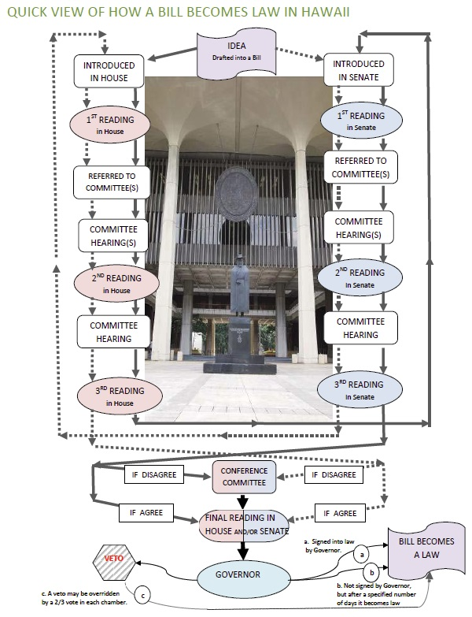
Today, we’re talking about this part of the process
Notes:
It’s this complicated looking part of the process that we’re focusing on today.

Slide 4
Here’s a brief glimpse of what a bill needs to go through to become a law…
Pass through all committees (hearings) the House and Senate have referred it to
and
Pass three readings (votes) in each chamber (all members)
and
Have exact wording agreed to by House and Senate
and
Be signed or allowed to come into law by Governor, or House and Senate successfully overrides his veto.
Notes:
Here’s a brief glimpse of what a bill needs to go through to become a law….
A bill has to have made it through all the committees it was referred to (which is when the public got to offer testimony at hearings) and passed three readings (or votes) on the floor of both the House and the Senate.
Now we’re to the third item on this list – agreeing on the exact wording of the bill that will go off to the Governor.

Slide 5
Have both House and Senate agree on exact wording
… now this isn’t even an issue if the non-originating chamber did not make any changes …
Notes:
Agreeing on the exact wording…
Now this isn’t even an issue if the non-originating chamber did not make any changes…

Slide 6
But most bills have been changed…
House bills changed by the Senate and
Senate bills changed by the House
Notes:
But at this point, most bills have been changed.
In 2013, 88% of the bills that passed Second Crossover were changed and 12% were not changed in the non-originating chamber.

Slide 7
And – almost always – those changes are not “Agreed to” by the originating chamber…
Notes:
And- almost always- those changes are not “agreed to” by the originating chamber.
Of bills passing Second Crossover with changes in 2013, 98% had the changes “disagreed to.”
Only 2% were “agreed to.”

Slide 8
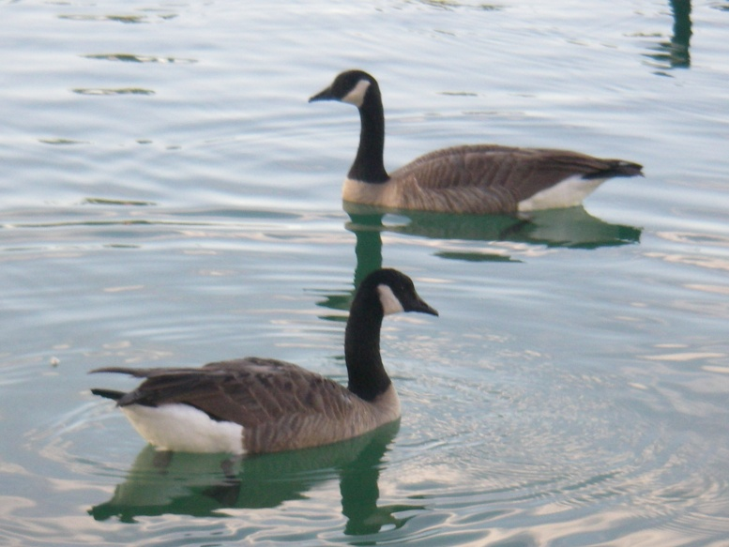
Instead, the originating chamber chooses to “disagree” with the changes made…
Notes:
Instead, the originating chamber chooses to “disagree” with the changes made…
Conference Committees start meeting the week after Second Crossover.

Slide 9
Which means that bill will go to Conference
A Bill for an
Act
…
Notes:
If the originating chamber disagrees with the changes made by the non-originating chamber, it goes to conference.

Slide 10
Why Conference?
When the Senate and House pass different versions of a bill, it poses a problem: only one version can go off to the Governor for consideration.
As a result, unless the originating chamber agrees to the other's version, the bill moves into the conference committee process.
Notes:
Why Conference?
When the Senate and House pass different versions of a bill, it poses a problem: only one version can go off to the Governor for consideration.
As a result, unless the originating chamber agrees to the other's version, the bill moves into the conference committee process.

Slide 11

What is a Conference Committee?
For each bill that reaches this stage, conference committees may be formed with members appointed from each chamber
Members from Senate
Bill #SB2394 SD1 …. HD1
Members from House
Notes:
What is a Conference Committee?
For each bill that reaches this stage, conference committees (one for the House, one for the Senate) may be formed with members appointed from each chamber.

Slide 12
Not guaranteed…
Some bills reach this point, and the conferees for one or the other chamber are not appointed
Then, the bill dies unless something extraordinary happens
If previous conferees were “discharged,” new ones must be named
Notes:
Not guaranteed…
Some bills reach this point, and the conferees for one or the other chamber are not appointed.
Then, the bill dies unless something extraordinary happens.
If previous conferees were “discharged,” new ones must be named.

Slide 13
Who are the conferees?
appointed by leadership
chairs = usually the subject matter chairs (typically the bill's first committee referrals)
“managers” or “conferees” – numbers vary
Notes:
Who are the conferees?
Members are often called “managers” or “conferees.” The numbers vary.
Members of both chambers are appointed by the Senate President and the House Speaker. (Minority leadership may be consulted for minority appointments.)
The House and Senate Chairs of the conference committee are usually the subject matter committee chairs for a given measure (typically the bill's first committee referrals).
You can frequently find more than one Chair for a measure depending on the referral, or you may even find a Vice-Chair heading-up a Conference Committee.

Slide 14
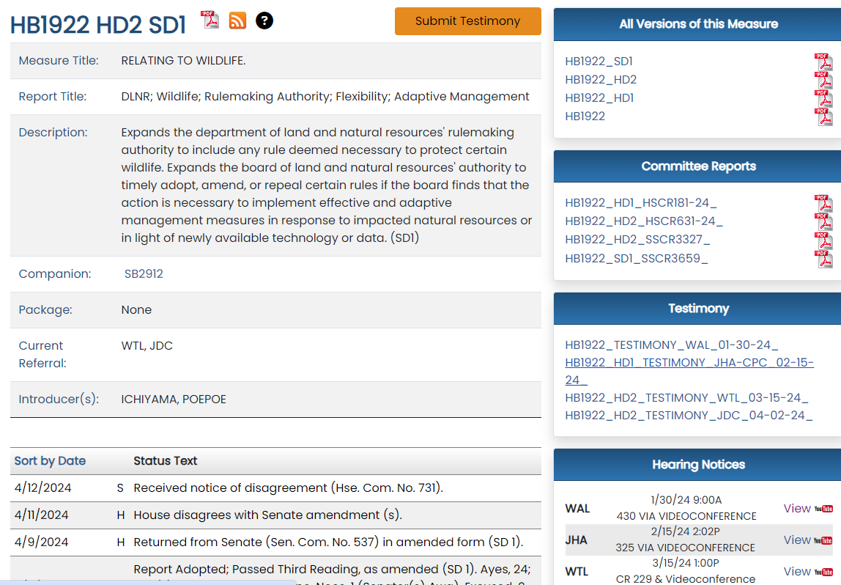

Slide 15
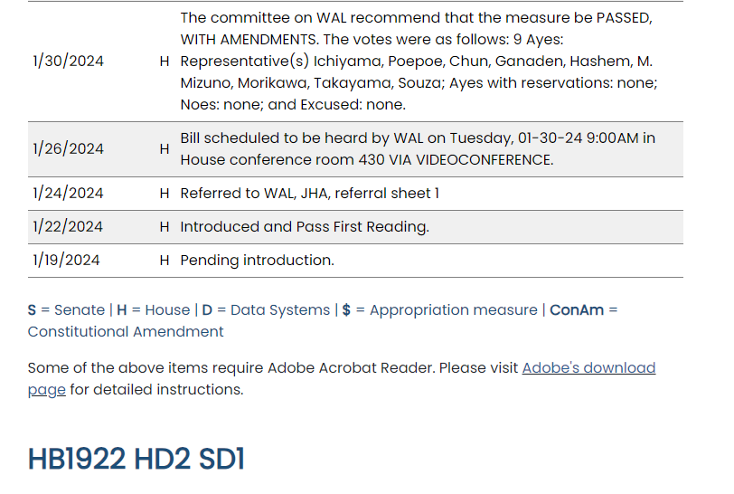

Slide 16
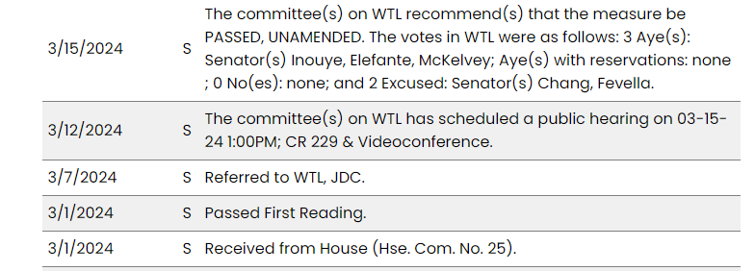

Slide 17
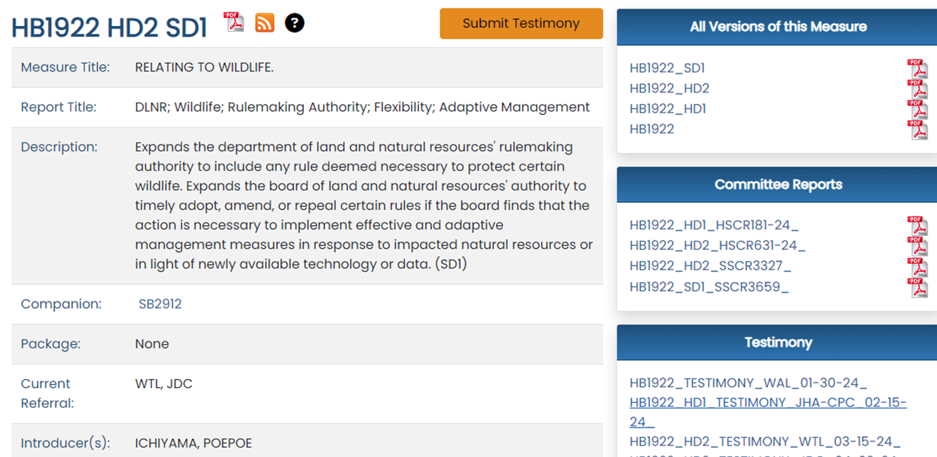

Slide 18
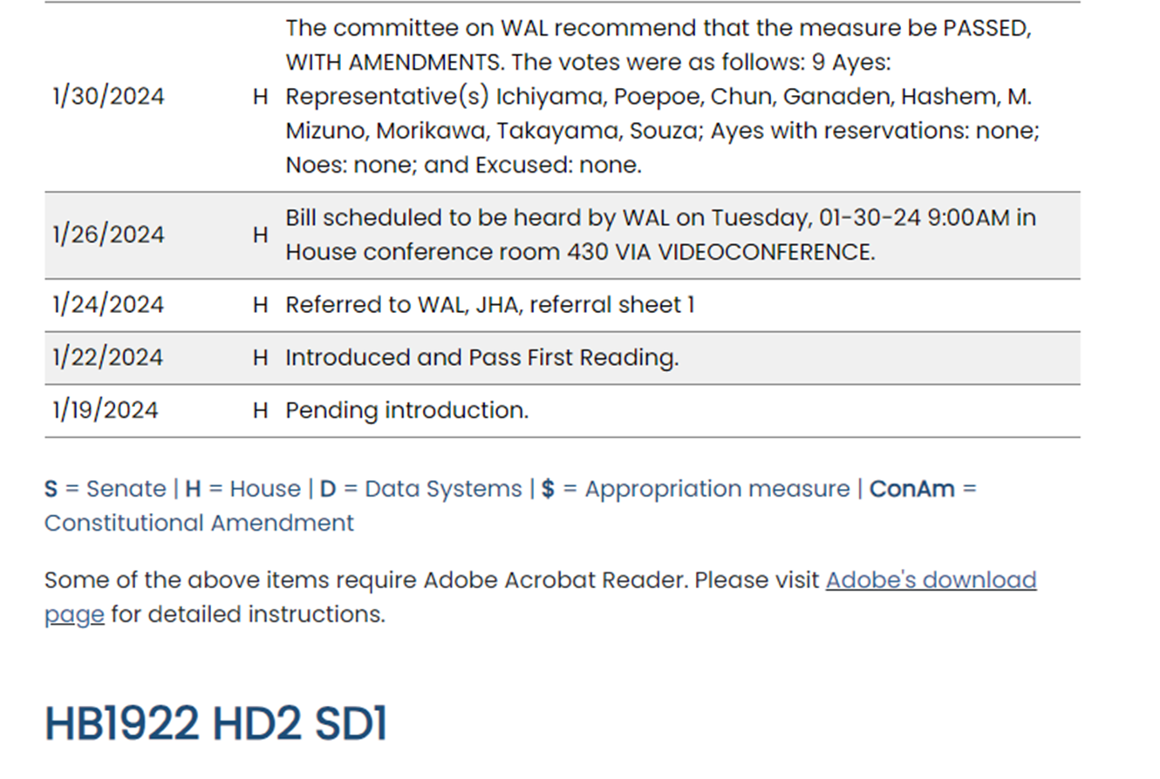

Slide 19
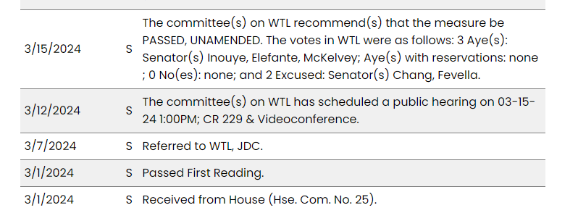

Slide 20
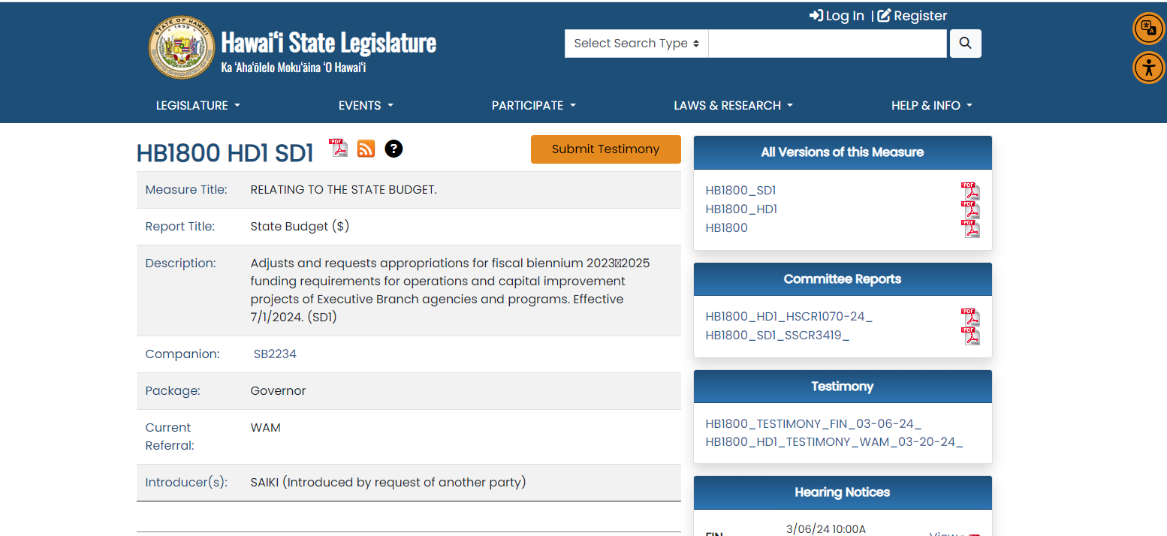

Slide 21
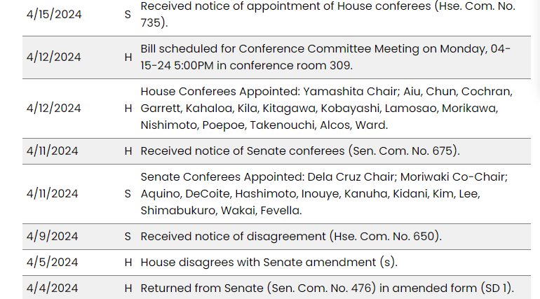

Slide 22
Two committees
We speak of “the conference committee for HB123” but it’s easier to think of it as two committees…
  the House conference committee for HB123 and
  the Senate conference committee for HB123
They meet together – to discuss, confer, and make decisions – but the votes are taken separately, and each committee must meet its chamber’s quorum requirements
Notes:
Two committees…
We speak of “the conference committee for HB123” but we’re actually talking about two committees: the House conference committee for HB123 and Senate conference committee for HB123.
They meet together to discuss, confer and make decisions- but the votes are taken separately, and each committee must meet its chamber’s quorum requirements.

Slide 23
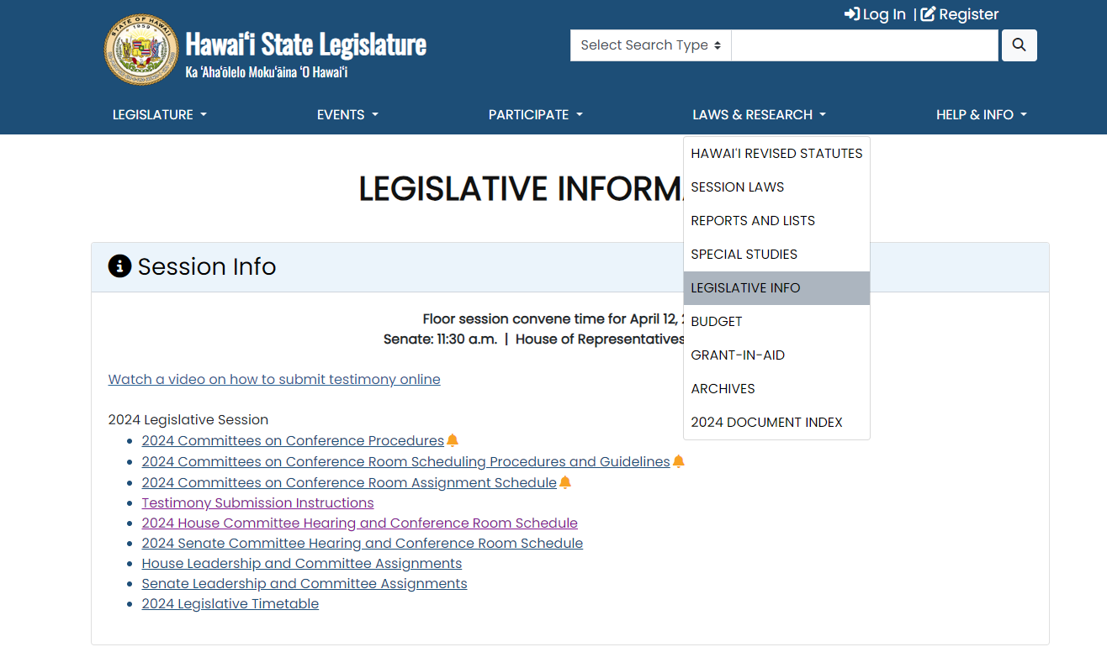
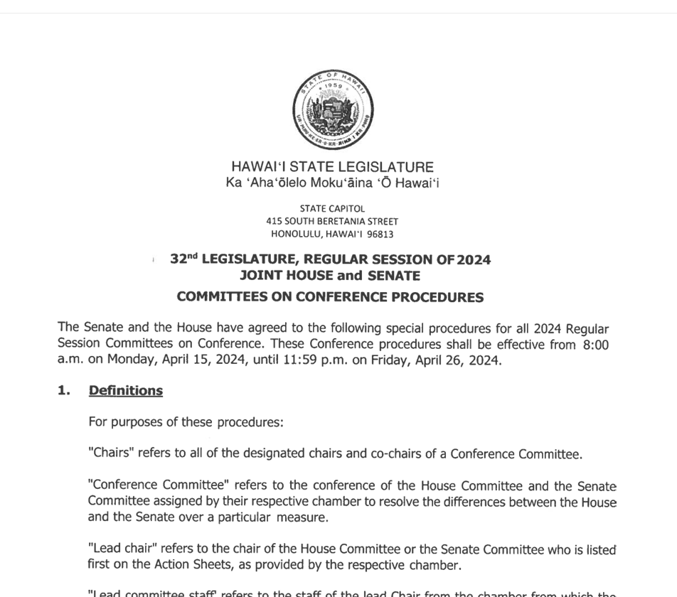
Procedures
Once available, they can be found under “Legislative Information" found on the drop- down menu under “Laws & Research”
Notes:
Procedures:
Conference committee procedures are usually agreed upon in early-mid April.
Once available, they can be found under “Legislative Information" found on the drop-down menu under the “Laws & Research” tab.

Slide 24
Procedures
24-hours notice given for 1st meeting; subsequently, can just announce reconvene times and locations.
Votes are taken separately (i.e., House conferees vote amongst themselves, Senate conferees amongst themselves).
Rules specify quorum needed for convening and decision making.
Notes:
Legislators may serve on numerous committees and scheduling votes can be a challenge for legislative staff.
Procedures:
24-hours notice given for 1st meeting; subsequently, they can just announce reconvene times and locations.
Votes are taken separately (i.e., House conferees vote amongst themselves, Senate conferees amongst themselves).
Rules specify quorum needed for convening and decision making.

Slide 25
Procedures
Originating chamber’s subject committee chair =
usually the originating chamber’s lead chair, and responsible for scheduling the meetings
Notes:
Procedures:
Originating chamber’s subject committee chair is usually the originating chamber’s lead chair, and responsible for scheduling the meetings.
Usually, the lead chairs are the only ones who speak at the meetings.

Slide 26
Procedures
No new subject matter should be inserted [except for the budget bills (Executive, Judiciary and Office of Hawaiian Affairs)]
Not allowed to merge two or more distinct but related measures into one encompassing measure
Notes:
Procedures:
No new subject matter should be inserted [except for the budget bills (Executive, Judiciary and Office of Hawaiian Affairs)]
Not allowed to merge two or more distinct but related measures into one encompassing measure

Slide 27
A Note re: Fiscal ($) Bills
Bills with fiscal implications must get approval by money chairs.
This means that even if you’ve got loads of support from the other conferees, the fate of your bill – and whether or not it comes out of conference – may not be known until the evening of the Final Decking deadline for fiscal bills.
Notes:
A Note regarding Fiscal Bills:
Bills with fiscal implications must get approval by money chairs. This includes all bills that have a FIN or WAM referral.
This means that even if you’ve got loads of support from the other conferees, the fate of your bill – and whether or not it comes out of conference – may not be known until the evening of the Final Decking deadline for fiscal bills.

Slide 28
Can the public testify?
No. The opportunity for public testimony was during the committee hearing process.
Conference is the time when legislators work out compromises among themselves.
The meetings are open to the public (and streamed and archived on YouTube).
Notes:
Can the public testify?
No. The opportunity for public testimony was during the committee hearing process.
Conference is the time when legislators work out compromises among themselves.
The meetings are open to the public. All meetings will be streamed and saved on YouTube.

Slide 29

Should I attend conference committee meetings?
Being present allows you to follow any discussions during the meetings.
Notes:
Should I attend Conference Committee meetings?
Being present allows you to follow any discussions during the meetings.
It is always good for advocates and/or opponents to be present as a statement of the bill’s importance

Slide 30
Should I attend conference committee meetings?
Conference period:
  This year, the two weeks between
  Monday, April 15, 2024 and
  Friday, April 26, 2024
Notes:
Should I attend Conference Committee meetings?
Being present allows you to follow any discussions during the meetings.
It is always good for advocates and/or opponents to be present as a statement of the bill’s importance

Slide 31
How can I advocate at this stage?
Contact the conference members independently and concisely communicate what aspect of the bill you believe is a “must have” or an “absolutely not” to any final version they come up with.
Ask your own Senator or Representative for assistance in influencing the legislation.
Notes:
How can I advocate at this stage?
Contact the conference members independently and concisely communicate what aspect of the bill you believe is a “must have” or an “absolutely not” to any final version they come up with.
Ask your own Senator or Representative for assistance in influencing the legislation.

Slide 32
How can I advocate at this stage?
How can I advocate at this stage?
Encourage constituents from the conferees' districts to communicate with their legislators about the legislation.
Talk to anyone you’ve developed a good relationship with at the Legislature to see if they can influence the situation!
Notes:
How can I advocate at this stage?
Encourage constituents from the conferees' districts to communicate with their legislators about the legislation.
Talk to anyone you’ve developed a good relationship with at the Legislature to see if they can influence the situation!

Slide 33
Following the Action
Conferees will use ‘comparison sheets’ which cite the differences in the language of the two drafts. (These are usually created by the Senate Majority Staff Office (SMA) for Senate Bills and the House Majority Staff Office (HMSO) for House Bills; they are not made available to the public.)
These sheets list the pages and lines of dissimilar verbiage in the drafts, which the Conferees will then refer to in their hearings.
This tool is used to confine the efforts of the committee members to the points that have not been agreed to.
Notes:
Following the Action:
Conferees will use ‘comparison sheets’ which cite the differences in the language of the two drafts.
These sheets list the pages and lines of dissimilar verbiage in the drafts, which the Conferees will then refer to in their hearings.
This tool is used to confine the efforts of the committee members to the points that have not been agreed to.

Slide 34
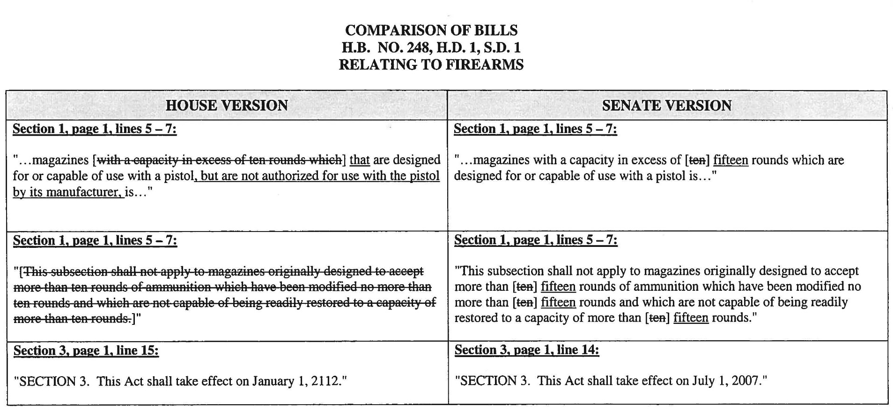
Sample from a Comparison Sheet…
Notes:
Here’s a sample from a comparison sheet…
This tool is used to confine the efforts of the committee members to the points that have not been agreed to and eliminates the need to compare the drafts of the measures as a whole.

Slide 35
Helpful Tools
Conference Committee discussion moves at a swift pace. You may want to create a tracking chart to help keep track of all of your bills, and their re-convene times.
Notes:
Helpful Tools:
Conference Committee discussion moves at a swift pace. You may want to create a tracking chart to help keep track of all of your bills, and their re-convene times.

Slide 36
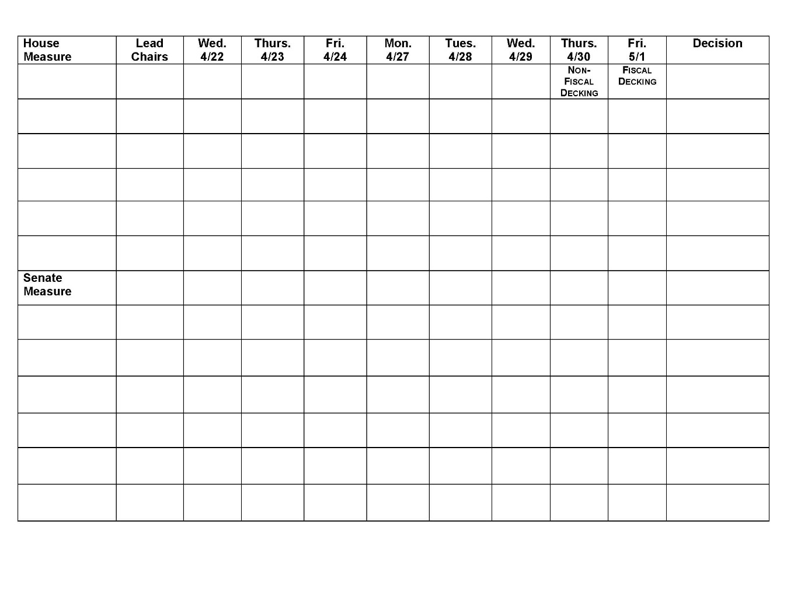
Notes:
Here’s an example of a tracking chart.

Slide 37
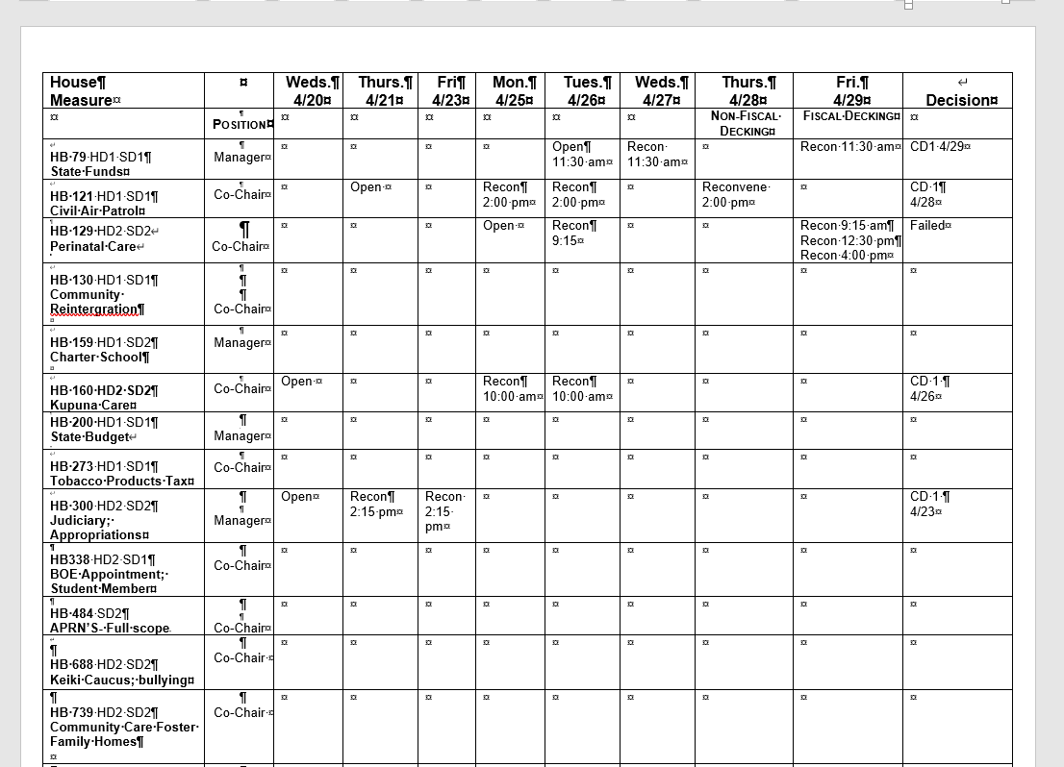

Slide 38
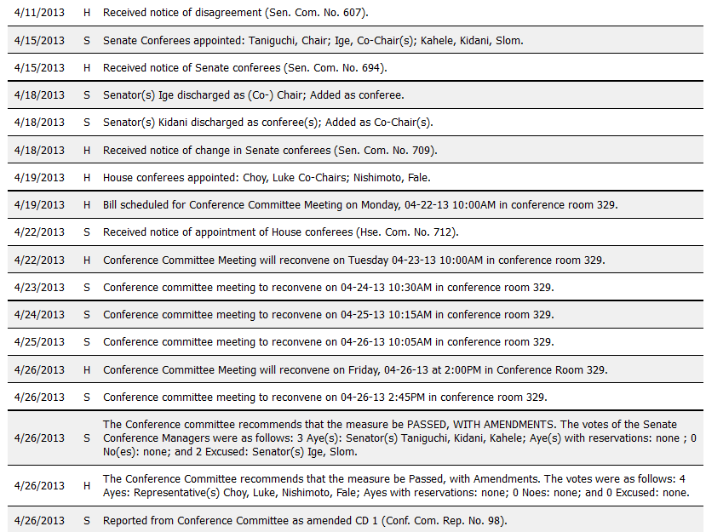
Where can I stay informed about conference committee actions?
Measure’s Status Page
Notes:
Where can I stay informed about conference committee actions?
The bill’s status sheet will be updated as its conferees are assigned, and meetings scheduled.

Slide 39
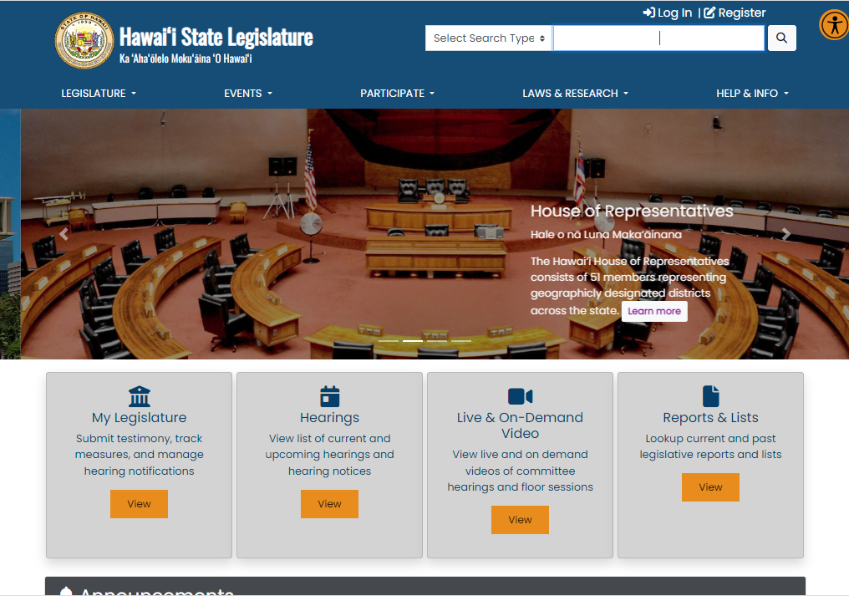
capitol.hawaii.gov
Where can I stay informed about conference committee actions?
Notes:
Where can I stay informed about conference committee actions?
Go to the Reports and Lists button on the Legislature’s website (capitol.hawaii.gov). It’s the last gray box on the homepage.

Slide 40
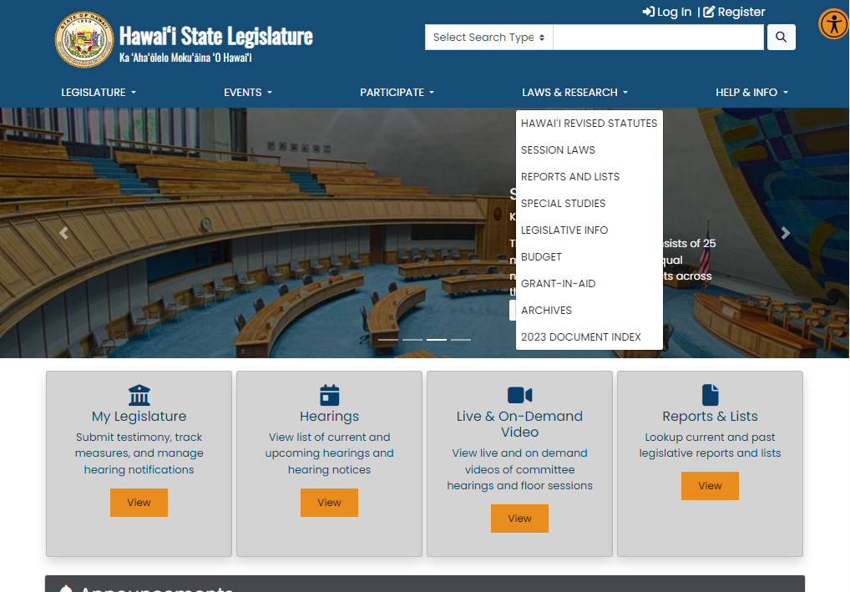
Notes:
You can also get to the “Reports and Lists” page by using the drop-down menu under the “Laws & Research” tab.

Slide 41
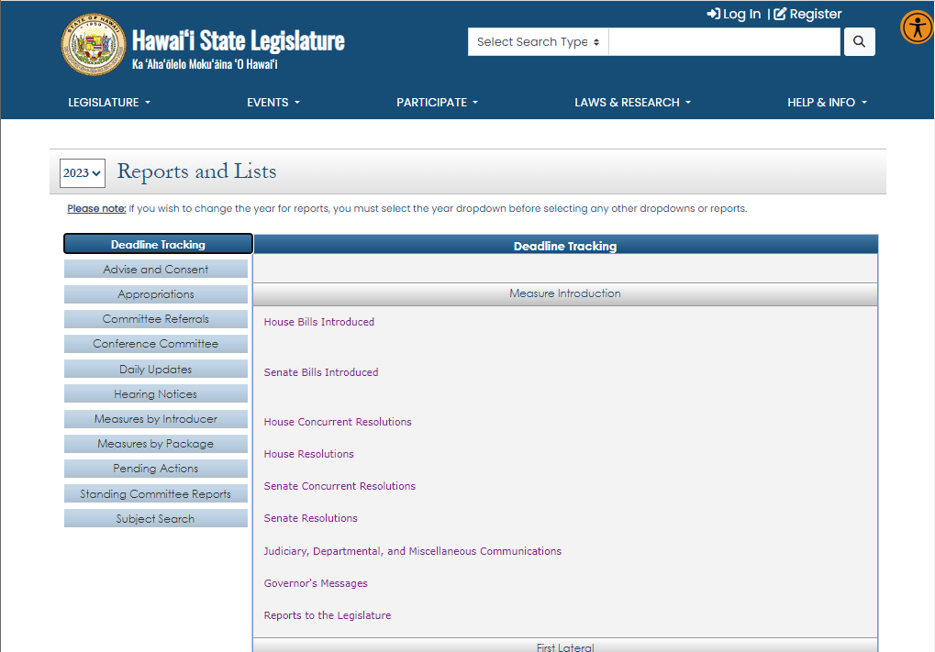

Reports and
Lists page
Notes:
On the Reports and Lists page, click “Conference Committee.”

Slide 42
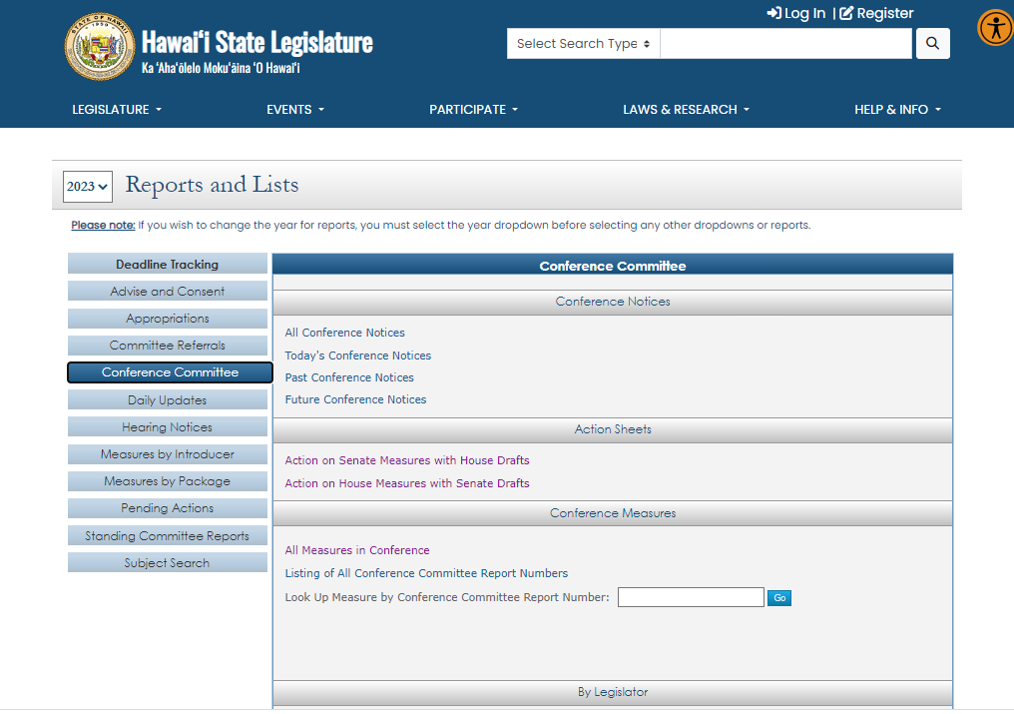
Notes:
You’ll see this screen.

Slide 43
You can find all sorts of helpful information…
Find all conference meetings for the day…
Track down legislators based on their conference assignments…
Get lists of all measures in conferences and their current status…
Notes:
You can find all sorts of helpful information…
Find all conference meetings for the day…
Track down legislators based on their conference assignments…
Get lists of all measures in conferences and their current status…
You’ll also find a list of room assignments there, arranged according to subject matter committees.

Slide 44
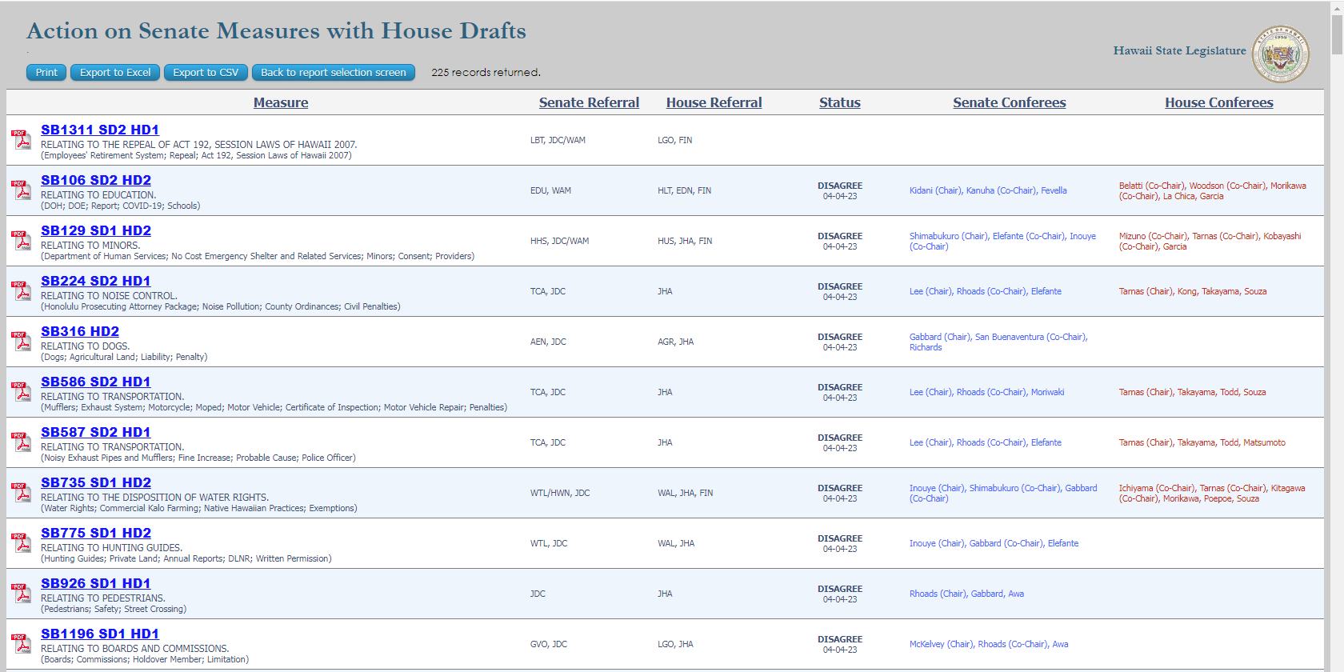

Slide 45
What’s a conference meeting like?
Chairs are usually the only ones speaking
Meetings often grouped together – gavel out of one bill, and into another
Often only discussion is whether agreement has been reached – if not, another time to meet is set
Sometimes, one or both sides decide an agreement is not going to be forthcoming
Notes:
What’s a conference meeting like?
Chairs are usually the only ones speaking
Meetings often grouped together – gavel out of one bill, and into another
Often only discussion is whether agreement has been reached – if not, another time to meet is set
Sometimes, one or both sides decide an agreement is not going to be forthcoming (the bill dies)

Slide 46
What’s the deadline for the conference committees to come to a decision?
Executive Budget – Monday, April 22
Fiscal Bills – Friday, April 26
Non-Fiscal Bills – Thursday, April 25
HB1800
$
$
Final version (CD1) & committee report
must be delivered to Chief Clerks’ offices
Notes:
All money bills will have to have the okay from the FIN and WAM chairs. The deadlines for coming out of conference are posted on the session calendar.
Advocacy at this stage requires contacting anyone who may have influence – the conferees, your own legislators, the subject matter chairs, etc. – and getting others to do the same.
Here are the deadlines for bills to come out of conference and be delivered to the Chief Clerks’ offices:
HB1800 (the budget bill): Monday, April 22
Non-Fiscal Bills (those not referred to FIN or WAM): Thursday, April 25
Fiscal Bills (those that were referred to FIN or WAM): Friday, April 26

Slide 47
What’s the deadline for the conference committee to come to a decision?
__April 25th_– Decking for non-fiscal bills
__April 26th_– Decking for fiscal bills
Any conference draft or decision on final form must be delivered to the House and/or Senate Chief Clerk by then (placed on the clerks’ “decks,” or desks).
Notes:
The deadline for the conference committee to come to a decision:
April 22nd Decking for non-fiscal bills
April 23rd Decking for fiscal bills
Any conference draft or decision on final form must be delivered to the House and/or Senate Chief Clerk by then (placed on the clerks’ “decks” or desks).

Slide 48
What’s the deadline for the conference committee to come to a decision?
They set deadlines more specifically…
For example, they could set deadlines:
6:00 p.m. = conclude negotiations
9:00 p.m. = committee report available for review and signature
11:30 p.m. = file committee report and bill draft with Chief Clerk
Notes:
What’s the deadline for the conference committee to come to a decision?
They set deadlines more specifically… for example…
6:00 p.m. = conclude negotiations
9:00 p.m. = committee report available for review and signature
11:30 p.m. = file committee report and bill draft with Chief Clerk
This year’s may be different!

Slide 49
The fate of the bill…
Notes:
The fate of the bill…

Slide 50
The fate of the bill…
CD1
The conferees may come to an agreement on a new version of the bill.
Both the House conferees and the Senate conferees vote to pass a CD1 (conference draft #1) version of the measure.
The chairs write a committee report that will accompany the new draft; it will be written to the Speaker and President recommending the bill be scheduled for a Final Reading vote in each chamber. Must be available for signature and submitted to the clerk by specific times on the decking deadline.
Notes:
The fate of the bill…
The conferees may come to an agreement on a new version of the bill.
Both the House conferees and the Senate conferees vote to pass a CD1 (conference draft #1) version of the measure.
The chairs write a committee report that will accompany the new draft and present it to the Speaker and President recommending it be scheduled for a Final Reading vote in each chamber.

Slide 51
The fate of the bill…
AGREE
The originating chamber’s conferees may vote to go along with the non-originating chamber’s version (the current version) of the bill.
Note: No quorum or action is required by the non-originating chamber and its conferees.
A vote is taken on the floor of the originating chamber to change the previous decision of “Disagree” to an “Agree;” the bill gets scheduled for a Final Reading vote.
Notes:
The fate of the bill…
The originating chamber’s conferees may vote to go along with the non-originating chamber’s version (the current version) of the bill.
A vote is taken on the floor of the originating chamber to change the previous decision of “Disagree” to an “Agree;” the bill gets scheduled for a Final Reading vote in the originating chamber.
Note: No action is required by the non-originating chamber and its conferees.

Slide 52
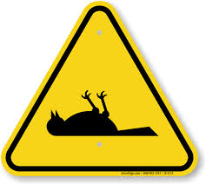
The fate of the bill…
DEAD
The conferees may fail to come to an agreement prior to the decking deadline.
The bill “dies in conference.”
If it is the first year of the biennium, it will carryover to the next year’s session. There is always the possibility that conferees may resume negotiations and move it forward. (Conferees may be discharged at the start of the 2nd year’s session – requiring action to get negotiations moving again.)
Notes:
The fate of the bill…
The conferees may fail to come to an agreement prior to the decking deadline.
The bill “dies in conference.”
If it is the first year of the biennium, it will carryover to the next year’s session. There is always the possibility that conferees may resume negotiations and move it forward. (Conferees may be discharged at the start of the 2nd year’s session – requiring action to get negotiations moving again.)

Slide 53

Final reading
Must happen before end of session (adjournment sine die).
Not over ‘til it’s over… a bill then needs to go off to the Governor, who may sign the bill into law, allow it to become law without signature, or veto the bill. (There is a mechanism by which the Legislature can override the Governor’s veto.)
Notes:
Final Reading:
Must happen before end of session (adjournment sine die).
Not over ‘til it’s over… a bill then needs to go off to the Governor, who may sign the bill into law, allow it to become law without signature, or veto the bill. (There is a mechanism by which the Legislature can override the Governor’s veto.)
Note: Exception is a bill that proposes a constitutional amendment; instead of going to the governor, it goes on the ballot.

Slide 54
Conference
A Bill for an
Act
…
Use the tools available to follow what you can
Call on the relationships you’ve developed with colleagues and allies
Keep up the effort!
Notes:
Use the tools available to follow what you can
Call on the relationships you’ve developed with colleagues and allies
Keep up the effort!

Slide 55
Pau!
A Bill for an
Act
…
Public Access Room (PAR)
587-0478
par@capitol.hawaii.gov
lrb.hawaii.gov/par
Notes:
Pau!
Public Access Room (PAR)
587-0478
par@capitol.hawaii.gov
https://lrb.hawaii.gov/par

