Slide 1
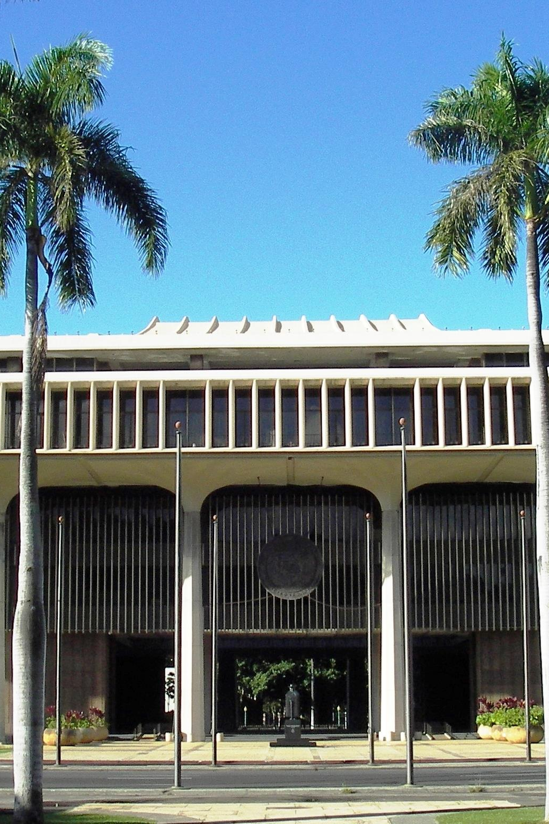
Following the Budget at Hawaii’s State Capitol
$
Public Access Room (PAR)
808/587-0478 par@capitol.hawaii.gov
lrb.hawaii.gov/par
Notes:
Following the Budget at Hawaii’s State Capitol: Public Access Room (PAR) 808/587-0478, par@capitol.Hawaii.gov, https://lrb.Hawaii.gov/par

Slide 2
Following the Budget
Public Access Room (PAR)
Overview of ‘the Budget’
The Budget Bill
  Following other money bills
  Grants in Aid (GIA)
Legislature’s website capitol.hawaii.gov
Notes:
“Following the Money” can be a difficult task, and there’s a lot to learn. In this workshop, we’ll start you on the road by offering an overview. Here’s what we’ll cover.
Contact PAR with questions or if you want to dive deeper into a certain area.

Slide 3
Following the Budget
Public Access Room (PAR)
Overview of ‘the Budget’
The Budget Bill
  Following other money bills
  Grants in Aid (GIA)
Legislature’s website capitol.hawaii.gov
Notes:
First, let us introduce you to the Public Access Room (PAR), a great resource for legislative advocates.

Slide 4
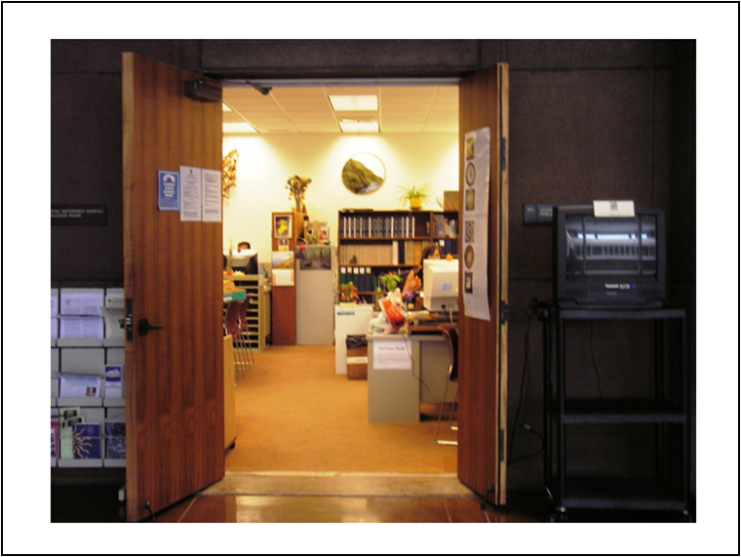
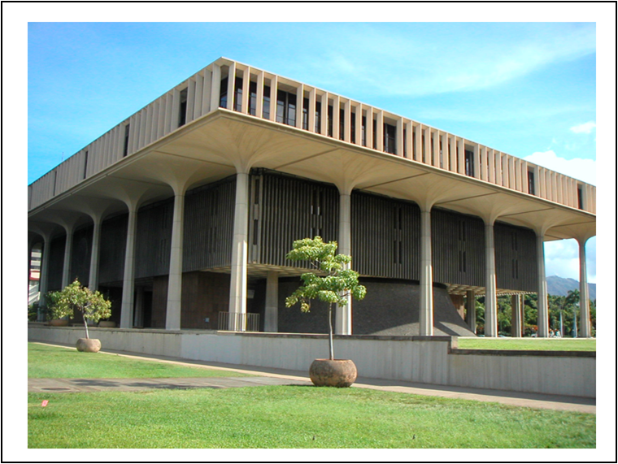
Your Office
Public Access Room (PAR)
at the
State Capitol
4th Floor, Room 401
808/ 587-0478
par@capitol.hawaii.gov
Notes:
The Public Access Room (your office at the Capitol) – is in Room 401 of the State Capitol building at the corner of Punchbowl and Beretania in downtown Honolulu.
(Physical address: 415 South Beretania Street, Honolulu, HI 96813)

Slide 5

Public Access Room (PAR)
Help, information and training at no charge
Non-partisan
Lots of resources!
  Guidance on process
  Computers with internet
  Wireless access & recharge
  station
  Copies of testimony
  Helpful handouts
  Workshops and tutorials
Notes:
We are non-partisan, dealing exclusively in process and never in policy considerations. There is never a fee for our services – we’re supported by your tax dollars. You can come to PAR to use one of the public computers or the printer, have a small meeting, get copies of your testimony, or watch a hearing remotely. We have tables for you to work on your laptop (there’s free wi-fi throughout the building) or recharge your devices. Or perhaps just sit and relax a while. We can answer your questions and point you to resources. We also offer workshops and tutorials so you can learn more.
Our office is one of the five divisions of the (also non-partisan) Legislative Reference Bureau (LRB), a legislative service agency. More information on PAR can be found on the website: https://LRB.hawaii.gov/par/

Slide 6
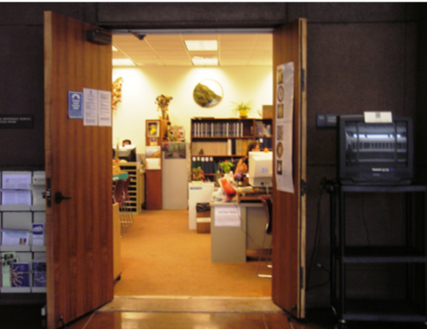
The place to go to:
ask questions
type up your testimony
- do online research
re-group or meet up with others
watch hearings
recharge your laptop or phone
pick up handouts
take a breather (puuhonua of the bldg)
Notes:
And don’t forget, you can pick up handouts! (Many of them are also available on our website, lrb.hawaii.gov/par)

Slide 7
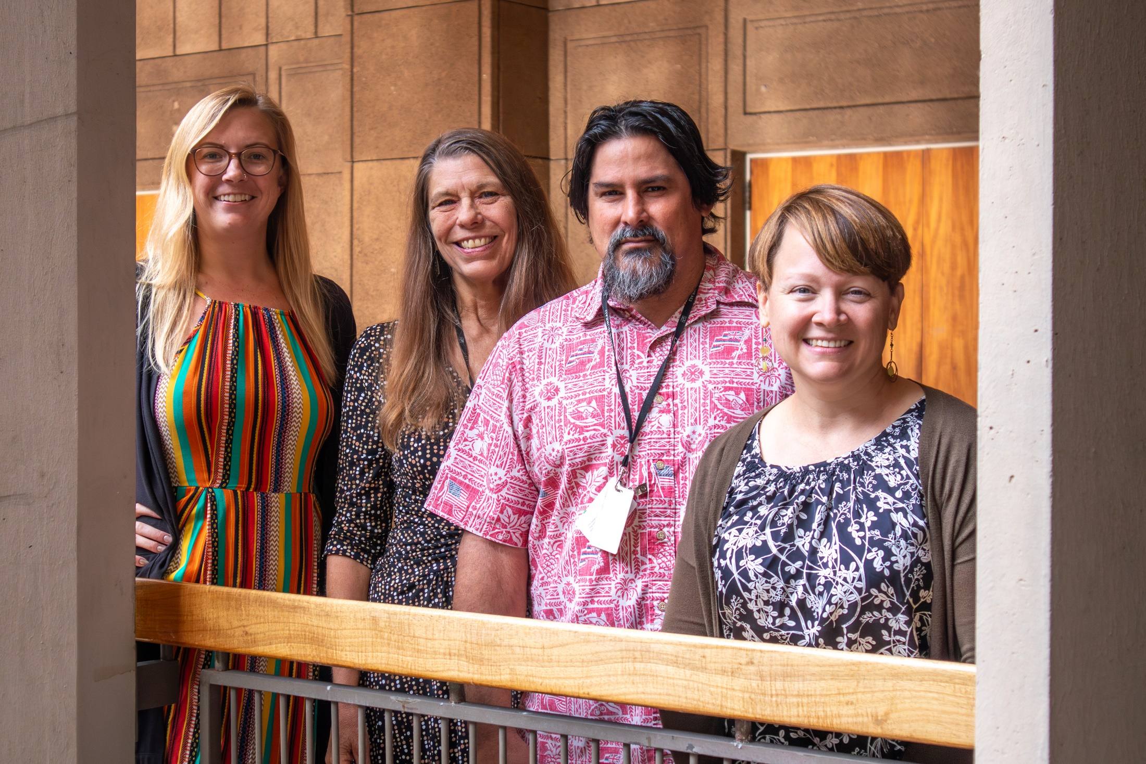
Expert and friendly staff – Always happy to help!
Notes:
The two people in the center – Virginia Beck and Keanu Young – are in the office year-round. Courtney Mrowczynski (on the left) and Andy Eickholt (on the right) were hired to help us during the 2024 legislative session. Any of us is happy to help!

Slide 8
Following the Budget
Public Access Room (PAR)
Overview of ‘the Budget’
The Budget Bill
  Following other money bills
  Grants in Aid (GIA)
Legislature’s website capitol.hawaii.gov
Notes:
Now to look at the budget – let’s start with an overview of what we’re looking at.

Slide 9


3 Equal Branches of
Hawaii’s State Government
Legislative
Make the law
Executive Implement the law
Judiciary
Interpret the law
Notes:
Let’s start with the big picture. Our democracy is set up with a balance of power – three different, equal branches of government that help to keep one another in check. Roughly speaking, the Legislative branch makes the laws, the Executive branch implements those laws, and the Judiciary branch interprets the law.
In this workshop, we’ll be focused on the Legislative branch, the branch of government concerned with making the laws.

Slide 10
3 Equal Branches of
Hawaii’s State Government
Legislative
Make the law
Crafts/passes the budgets of all branches
Executive Implement the law
Judiciary
Interpret the law
Notes:
It is the legislative branch that actually passes the budget and spending authorization bills for the State.

Slide 11
Actually 4 Separate Budgets
Legislative
Make the law
1
Executive Implement the law
Judiciary
Interpret the law
4
2
Office of Hawaiian Affairs
Hawaii Constitution,
Article XII, Section 5
3
Notes:
There are actually 4 ‘budget bills’ that the Legislature passes each year – covering the Legislative branch (often one of the first bills enacted each Session), the Executive branch, Judiciary, and the Office of Hawaiian Affairs (OHA).

Slide 12
“The Budget Bill” = the Executive Branch budget
Legislative
Make the law
1
Executive Implement the law
Judiciary
Interpret the law
4
2
Office of Hawaiian Affairs
Hawaii Constitution,
Article XII, Section 5
3
Notes:
But when someone talks about “The Budget Bill,” they’re referring to the bill that establishes the budget for the Executive branch, headed by the Governor and consisting of numerous departments.

Slide 13
Current Fiscal Biennium is FY 2023-2025:
This is the State budget period.
July 1, 2023 – June 30, 2024 = Fiscal Year 2024
a.k.a. FY 2023-2024 or FY24
July 1, 2024 – June 30, 2025 = Fiscal year 2025
a.k.a. FY 2024-2025 or FY25
Fiscal biennium starts in odd year
Notes:
The budget bill covers the fiscal biennium, a two-year period starting on July 1 in an odd-numbered year.
For example, Current Fiscal Biennium is FY 2023-25: This is the State budget period.
July 1, 2023 – June 30, 2024 = Fiscal Year 2024
a.k.a. FY 2023-2024 or FY24
July 1, 2024 – June 30, 2025 = Fiscal year 2025
a.k.a. FY 2024-2025 or FY25

Slide 14
The first year of session (2023):
pass General Appropriations Act
for FY 2023-25
The second year of session (2024):
pass Supplemental Appropriations Act
for FY 2023-25
updating the previous year’s act
Notes:
Both the General Appropriations bill passed in the first year of session and the Supplemental Appropriations bill passed in the second year of session deal with the same two-year fiscal biennium. In fact, the Supplemental Appropriations bill proposes changes to the General Appropriations Act that was passed during the first year of the biennium.

Slide 15

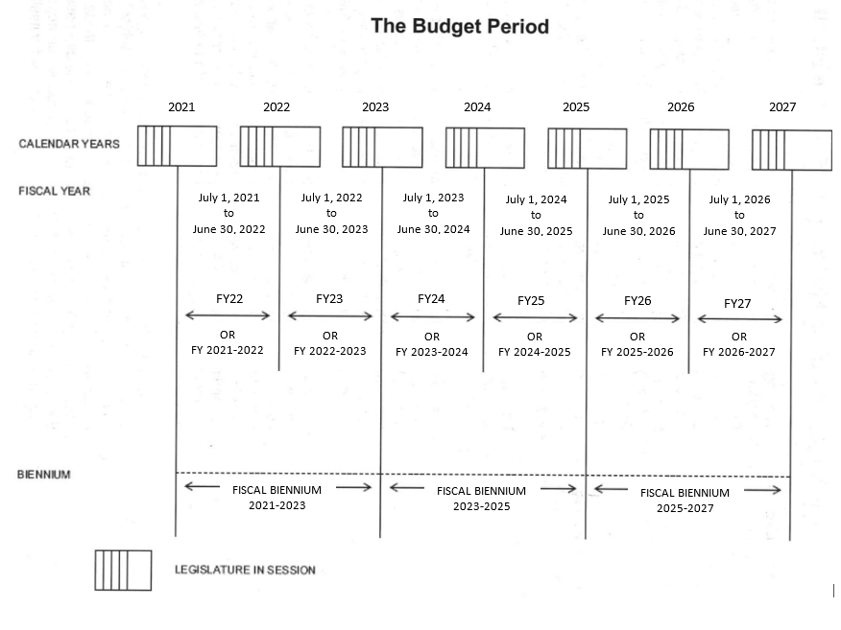
Current Session
Notes:
Accordingly, in the 2023 Session, the legislature passed the budget bill (“General Appropriations Act”) covering Fiscal Biennium 2023-25 (consisting of FY24 and FY25).
Here’s a chart that explains it all – calendar years, session, fiscal years – if you have the patience to read through it!

Slide 16
Following the Budget
Public Access Room (PAR)
Overview of ‘the Budget’
The Budget Bill
  Following other money bills
  Grants in Aid (GIA)
Legislature’s website capitol.hawaii.gov
Notes:
Now let’s look at the budget bill itself – how it’s created, what it goes through, and how to read it.

Slide 17

Hawaii State Legislature
Senate | House of Representatives
State Senators (25) | State Representatives (51)
4-year terms | 2-year terms
Each chamber organizes itself into:
Leadership positions
Committees
Notes:
The Hawaii State Legislature is bicameral, which means that it is made up of two different chambers – the Senate is comprised of 25 Senators serving 4-year terms, and the House of Representatives is comprised of 51 Representatives serving 2-year terms.

Slide 18
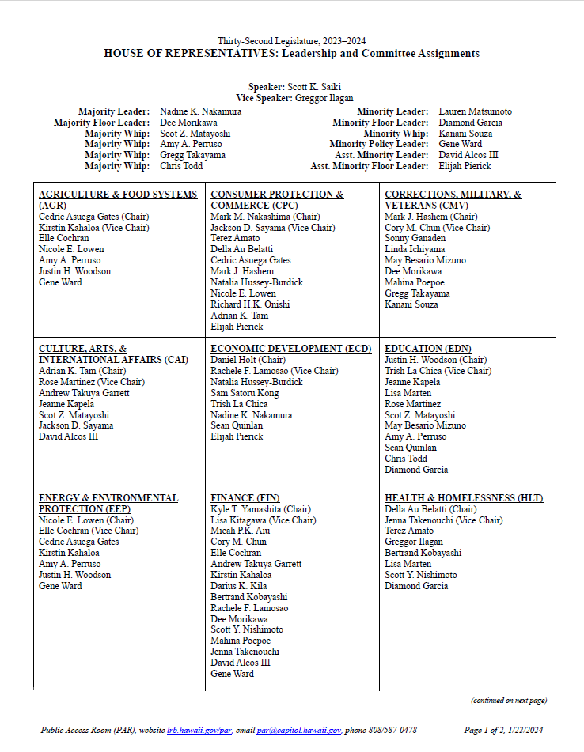
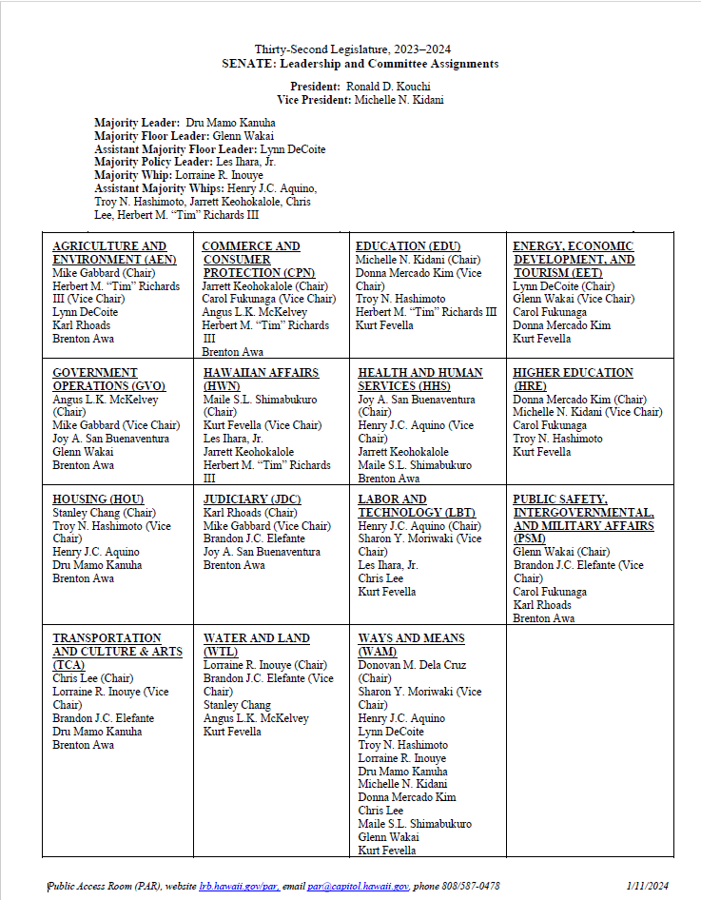
Notes:
Both chambers organize themselves into various leadership roles and standing committees. Such roles and assignments allocate power and responsibility, and anyone attempting to influence legislation is aided by an understanding of these dynamics. Each chamber establishes rules governing their procedures.
While in discussing the budget we talk a lot about the Senate Ways and Means (WAM) Committee and the House Finance (FIN) Committee, the chairs of the other committees play an important role, too.

Slide 19
Just a reminder of what a bill goes through…
Successfully pass through all committees the House
and Senate have referred it to
and
Successfully pass three readings in both the House
and Senate chambers (where all the members
convene)
and
Have both House and Senate agree on exact wording
and
Be signed or allowed to come into law by Governor, or House and Senate successfully overrides his veto
Notes:
A bill needs to meet a lot of requirements to become law:
A quick review -- it must:
Survive all the committees it’s referred to (though different versions will probably emerge as the bill moves from one committee to the next).
Pass 3 readings (votes) on the floor of each chamber.
Have both chambers agree on a final version.
Be signed into law by the Governor, or become law without his signature, or have his veto overturned by 2/3 of all the members of both the House and the Senate.

Slide 20
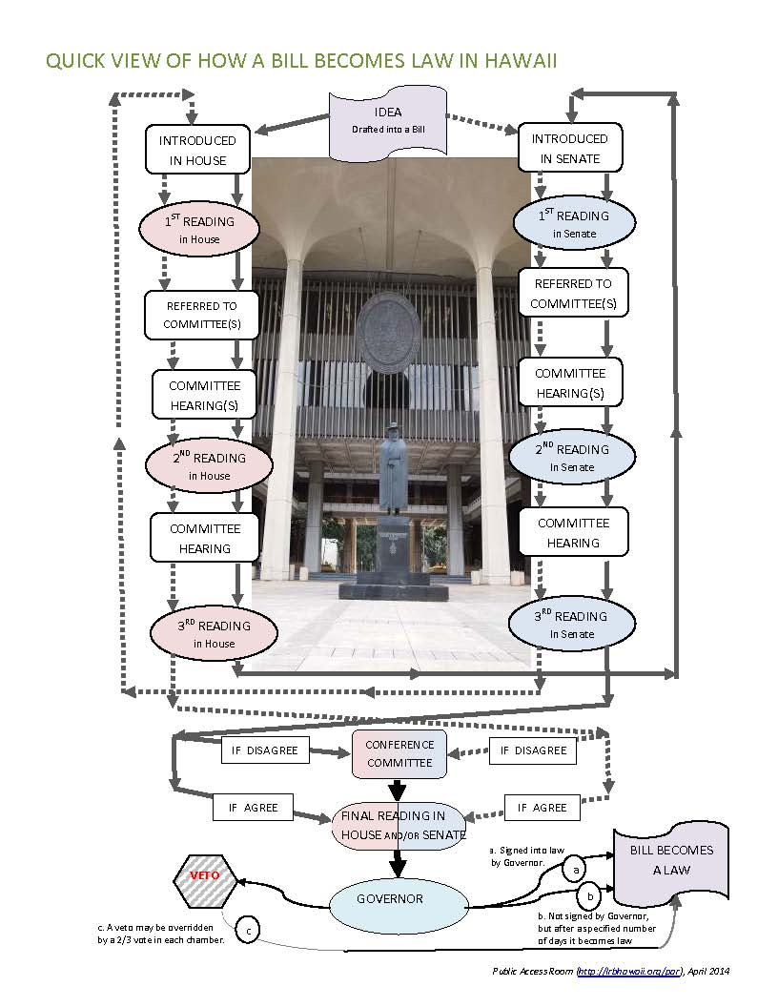
Budget and money bills must go through the process just like other bills
Notes:
Budget and money bills have to go through the legislative process just like other bills. By law, the Budget Bill must go to the Governor before other appropriations bills.
HRS Chapter 37 provides a lot of information regarding the budget process:
http://www.capitol.hawaii.gov/hrscurrent/Vol01_Ch0001-0042F/HRS0037/HRS_0037-.htm
The provision regarding the General Appropriations Act (or Supplemental Appropriations Bill, in an even numbered year) going to Governor prior to other fiscal bills appears in the Hawaii State Constitution (Article VII, Section 9).

Slide 21
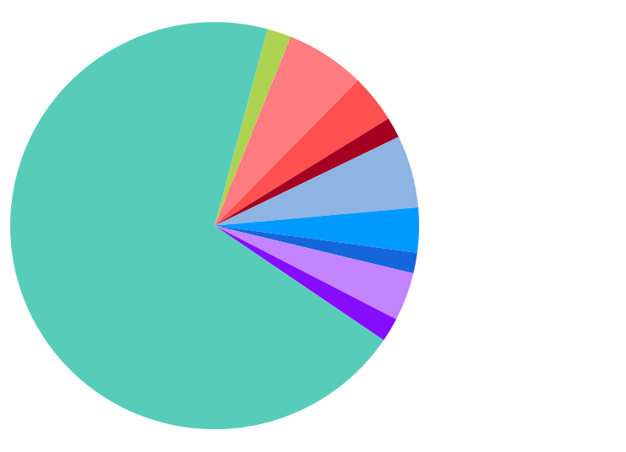
Per the State Constitution, session starts on the 3rd Wednesday in January each year…
This year, that was January 17, 2024
Session starts mid-January: Budget bill introduced
Jan
+
Oct
Apr
Ends late April or early May:
Budget bill passed
Governor signs bill:
Budget bill enacted
Jul
Notes:
The budget is passed as a bill, and a bill can only be formally introduced (start its way through the pipeline) when the Legislature is in session (though of course it can be written – “drafted” – in advance).
Hawaii has a ‘part-time’ legislature – they convene in Regular Session on the third Wednesday in January each year, and meet for 60 session days – which takes them to late April or early May.

Slide 22

A lot happens before the
‘Budget Bill’ is introduced…
Council on Revenues
predicts the future
(how much $ will we have)
Notes:
A lot happens before the Budget Bill is introduced.
As a starting point, let’s use the Council on Revenues projection of how much money the State will have to spend. They make these predictions four times a year. They’ll make one in late May. (For more information, please see the Council on Revenues website: http://tax.hawaii.gov/useful/a9_1cor/)

Slide 23

Council on Revenues
General Fund Forecast
January
March
May
September
Forecasts change throughout the year… affects total amount to work with
Notes:
The changing estimates made by the Council on Revenues affects the budget process throughout the year. Let’s start with the general fund forecast the Council comes out with in May (reported on June 1).
FYI: The Council on Revenues (COR) is attached to the Department of Taxation for Administrative Purposes and prepares revenue estimates of the state government for each fiscal year of the six-year state program and financial plan. The Council reports its latest revenue forecast to the governor and the legislature on June 1, September 10, January 10, and March 15 of each year.
Find more information here: https://tax.hawaii.gov/useful/a9_1cor/

Slide 24

JAN
FEB
MAR
APR
MAY
JUN
JUL
AUG
SEP
OCT
NOV
DEC
Summertime → September
Executive Departments
develop & submit their requests to Governor
$ Needs
$ Needs
$ Needs
$ Needs
$ Needs
$ Needs
$ Needs
$ Needs
$ Needs
Governor’s Office
receives requests from all
Executive Departments
$ Needs
$ Needs
$ Needs
$ Needs
$ Needs
$ Needs
$ Needs
$ Needs
$ Needs
Notes:
The Executive Departments will prepare their requests for funding and submit them to the Governor over the summer.
Advocates may want to contact a department to ask them to include certain programs or funding in their budget request.

Slide 25
Council on Revenues
General Fund Forecast
January
March
May
September
By September, the forecast
(and the total amount to budget)
may have changed
Notes:
September brings another general fund forecast that affects how much money the governor has to work with.

Slide 26
JAN
FEB
MAR
APR
MAY
JUN
JUL
AUG
SEP
OCT
NOV
DEC
September → December
Department of Budget & Finance (B&F)
works with the Governor
and the departments to compile initial budget request
Notes:
The Governor works with his team in the Department of Budget & Finance (B&F) to compile the initial budget. It is offered to the Legislature in late December (30 days prior to the start of Regular Session).

Slide 27
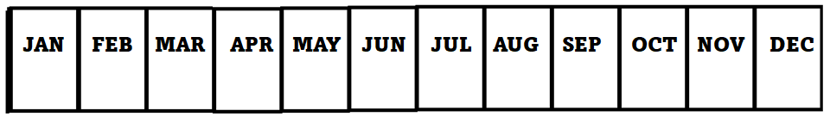
Governor
submits Budget Bill (and a lot more) to Legislature in December
(PFP, or Multi-Year Program and Financial Plan and Executive Budget)
“…Not fewer than thirty days before the legislature convenes in every odd-numbered year, the governor shall submit to the legislature and to each member thereof the six-year program and financial plan….”
Notes:
The Governor must provide the budget and the Program and Financial Plan (PFP) to the legislature not less than 30 days prior to opening day. (HRS §37-71)

Slide 28
B&F website: budget.hawaii.gov
Treasure Trove of Information
Budget Summary
Program and Financial Plan (PFP) includes program structure details, proposed budget as well as prior expenditures, proposed CIP (Capital Improvement Projects), info on economy, financial plan
Notes:
It includes: 1) State program structure; 2) Statements of statewide objectives; 3) Financial requirements for next two fiscal years to carry out recommended programs; 4) Summary of state receipts and revenues, revised estate of current fiscal year, estimate for succeeding biennium.
In general, the “PFP” contains:
(1) The state program structure (which we’ll discuss more in a minute);
(2) Statements of statewide & program objectives;
(3) Program plans on the implementation of the objectives over the next six fiscal years; and
(4) A financial plan of the fiscal impact of the recommended program over the next six fiscal years. (HRS §37-69)
For more information, please see the Budget & Finance website: http://budget.hawaii.gov/
Budget page: http://budget.hawaii.gov/budget/
Finance page: http://budget.hawaii.gov/finance/

Slide 29
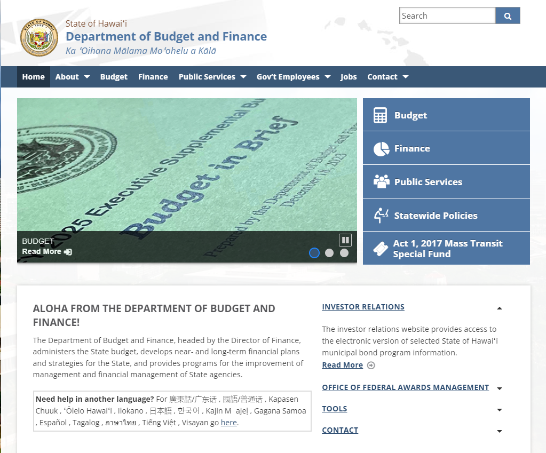
budget.hawaii.gov
Notes:
Here’s the Budget & Finance website – budget. Hawaii.gov. Click on “Budget”

Slide 30
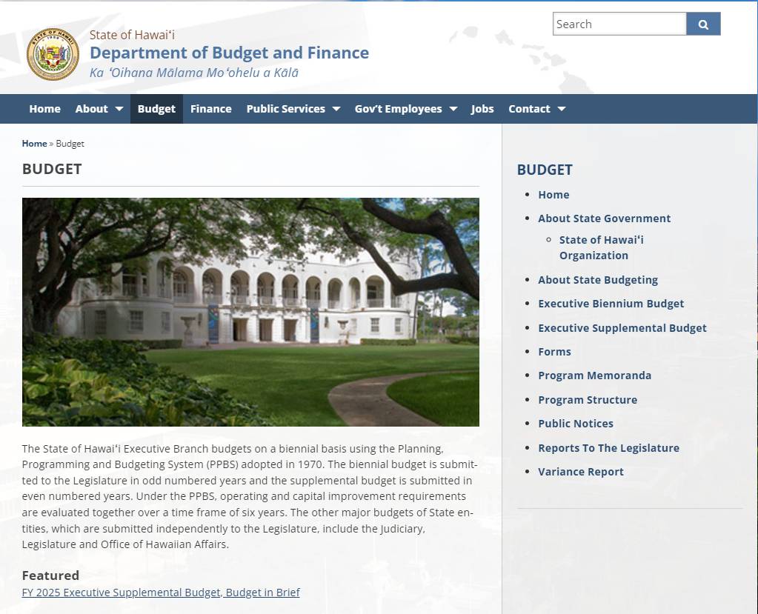
budget.hawaii.gov/budget
Notes:
And it brings you to the Budget page, budget.hawaii.gov/budget. You can read more about the budget here, but for now let’s click on “Executive Supplemental Budget” since this is the second year of the biennium, and that will be what we’re focused on.

Slide 31
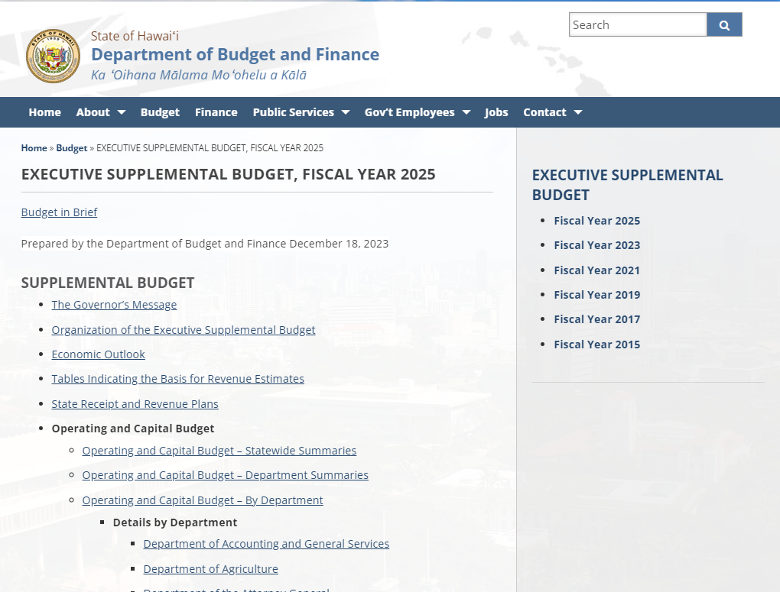
https://budget.hawaii.gov/budget/
executive-supplemental-budget-fiscal-year-2025/
Notes:
A great summary of the Executive Branch’s request can be found in the “Budget in Brief” document.

Slide 32
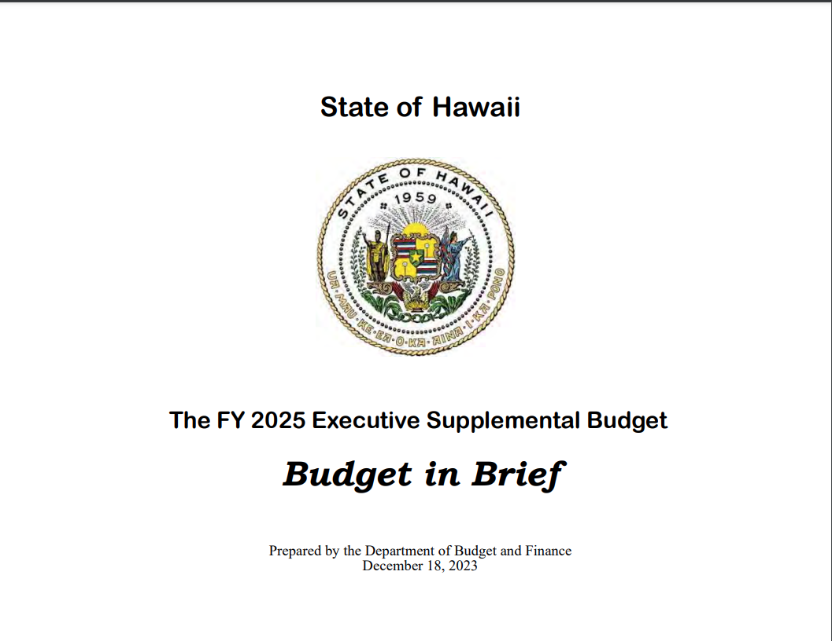
Notes:
As noted, it’s delivered in December along with all the figures.

Slide 33
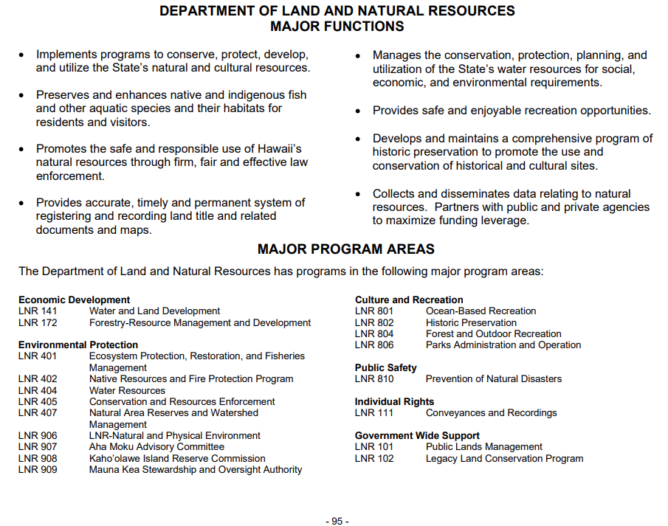
Notes:
It provides charts and figures, but also offers these handy summaries of each department, their responsibilities, and the major program areas that provide the department with funding.

Slide 34
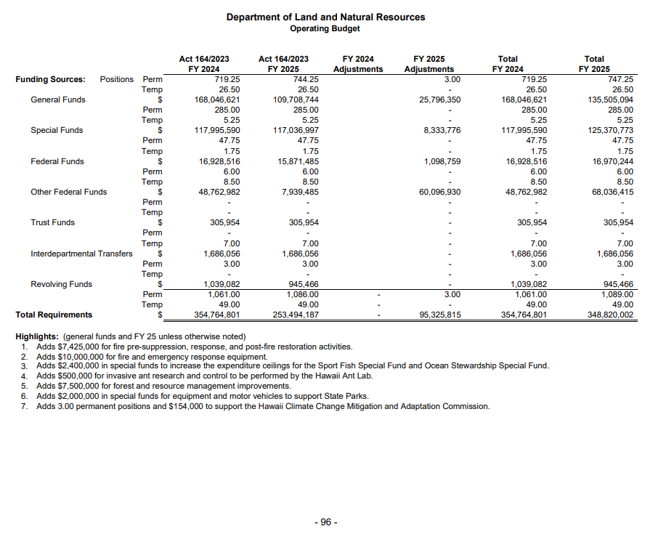
Notes:
It provides a summary of each department’s request for funding.

Slide 35
https://budget.hawaii.gov/budget/
executive-supplemental-budget-fiscal-year-2025/
Scroll down for more
Notes:
If we go back to the Supplemental Budget page, and scroll down…

Slide 36
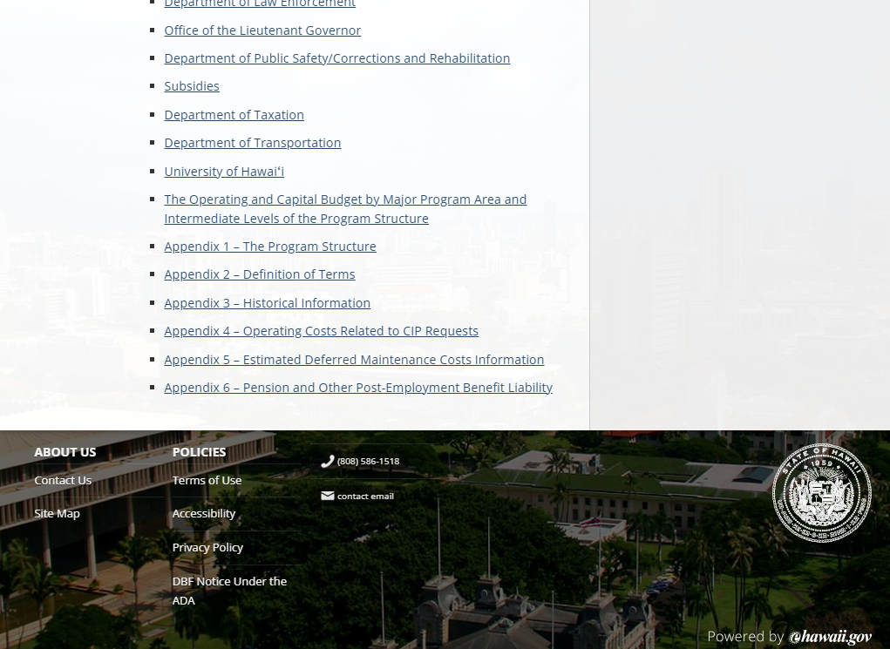
Appendix 1 = The Program Structure
Since the budget bill is organized by
Program Structure this can be helpful when you’re trying to sense of things!
Notes:
We can look at the program structure that is the backbone of the budget document. Click on Appendix 1.

Slide 37
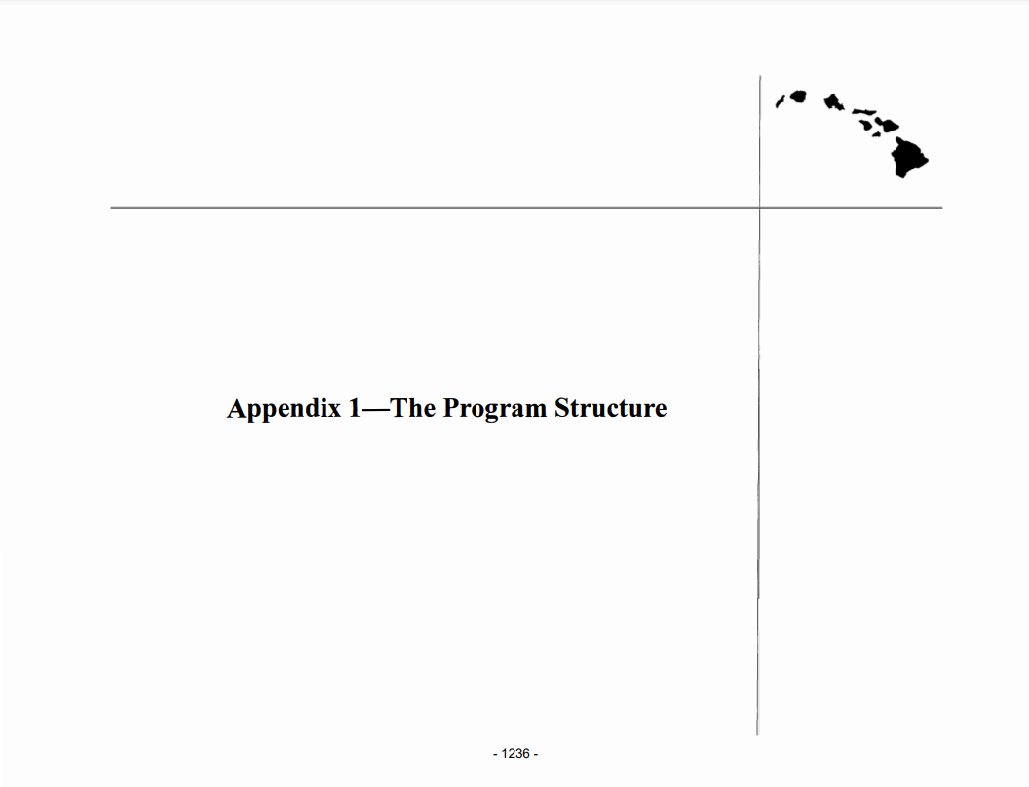
Notes:
It opens a report…

Slide 38
THE PROGRAM STRUCTURE
01 Economic Development
02 Employment
03 Transportation Facilities & Services
04 Environmental Protection
05 Health
06 Social Services
07 Formal Education
08 Culture & Recreation
09 Public Safety
10 Individual Rights
11 Government-Wide Support
Notes:
Here’s an overview of the program structure, and…

Slide 39
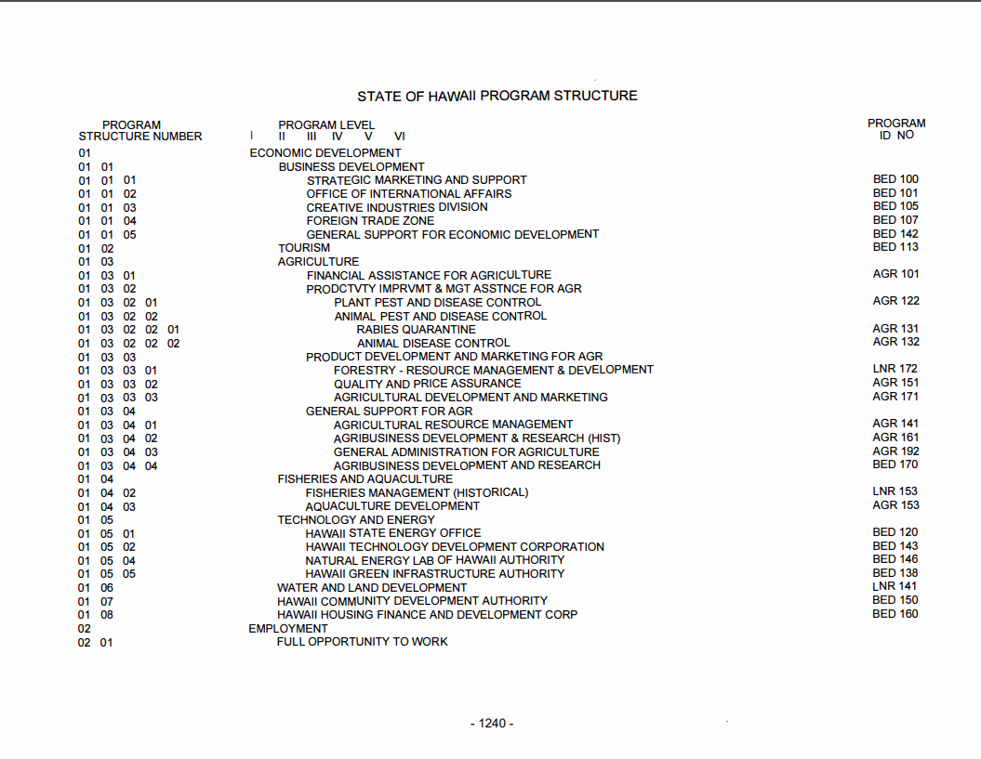
Many different departments involved with Economic Development
Notes:
Here’s what the program structure looks like… you’ll see in the right-hand column that the department in charge of the programs vary.
Within each of the 11 major programs is a hierarchical structure of sub-programs.
Each lowest level sub-program in the structure has a “program ID” number. This number is used to indicate the State executive department which administers or operates the program ID.
The number consists of three letters and three digits. The letter identify the department, and the digits identify the program. For example: BED105 is the program ID for the Creative Industries Division of DBEDT.
Appropriations are made to the program IDs.

Slide 40
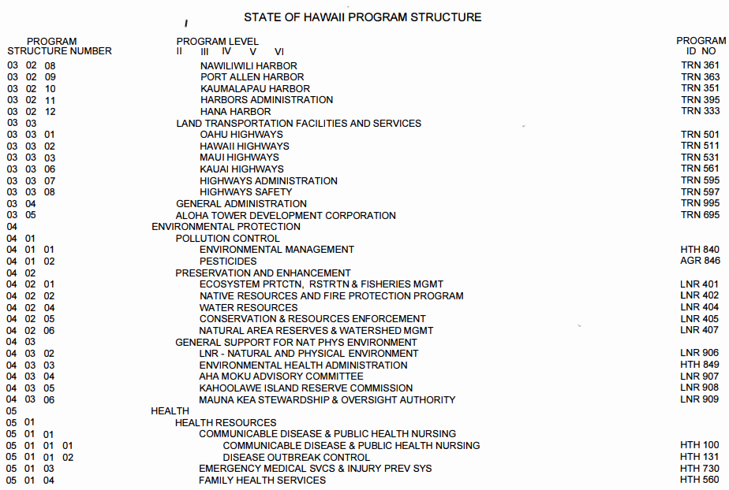
If we want to look at a Program ID more closely…
Notes:
Let’s look at one of the program IDs. LNR 402 is the “Native Resources and Fire Protection Program” housed in the Department of Land and Natural Resources (DLNR).

Slide 41
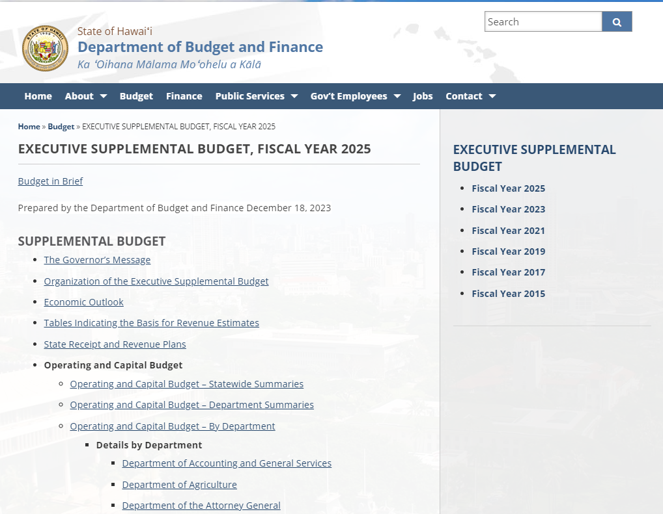
https://budget.hawaii.gov/budget/executive-supplemental-budget-fiscal-year-2025/
Notes:
To find information about LNR402’s request for funding, we’ll look at the “Details by Department”.

Slide 42
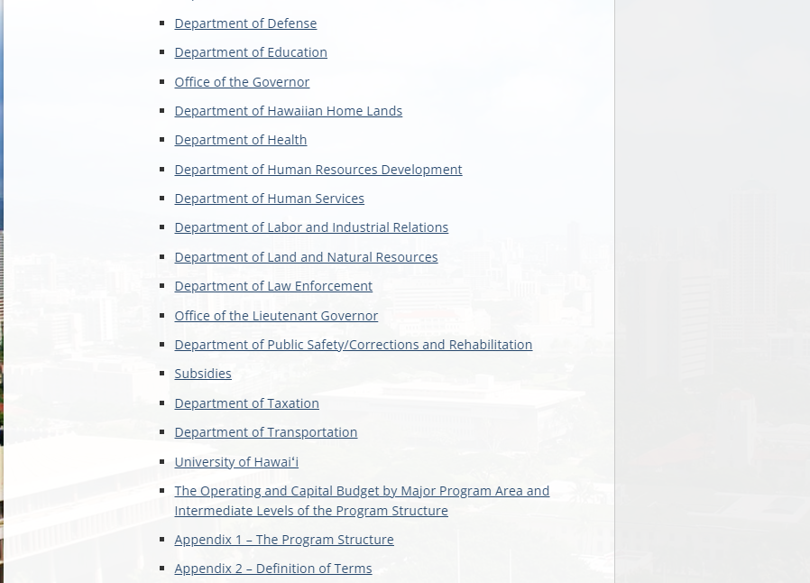
Notes:
Scroll down to the “Department of Land and Natural Resources”.

Slide 43
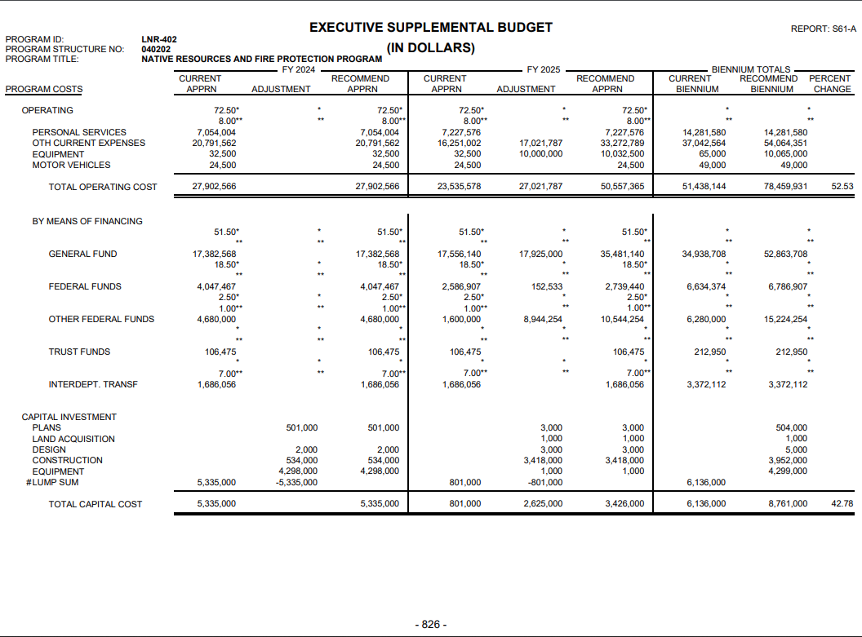
Notes:
Then, search for “LNR 402” (to search a website, most browsers have a search function that pops up when you use <Ctrl><F>).

Slide 44
Notes:
The first page of the program ID shows the Operating Costs – both in categories and by means of financing. It spells out how much of an adjustment is being requested by the Department to meet the program’s aims.

Slide 45
Notes:
Here’s a close up of the numbers, showing the initial amount on the left, then the adjustment, and the new total. The first fiscal year appears to the left of the line, the second fiscal year appears on the right.

Slide 46
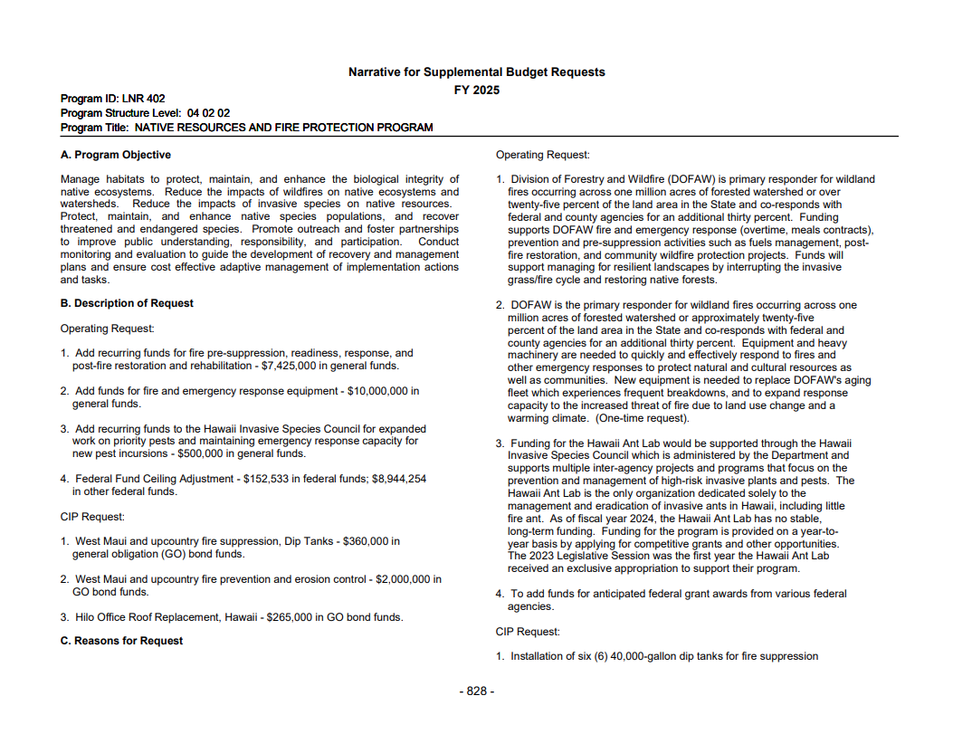
Description of what’s included in the request
Notes:
The next page will outline the program, what’s being requested, and why.

Slide 47
Adding 1., 2., 3. amounts = $17,925,000 = change in funding, general funds
First amount in 4. = change in funding,
federal funds
Second amount in 4. = change in funding, other federal funds
Notes:
The amounts break down the requests that appeared on the LNR 402 fund request.

Slide 48
Early January
Legislature’s money committees
ask Executive Departments
to brief them on their budget requests
Money committees =
  Senate Ways and Means (WAM)
  House Finance (FIN)
  Often ask subject matter committee to join
Notes:
The money committees invite the Executive Departments to brief them on their budget requests. The informational briefings usually take place in January. If you sign up for the WAM and FIN hearing notices, you’ll be sure not to miss them.

Slide 49
Materials presented at the informational briefings may provide a great level of detail
WAM usually posts briefing materials to the hearing notice –
find them using the ‘Reports and Lists’ page
Notes:
Since all the proceedings are now livestreamed and archived on the House and Senate YouTube pages, you can watch them live or after the fact. Additionally, sometimes the department’s briefing materials are available via a link on the informational briefing notice (usually WAM briefings) or on the committee page. This can be helpful when researching fund requests.
Find past hearing notices on the “Reports and Lists” page – use the “Hearing Notices” bar.
Find committee pages under the “Legislature” tab.

Slide 50

WAM and FIN Staff
Keep track of all appropriations bills…
big picture, small details, all funds
(long hours!)
Must consider financial plans (6-yr plan) and expenditure ceilings
Operating expenditures (recurring, operating costs)
Capital expenditures (non-recurring, CIPs)
Notes:
The money committee staffs work hard and long hours! If you need to contact them, please treat them with respect and patience. They keep their eye on the minute details as well as the big picture of all the appropriation bills and financial plans.

Slide 51
3rd Wed in January:
Legislative Session starts
House Speaker & Senate President both introduce bills for the Executive budget; marked “by request” and coded as part of Governor’s package of legislation
Other bills with appropriations are also introduced
Notes:
In Hawaii, only legislators can introduce bills. As a result, the Governor’s package of legislation (including the Budget Bill) is introduced by the House Speaker and the Senate President “by request” and is coded so that it is evident that it’s being introduced as part of the Governor’s package. By mutual agreement, they will use the House version of the bill to move the budget forward.
NOTE: To view the ‘Governor’s Package’ of legislation (which includes other bills put forward by the Governor and his departments), visit the “Reports and Lists” page and click on the “Measures by Package” bar.
NOTE: To view other appropriations bills, again visit the “Reports and Lists” page and click on the “Appropriations” bar.

Slide 52
Council on Revenues
General Fund Forecast
January
March
May
September
By January, the forecast
(and the total amount to budget)
may have changed
Notes:
Another COR general fund forecast is reported in January.

Slide 53
HB1800
By agreement, the
House bill
will be the vehicle
for the budget
Notes:
The chambers agree that the House bill will be used to craft the Executive Budget. This means that the House will be first to consider the bill, make any changes to it, and then deliver it to the Senate for their consideration and changes. Final changes will be worked out in conference near the end of session.

Slide 54
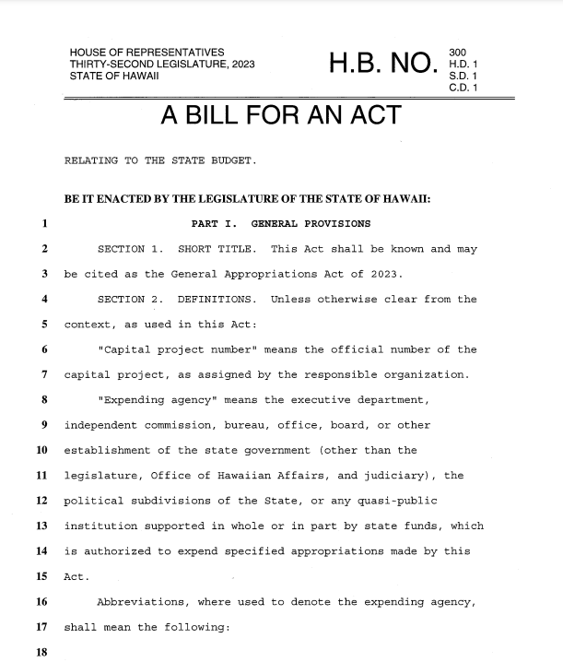
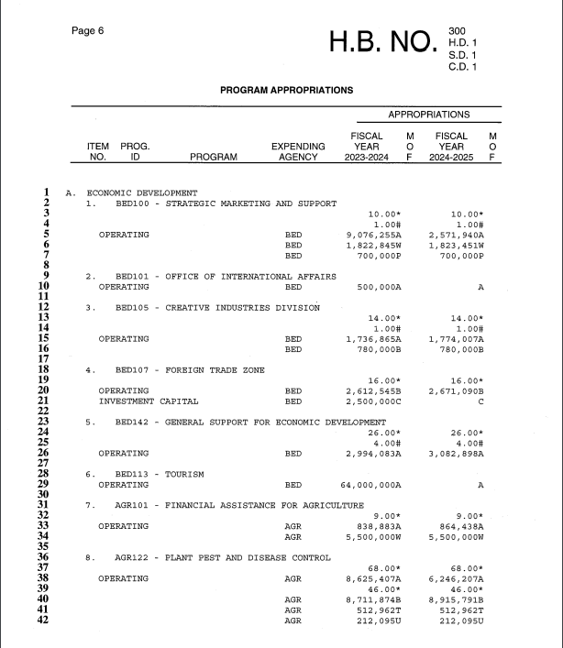

In the Budget Bill, you’ll find page after page of numbers and acronyms!
Notes:
The budget bill can be a bit daunting – page after page of numbers and acronyms…

Slide 55
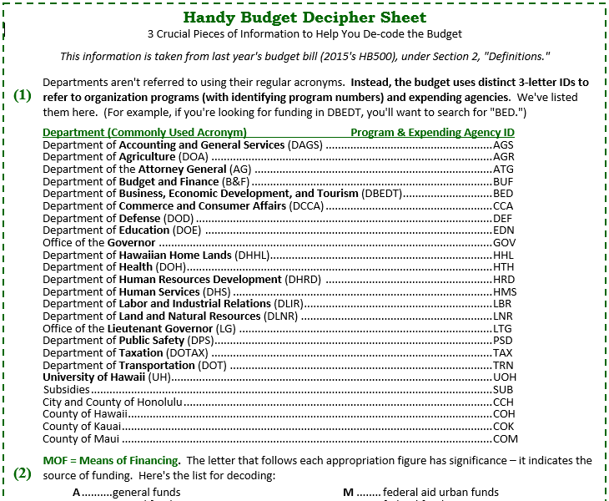
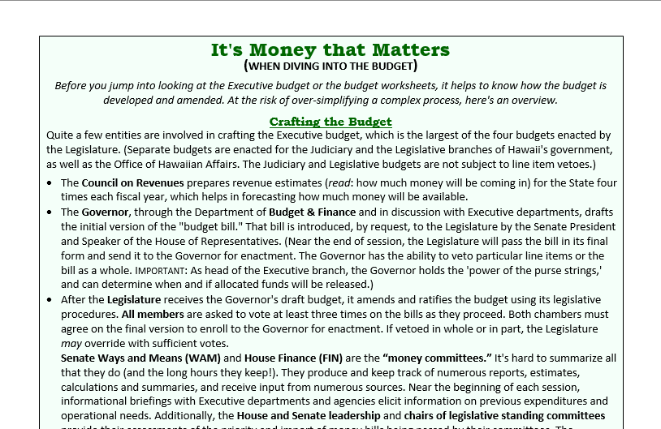
Budget Decipher Sheet
Don’t be intimidated!
Learn to “read” the budget.
Notes:
The decipher sheet found on PAR’s ‘Information Sheets’ page can help you understand how to ‘read’ the budget. In addition to an easy reference list to help you identify expending agencies.
Find it on PAR’s website: under the “Learn” tab, use the drop-down menu and select “Overview of the Legislative Process” (https://lrb.hawaii.gov/par/overview-of-the-legislative-process/). Then, click on “The Budget Process” (https://lrb.hawaii.gov/par/overview-of-the-legislative-process/the-budget-process/) and find the .pdf for “Deciphering the Budget” (https://lrb.hawaii.gov/par/wp-content/uploads/sites/2/2024/01/2024-budget-decipher-sheet.pdf).

Slide 56
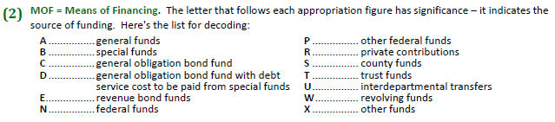
Notes:
This is all taken from the budget bill itself. Information regarding the Means of Financing (MOF) – next to the line-item figures in the budgets, you’ll see a letter which indicates where the money will be coming from.
These are the current source of funding list:
A: General funds
B: Special funds
C: General obligation bond fund
D: General obligation bond fund with debt service cost to be paid from special funds
E: Revenue bond funds
N: Federal funds
P: Other federal funds
R: Private contributions
S: County funds
T: Trust funds
U: Interdepartmental transfers
W: Revolving funds
X: Other funds

Slide 57
Position Ceiling (Staffing)
Above certain line items you'll find numbers
followed by asterisks*
These * indicate the maximum number of
full-time equivalents (FTEs) that may be funded
by the dollar amount and funding source noted immediately below it.
(Note: ** or # indicates temporary FTEs)
Notes:
You may also see figures indicating the number of positions being funded. Staffing is measured by FTEs (full-time equivalents), and the number followed with an asterisk refers to the dollar amount below it.
Depending on the draft, temporary positions are noted with a double asterisk (**) or pound sign (#).

Slide 58
LNR 402 is the Program ID we looked at earlier on the Budget & Finance website…
Notes:
The budget bill translates all that material that was presented on the Budget & Finance website into a bill specifying funding for each program ID. Let’s look at LNR 402.

Slide 59
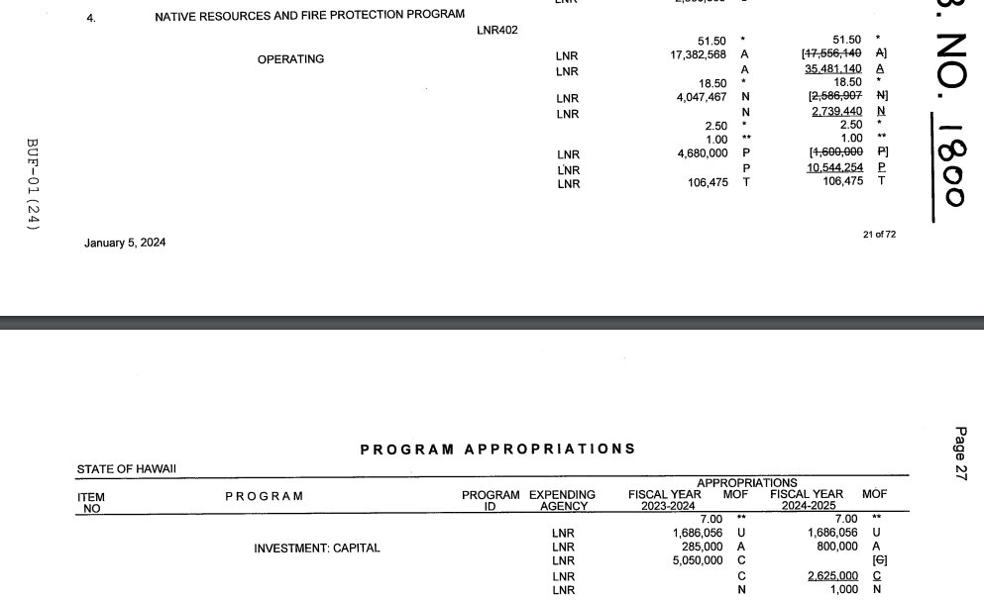
Notes:
Again, we can search the document (using <Ctrl><F>) for LNR402 (be sure to note whether there’s a space in there). This program ID straddles two pages, but we were just looking at the Operating Costs on the first page.

Slide 60
2023-24
2024-25
A = general funds
N = federal funds
P = other federal funds
T = trust funds
A = 2023-24: No change; 2024-25: Increase from $17,556,140 to $35,481,140
N = 2023-24: No change; 2024-25: Increase from $12,586,007 to $2,739,440
P = 2023-24: No change; 2024-25: Increase from $1,600,000 to $10,544,254
T = 2023-24: No change; 2024-25: No change
Note: number of positions authorized shows no change either year
Notes:
Here’s a close up of the numbers. As you can see, all three of the funds that showed increases are reflected here. The old figures (what was allocated in last year’s budget bill) are crossed out, and the new figures appear on the next line, underlined. If there had been a change in the number of positions being funded, we would see similar changes for the numbers designated with an asterisk (or double asterisks).

Slide 61
The budget bill starts in House…
FIN assigns program areas to subject matter committees for their recommendations/priorities
Subject matter chairs submit recommendations to FIN
HB1800
Notes:
So, back to the budget bill. While a bill will be introduced by both the Senate President and House Speaker, by agreement the House bill will be used as the vehicle for the budget. This year, it’s bill number is HB1800. After introduction and First Reading, the bill will be referred to the FIN committee.
Behind the scenes: The FIN committee assigns budget areas to the subject matter committees for their recommendations and priorities. While the public doesn’t see the part of the process where the subject matter committees submit their priorities to the money committees, it is an important part of the process.

Slide 62
Subject matter chairs submit recommendations to FIN
Notes:
Part of your advocacy effort may include asking the chair of the subject matter committee to make your funding issue a priority.

Slide 63
House makes changes…
HB1800 HD1
FIN has a hearing
FIN presents amended bill (HD1) and submits to House Clerk’s office by the Budget Decking deadline
HD1 may incorporate some separate appropriations bills
Notes:
The FIN committee will schedule a public hearing. You can submit testimony, just like you would for any other bill. If your request concerns a particular program area, it is helpful to include specifics and the correct citation.
It is not uncommon for a separate appropriation bill being considered by FIN to be held or deferred, and the allocation incorporated into the larger Budget Bill.
FIN will pass the budget in an amended version – it will be given the suffix of HD1 (“House Draft 1”). They need to submit this revised bill to the House Clerk’s office by the Budget Decking deadline. The bill then needs to pass a Second Reading on the floor, and be scheduled for Third Reading.

Slide 64
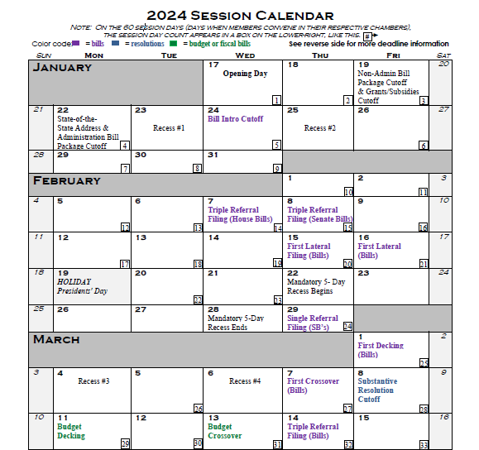
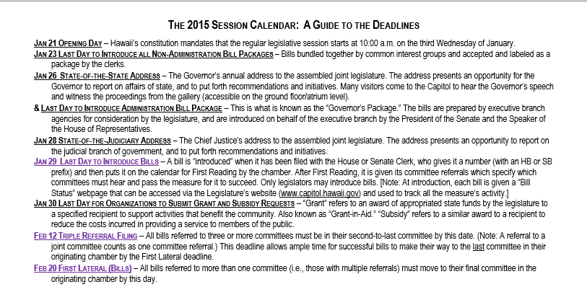
Session Calendar
Includes Deadline for Decking the Budget
Notes:
The deadline for the budget bill to be decked by the FIN committee is March 11, and the House needs to hold the Third Reading on the bill by March 13.

Slide 65
House holds third reading and passes bill (HD1) by the Budget Crossover deadline
Bill crosses over to the Senate, passes first reading, gets referred to Ways and Means (WAM)
Notes:
After the House has held a Third Reading (vote) on the HD1 version of the bill, it crosses over to the Senate for their consideration. The Senate will have it pass First Reading and will refer the bill to its money committee, Ways and Means (WAM).

Slide 66
Council on Revenues
General Fund Forecast
January
March
May
September
The March forecast
may have changed the total amount available to be budgeted
Notes:
In addition to receiving the revised budget bill, the Senate will also have the March forecast provided by the Council on Revenues.

Slide 67
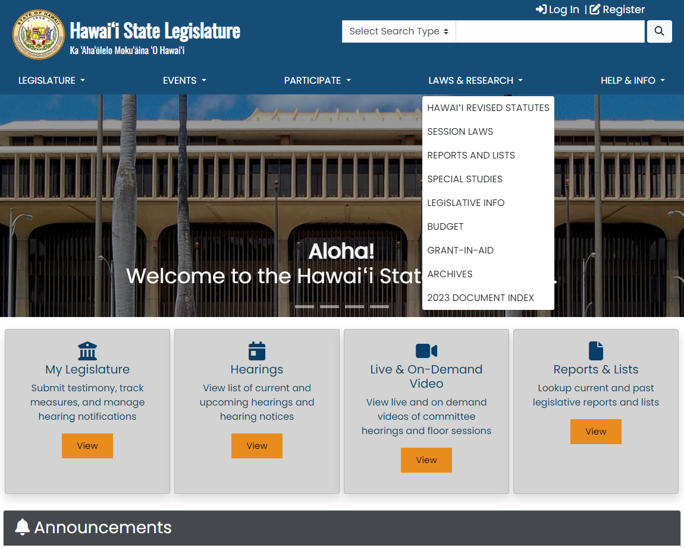
Budget worksheets
can be found under the “Laws & Research” tab…
Notes:
After the bill is amended, budget worksheets will be made available outlining the changes made from the original version of the bill. This is where you’ll be able to see details regarding the changes.
Worksheets can be found on the “Budget” page, found under the “Laws & Research” tab.

Slide 68
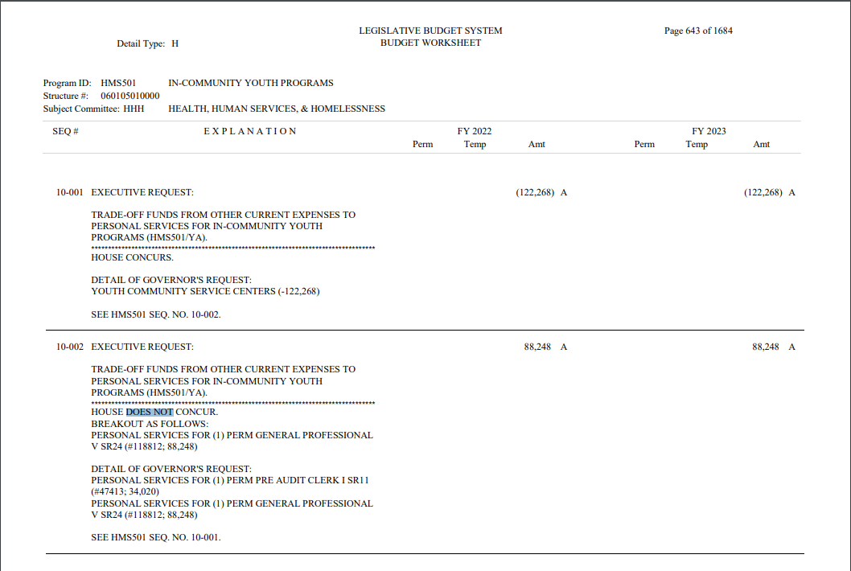
Compares HD1 to Governor’s Request
Notes:
The budget worksheets highlight the differences between the initial bill and the HD1 version.

Slide 69
HB1800 HD1
WAM has the budget bill…
Senate subject matter committees have been assigned budget areas; provide their priorities to WAM
WAM schedules a hearing
Notes:
Again, the subject matter committees (this time the Senate committees) will be consulted and asked to provide their priorities to the money committee (this time, WAM). You can ask the subject matter committee chair to support your request as a priority.
WAM will schedule a public hearing, and just as you did before the House FIN committee, you can offer testimony – this time on the HD1 version of the bill and what, if anything, you’d like WAM to change.

Slide 70
HB1800 HD1 SD1
Senate makes changes…
WAM prepares amended bill (SD1) and submits to Clerk’s office by decking deadline
SD1 may incorporate some separate appropriations bills
Notes:
WAM passes the bill and publishes an amended version – SD1 (“Senate Draft 1”) by the decking deadline. The Senate will hold Second Reading and schedule the bill for Third Reading.
Again, changes in SD1 will be outlined in the budget worksheets after the fact. There’s no set time frame on when the budget worksheets appear.

Slide 71
HB1800 HD1 SD1
Senate holds Third Reading and passes bill (SD1) by Second Crossover deadline
Notes:
After the bill is voted on in the Senate chamber the required 3rd time.

Slide 72
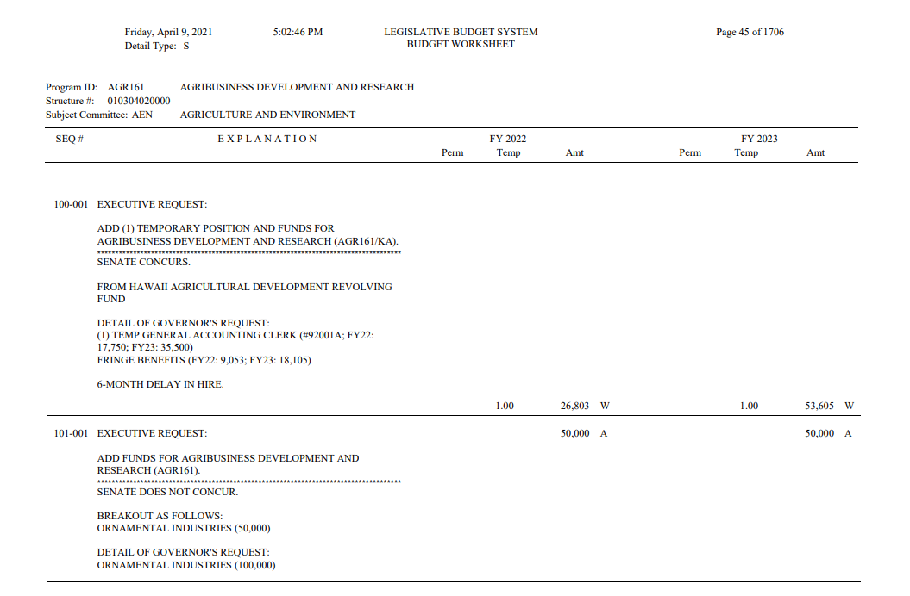
Compares SD1 to Governor’s Request
Notes:
Here’s a snapshot of the budget worksheet for an SD1 version passed by the Senate. It compares the SD1 version to the governor’s initial request.

Slide 73
House passed….
Senate passed….
HB1800 HD1
HB1800 HD1 SD1
Bill crosses back over to House
House disagrees with changes
Budget conferees named for both House and Senate (often all the members of the money committees)
Notes:
Once the bill has passed its Third Reading in the Senate, it crosses back over to the House. The House immediately disagrees with the changes, moving the bill to the conference process.
Conferees are named by both chambers. The conference committees will produce a CD1 version of the bill that can be voted on by both chambers and then presented to the governor. They need to come up with the CD1 version by the Final Budget Decking deadline, April 22.

Slide 74
Following the Budget
Public Access Room (PAR)
Overview of ‘the Budget’
The Budget Bill
  Following other money bills
  Grants in Aid (GIA)
Legislature’s website capitol.hawaii.gov
Notes:
Before we get into the conference process, let’s take a moment to talk about other bills that appropriate funds.

Slide 75
Other Appropriations Bills
Despite initially being drafted with a dollar amount, the bill may move forward with blank $____ amounts in funding sections.
Bill itself may die… but funding is incorporated into the budget bill.
Notes:
Despite starting the session with a specific request for X number of dollars, most appropriation bills will quickly be stripped of their dollar amounts and proceed with blanks. Don’t be surprised by that. The particulars need to wait until the end of session when the budget and final dollar allocations have been decided.
Also, as the budget bill changes, it may absorb other appropriation bills. So, it is not unusual for your appropriation bill to die, and yet the appropriation itself survives – it’s just been absorbed by the larger budget bill.

Slide 76
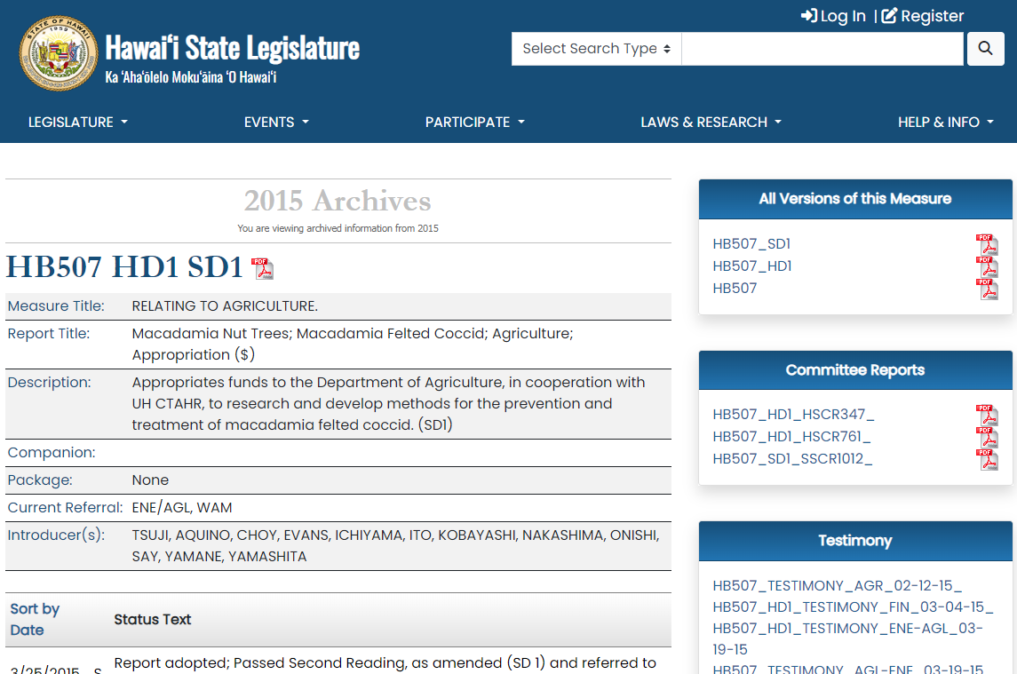
HB507 = $1 million to help with macadamia felted coccid… HD1 = “unspecified” funds; defective date
SD1 = corrected date… made it to WAM and ‘died’ there
Notes:
Here’s an example from 2015.
HB507 was an appropriation bill separate from the larger ‘budget bill.’ It was initially drafted asking for $1 million to help with the macadamia felted coccid. It was referred to AGR, FIN. AGR passed the bill with changes – they took out the specific $ amount and added a “defective” effective date. FIN passed the bill without changes.
It went through its Third Reading in the House, and then crossed to the Senate. There it was referred to ENE/AGL, WAM. The joint ENE/AGL amended the bill, correcting the date. It moved on to WAM, but never came out. The bill ‘died’ in WAM.
But… money was put in the budget bill to help with the macadamia felted coccid. The appropriation lived on!

Slide 77

How to find out
if it was incorporated into the budget bill?
Notes:
It’s not always clear what’s happened. How do you find out if the appropriation is dead along with the bill, or if the appropriation was incorporated into the larger budget bill?

Slide 78
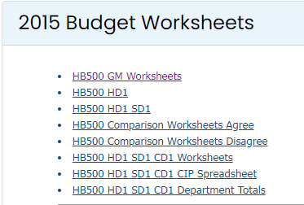
Committee report may highlight some changes
Budget worksheet published after the revised bill draft is issued: shows changes made, and includes more detail than the bill
Notes:
The budget worksheets are your best bet. The committee report that the money committee issues along with the revised draft may mention the program area you’re interested in, but usually it’s the worksheets that offer you a recap of the changes made in the latest draft.

Slide 79
Sometimes the level of detail published is just not sufficient!
Contact FIN or WAM staff for additional program detail – feel free to call PAR for initial guidance
Notes:
That said, sometimes even the level of detail offered in the worksheets is not sufficient. In those instances, it is certainly appropriate to contact the staff of FIN or WAM. The money committees keep track of everything! But they’re also incredibly busy – be courteous. Contact PAR if you need help identifying the program ID or to make sure we can’t help you find what you need.

Slide 80
Budget worksheets
can be found under the “Laws & Research” tab…
Notes:
Again, here’s where you can find the budget worksheets: select the “Budget” page from the “Laws & Research” drop-down menu.

Slide 81
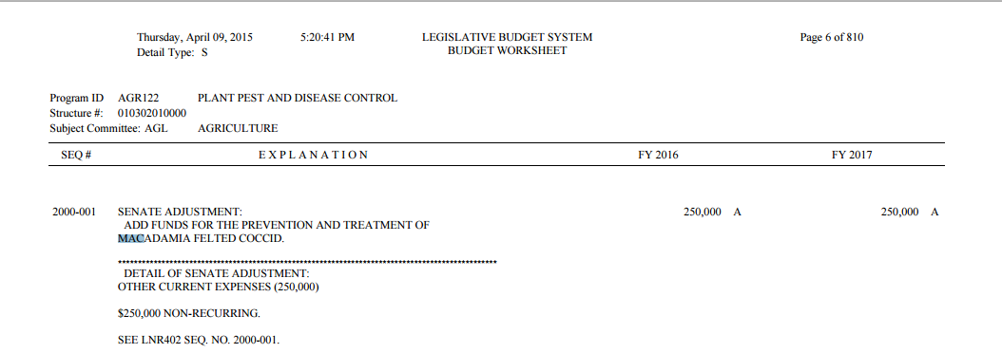
Back to our example… looking at the budget worksheet
WAM: in HB500 HD1 SD1
added $250,000 FY2016 and $250,000 FY2017
from general funds
Notes:
Back to our example, here’s a snippet from the SD1 version of the budget worksheet. It shows that the Senate WAM added $250k for FY 2016 and $250k for FY 2017, and the money will come from general funds (as noted by the “A” to the right of the figures) for the macadamia felted coccid. (Note the Program ID = AGR122, Plant Pest and Disease Control.)
We found this by going into the budget worksheet and searching for “macadamia”… we could have looked for “coccid” or another unique term.
NOTE: We know that “A” refers to General Funds because it is noted at the beginning of the General Appropriations bill, and it is also noted on PAR’s handy budget decipher sheet.

Slide 82
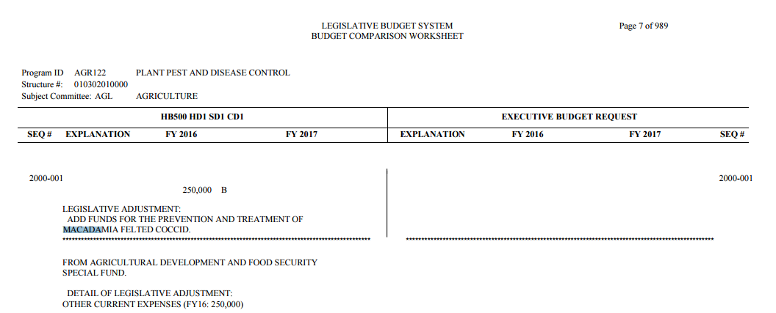
HB500 HD1 SD1 CD1
ended up with $250,000 FY2016 only
from special funds
Notes:
Just to follow through on this example, in the final version of the budget (CD1), the funding was cut to $250k for FY2016 only (no funds for 2017) and it is from special funds (as noted by the “B” to the right of the dollar amount). This version of the budget worksheet reflects changes from the originally introduced bill, which did not include a request for the macadamia felted coccid.

Slide 83
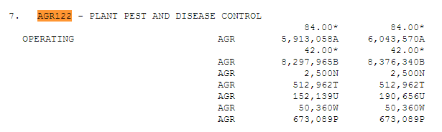
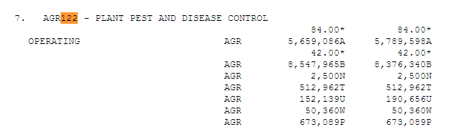
Looking at the bills… the level of detail is just not there
HB500 HD1 SD1:
HB500 HD1 SD1 CD1:
Notes:
If we were looking at the drafts of the budget bills themselves, we wouldn’t be able to see the specific allocation.
Just to see the level of detail – here are snippets from the text of the SD1 and CD1 drafts of the bill. It shows the program area, AGR122. The totals allocated for general funds (A) and special funds (B) reflect the changes between the versions.
The level of detail here is much less than we saw in the budget worksheets.

Slide 84
The detail could be found only on the budget worksheet
(or in the case of CD1, the committee report)
Notes:
The budget worksheets are a great source of information! Unfortunately, it can take a while for them to be posted after the bill draft has been published.

Slide 85
Floor Votes (Readings) on Bills
1st reading = at outset; everything passes
2nd reading = sometimes debate on House floor, rarely on Senate
3rd reading = possible debate in either chamber
Final reading = possible debate in both
Conference Committee
Notes:
Just a note – all bills need to have at least 3 readings or votes on the floor of each chamber. Debate may take place on the floor or beforehand, “in caucus” where members of the same political party discuss the upcoming session and pending legislation.
The Budget Bill is an important piece of legislation – it is usually commented on at length by the money committee chair and may prompt comment from legislators.
Before we get to the Final reading of the bill, we’ll have to go to Conference to come to an agreement…

Slide 86

To find agreement, leadership appoints members to Conference Committees for each of the bills that has passed the House and Senate in different versions
Members from House
Bill #HB1800 HD1 …. SD1
Members from Senate
Conference committees charged with reaching agreement on final version of the bill
Notes:
…Since the House has passed one version of the Budget Bill, and the Senate has passed another, the Conference Committees appointed by House and Senate leadership will have to iron out the differences and come to an agreement on the final version of the bill to be presented to their chambers.
The conferees need to come to agreement by the Final Budget Decking deadline. (For other appropriations bills, you’ll see that there’s a “Final Decking (Fiscal Bills)” deadline.)

Slide 87
HB1800 HD1 SD1 CD1
Goes to conference…
May be done piece by
  piece announcing areas
  on which they’ve come to
  agreement
  Large room, many people gathered
  CD1 version by Budget Decking deadline (affects CD1 of other appropriation bills)
Notes:
In addition to the budget bill, many other appropriation bills will need the fiscal okay from the money committees before their CD1 versions can be voted on.

Slide 88
What’s the deadline for the conference committees to come to a decision?
Executive Budget – Monday, April 22
Fiscal Bills – Friday, April 26
Non-Fiscal Bills – Thursday, April 25
HB1800
$
$
Final version (CD1) & committee report
must be delivered to Chief Clerks’ offices
Notes:
All money bills will have to have the okay from the FIN and WAM chairs. The deadlines for coming out of conference are posted on the session calendar.
Advocacy at this stage requires contacting anyone who may have influence – the conferees, your own legislators, the subject matter chairs, etc. – and getting others to do the same.
Here are the deadlines for bills to come out of conference and be delivered to the Chief Clerks’ offices:
HB1800 (the budget bill): Monday, April 22
Non-Fiscal Bills (those not referred to FIN or WAM): Thursday, April 25
Fiscal Bills (those that were referred to FIN or WAM): Friday, April 26

Slide 89
What’s the deadline for the conference committee to come to a decision?
They may set deadlines more specifically… such as:
6:00 p.m. = conclude negotiations
9:00 p.m. = committee report available
for review and signature
11:30 p.m. = file committee report and bill
draft with Chief Clerk
Notes:
Additionally, conference procedures are agreed upon by House and Senate leadership which provide more specifics – including the time to conclude negotiations, present the report, and file the report and bill with the Clerk.

Slide 90
A Note re: Fiscal ($) Bills
Bills with fiscal implications
must get approval
by money chairs (FIN and WAM)
This means that even if you’ve got loads of support from the other conferees, the fate of your bill – and whether it comes out of conference – may not be known until the evening of the Final Decking deadline for fiscal bills.
Notes:
Again, all bills with fiscal implications will need to get the approval of the money chairs. What this means? You may not know the fate of your bill until the deadline – its fate is tied into the fate of the other fiscal matters being considered.

Slide 91
Following the Budget
Public Access Room (PAR)
Overview of ‘the Budget’
The Budget Bill
  Following other money bills
  Grants in Aid (GIA)
Legislature’s website capitol.hawaii.gov
Notes:
Now let’s take a quick look at Grants in Aid…

Slide 92
Grant-in-Aid (GIA) $
If the Legislature is offering GIA money, the application will appear on the website (“Grant-in-Aid” page found under “Laws & Research” tab)
Deadline traditionally in January
Will be for upcoming fiscal year (July 1, 2024 to June 30, 2025)
HRS Chapter 42F for more information
Notes:
If the Legislature is offering GIA money, the application will appear on the website (“Grant-in-Aid” page found under “Laws & Research” tab). It’s usually posted sometime in December, and the deadline to submit the application is traditionally in January. The application will be for funds to be used in the upcoming fiscal year (FY25: July 1, 2024 to June 30, 2025). For more information, take a look at HRS Chapter 42F.

Slide 93
Grant-in-Aid $
Often a member of FIN and WAM are assigned to focus on GIAs
Can view previous years’ applications and awards online
Informational briefing held so applicants can appear and offer highlights of their request
Won’t know result until the end of process (conference draft of budget)
Notes:
Looking at past years’ applications and awards may be helpful. Redacted copies of the applications, as well as a list of the amounts awarded for both Operating and CIP funds, will be posted on the “Grant-in-Aid” page found under the “Laws & Research” tab.
It is common for WAM and FIN to host a joint informational briefing, often in late March, where all applicants are invited to provide a brief oral summary of their organization and its needs. While not required, many applicants do come to the capitol or join in over Zoom.
If you apply for GIA funds, you won’t know whether your application has been successful until the end of session when all the money bills get sorted out.

Slide 94
The Budget Bill
HB1800 HD1 SD1 CD1
  Needs to pass Final Reading before the end of session (adjournment sine die)
  Must go off to the governor before other appropriation bills can pass Final Reading
Notes:
Back to the budget bill. After the budget bill survives conference, it will have to succeed in its final readings (votes) in both chambers before the end of session. There is a requirement for the budget bill to be sent to the governor before any other appropriation bills can pass Final Reading. (Sometimes you see bills moved to the end of the agenda, or a recess called during the day’s proceedings, while they wait for the other chamber to pass the budget bill and to give the clerks time to transmit it to the governor.)

Slide 95
Governor
Use your administration contacts
Ask supporters to communicate (can use form on Gov’s website)
Governor can line-item veto budget bill
http://governor.hawaii.gov
Notes:
It’s important to remember that even if the funding you’re advocating for passes the legislature, the Governor has power over its fate. The Governor can veto bills and can line item veto the Budget Bill (that is, he can veto particular line items and leave others alone).
You can lobby the Governor as well as the administrative department that is charged with expending funds in your program area. The governor’s website (governor.hawaii.gov) provides a contact form where you can communicate your views.
There are deadlines by which the Governor must sign a bill into law, allow it to become law without signature, or veto it. Additionally, if a veto is being considered, he must advise the Legislature by a certain date. There is a mechanism by which the Legislature can override a veto. (Details: Constitution of Hawaii, Article III, Section 16, http://www.capitol.hawaii.gov/hrscurrent/Vol01_Ch0001-0042F/05-Const/CONST_0003-0016.htm)

Slide 96
Budget Bill – Overview
$ $ $ $ $ $ $ $ $ $ $ $ $ $ $ $ $ $ $ $ $ $ $ $ $ $ $ $
Summer/September: Departments make requests to Governor
1 month before Session: Governor provides Budget Request to Legislature
Early January: Money committees hold briefings with departments
Notes:
To recap:
The budget process starts on the tail of the previous year’s budget.
The departments are instructed to formalize their requests for funds to the Governor, who will work with his Budget & Finance department to craft the budget that he presents to the Legislature.
WAM and FIN begin briefings with the departments to more fully understand the requests and to question previous allocations/expenditures.

Slide 97

Budget Bill - Overview
$ $ $ $ $ $ $ $ $ $ $ $ $ $ $ $ $ $ $ $ $ $ $ $ $ $ $ $
January: Budget Bill formally introduced at start of session
Session: FIN and WAM hold public hearings, make amendments, come to agreement (subject matter chairs advise)
Budget Bill passed by Legislature
Budget Bill enacted by Governor
Process starts again
Notes:
The budget bill is formally introduced at the start of session by the House Speaker (and Senate President) “by request”. The House version of the bill will be the vehicle for the budget.
It will go through the House, then the Senate, and pass the legislature. (Along the way it will be heard in both FIN and WAM, pass three readings in each chamber, and pass a final reading in each chamber after the CD1 has been agreed to in conference.)
The bill will then be enacted by the Governor. (There may be line-item vetoes to contend with.)
And then the cycle starts all over again.
In following the budget bill… you can offer testimony at the hearings, lobby the chairs of subject matter committees, advocate to the money committees and anyone else.
While you can follow changes using the budget worksheets, remember that you can always call PAR (808/587-0478) and ask for help. Despite improvements, the process can be a bit opaque when it comes to tracking particulars!

Slide 98
Is it really over…?
Focus on implementation!
If there’s $, doesn’t mean it will be expended
Thanks to those who have helped
Debrief – valuable info for future
Notes:
And even after its over, is it really? Remember that the Governor holds the ‘power of the purse strings’ – just because the spending has been authorized doesn’t mean that it will be spent or released.
If you got what you’d hoped for, take time to thank those who have helped. Even if you haven’t gotten the results you were hoping for, debriefing with allies or reviewing what happened can be extremely helpful. You may be back next year!

Slide 99
At the Capitol…
You never know who’s going to prove helpful!
Staff may be key!
Legislators’ roles may change over the years
Listen and learn
Relationships
Don’t burn bridges
Notes:
A reminder… staff members may be key to your success, so treat them with respect and aloha. Also, legislators’ roles may change over the years – don’t completely discount someone ‘out of power,’ tomorrow the tables may have turned. In any case, you don’t want to burn bridges. Develop relationships – that’s really the key to getting things done at the Capitol. Listen and learn from all your experiences.

Slide 100
If you’ve got a good relationship with a legislator… ask for advice!
additional background that leads to stances/positions
better understanding of how to approach specific legislators
advice re: more/less pressure needed
where to focus energy
perspectives on bigger picture of what’s going on
Notes:
Especially when it comes down to the nitty-gritty, and you’re not sure how your bill or issue can survive, if you’ve got a good relationship with a legislator or staffer, ask for advice! It probably goes without saying that you’ll want to respect their time and not overdo it, but a legislator’s perspective may be invaluable.

Slide 101
Following the Budget
Public Access Room (PAR)
Overview of ‘the Budget’
The Budget Bill
  Following other money bills
  Grants in Aid (GIA)
Legislature’s website capitol.hawaii.gov
Notes:
Finally, a few comments on some helpful spots on the Legislature’s website, https://www.capitol.hawaii.gov/

Slide 102
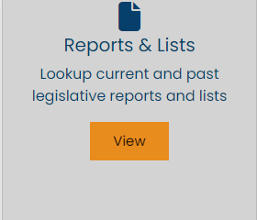
To find lists of bills with
Appropriations ($)
find the Reports and Lists
button on the homepage
capitol.hawaii.gov
Notes:
It’s easy to find appropriations bills online by visiting our favorite page, “Reports & Lists”.

Slide 103

Notes:
Use the “Reports & Lists” button on the home page. (You can also get to the Reports and Lists page through the “Laws & Research” tab and its pull-down menu.)

Slide 104
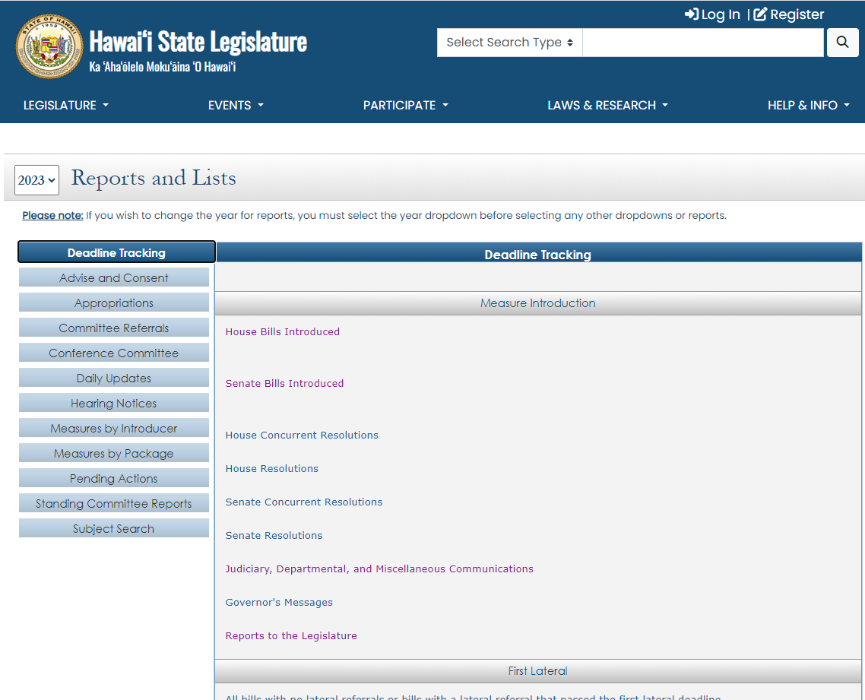
Can use this feature for 2013 session to current year
Notes:
Click on the “Appropriations” bar, it’s the second bar on the left.
(Note: You can change the year on this page to find information for sessions back to 2013.)

Slide 105
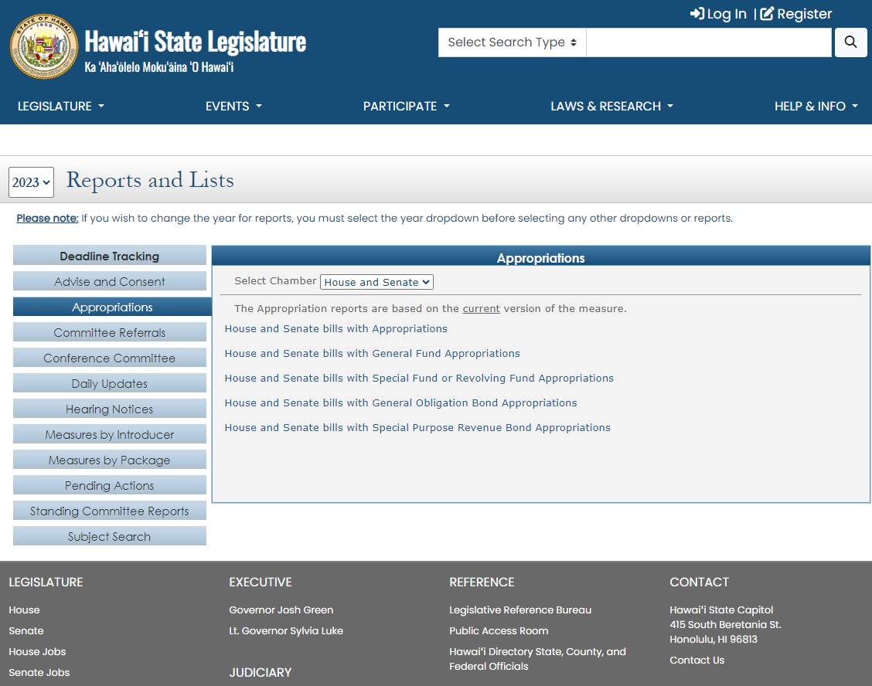
Notes:
You’ll find links to reports of all the appropriations bills, or ones with just particular fund sources, or for one or both chambers’ bills.

Slide 106
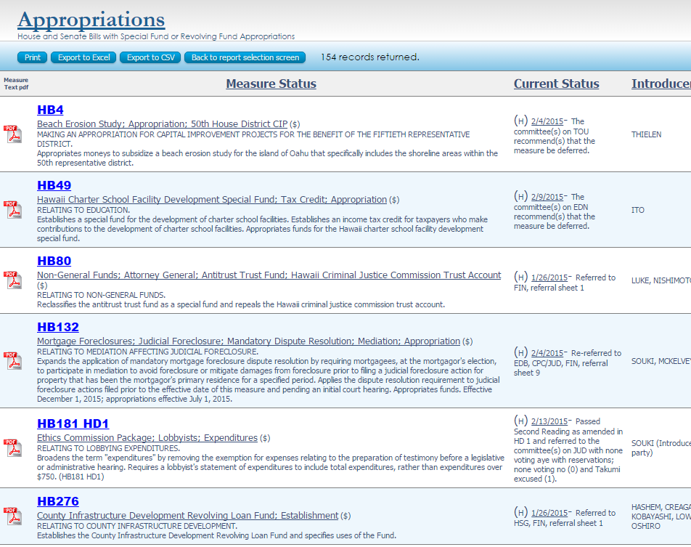
Helpful Features
easy to search using your web browser
can sort list by headers
can save as PDF or download to Excel
Notes:
Remember, you can always search the report by using your browser’s ‘search’ feature (often <Ctrl><F>).

Slide 107

Notes:
To find the budget acts and allocations made in prior years, you can go to the “Session Laws” page found under the “Laws & Research” tab.

Slide 108
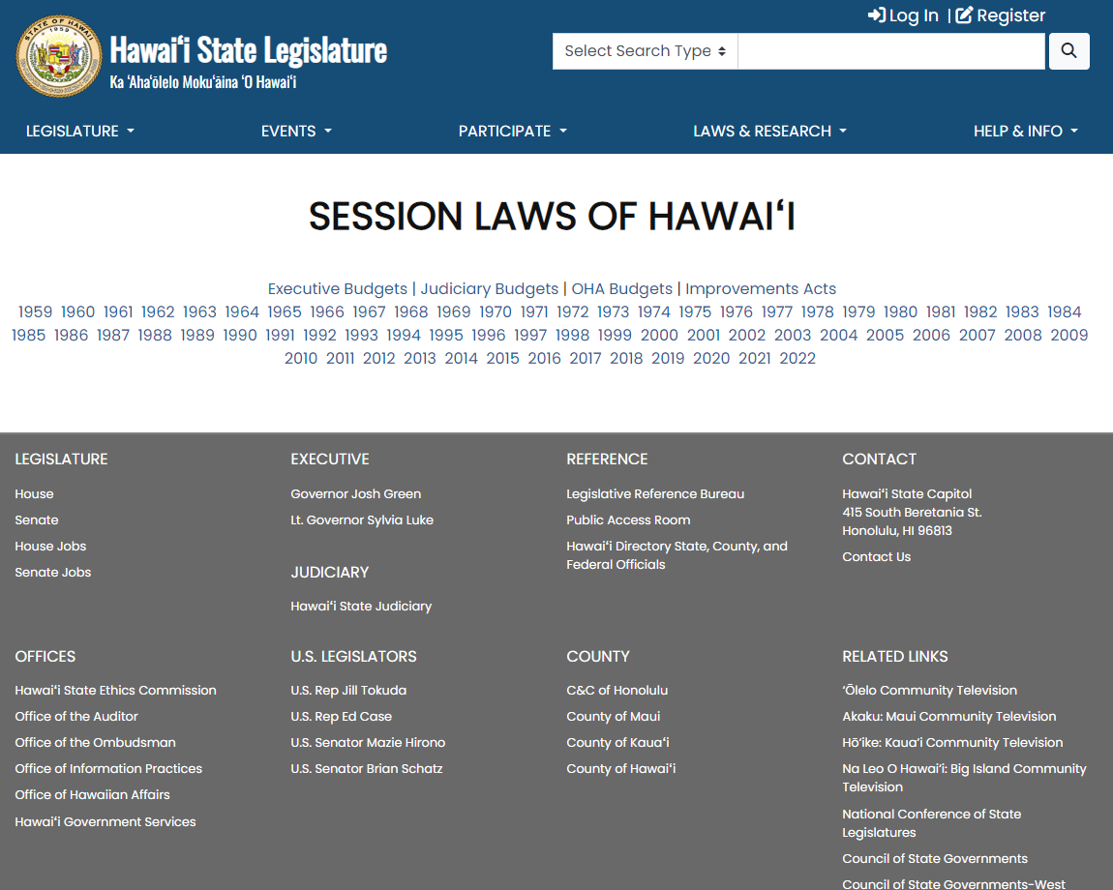
Notes:
Then, you can either select “Executive Budgets” to see a list of the budgets passed each year…

Slide 109
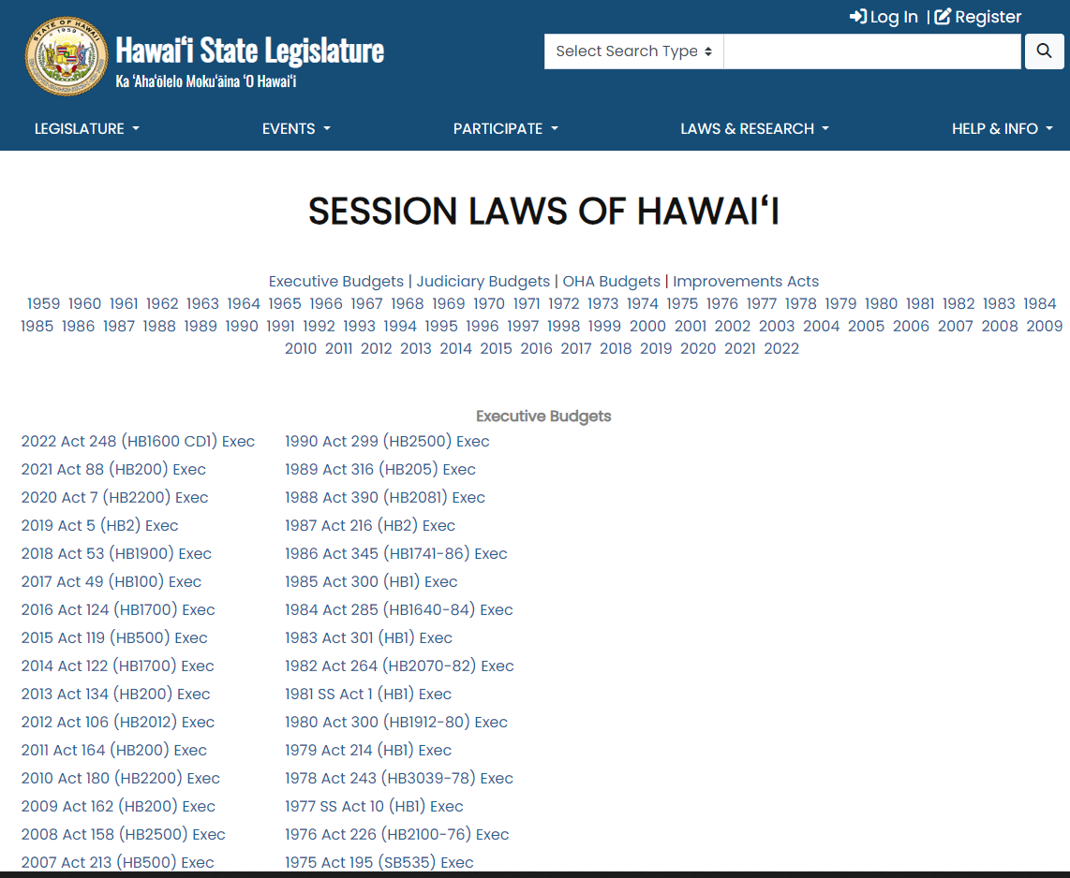
Notes:
And then you can select the year you’re interested in.

Slide 110
Notes:
Alternately, you can select a year…

Slide 111
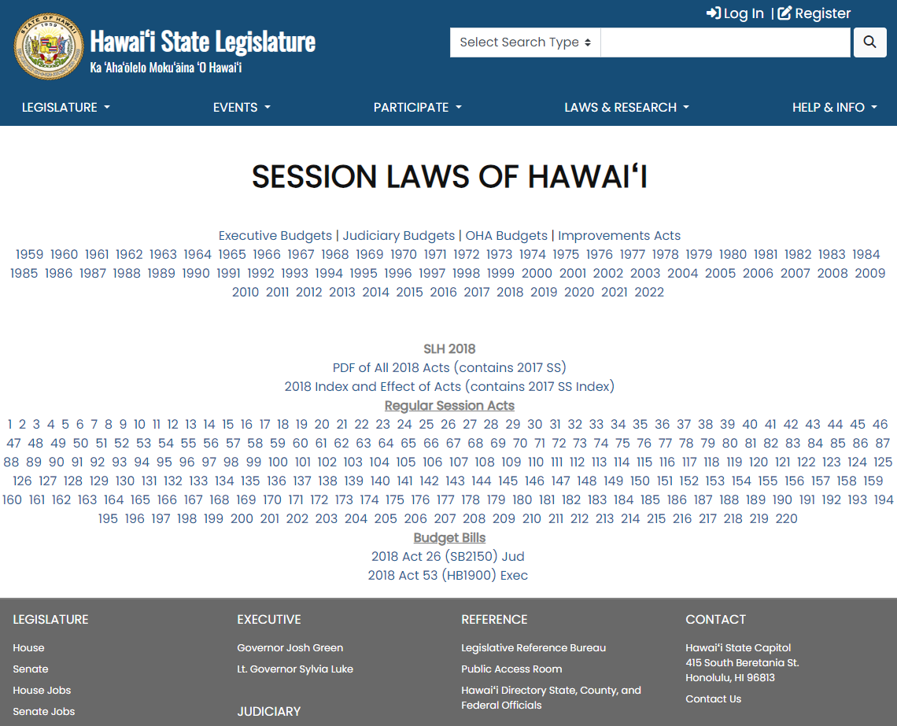
Index of laws passed that year
Notes:
Then find the budget bills listed below all the act numbers. (This shows 2018, which is the second year of the 2017-2018 biennium. The OHA budget was enacted in 2017 and no supplemental OHA budget was enacted in 2018.)
You can also use the index link at the top of the 2018 listing – use the index and look up ‘appropriations.’

Slide 112
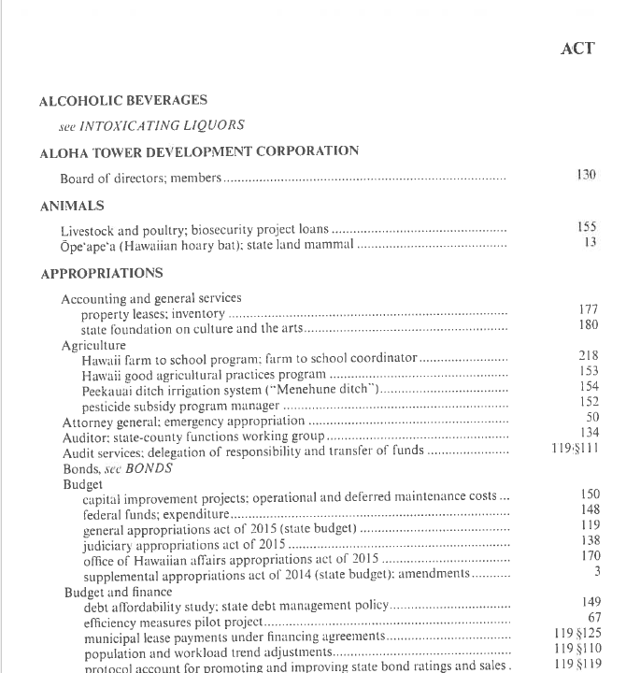

Index in
Session Laws of Hawaii (SLH) can help you find appropriations made in prior years
Notes:
Online, or If you’re looking at the hard copies, open the “Index” and look under “Appropriations” to find what you’re looking for. You can always contact the Public Access Room and we’ll be happy to help you find what you need.

Slide 113

PAR can Help!
PAR website offers handy lists, videos and learning materials (lrb.hawaii.gov/par/)
Get on our email list for notices and newsletters
Call or email us – often, we can save you time and energy by pointing you in the right direction
Notes:
That was a lot of information. We can’t stress this enough. Don’t hesitate to call or email PAR for assistance!
Remember, we’ve got a website with a lot of information (lrb.hawaii.gov/par) and you can email us (par@capitol.hawaii.gov) to subscribe to our email list.

Slide 114


Public Access Room (PAR)
(808) 587-0478
room 401
par@capitol.hawaii.gov
Hawaii Public Access Room
@PublicAccessRoom
publicaccessroom
https://lrb.hawaii.gov/par
Notes:
We’re here for you!
Public Access Room (PAR)
(808) 587-0478
room 401
Email par@capitol.hawaii.gov
Website https://lrb.hawaii.gov/par
Facebook @PublicAccessRoom
Instagram https://www.instagram.com/publicaccessroom/
YouTube https://www.youtube.com/channel/UCgLMUbGwLiZlzHQPe82oSRg

