Slide 1

Floor Sessions & Orders of the Day
Public Access Room (PAR)
808/587-0478 par@capitol.hawaii.gov
lrb.hawaii.gov/par
Notes:
This Public Access Room (PAR) workshop is designed to offer an introduction to the “Order of the Day” and House and Senate floor actions.
[Additional information can be found in the Hawaii State Constitution, the House and Senate Rules, and Mason’s Manual of Legislative Procedure.]

Slide 2

Order of the Day
WHAT IT’S NOT…
… the daily special at your favorite restaurant
Notes:
“Order of the Day” is an example of the special vocabulary used at the legislature.

Slide 3
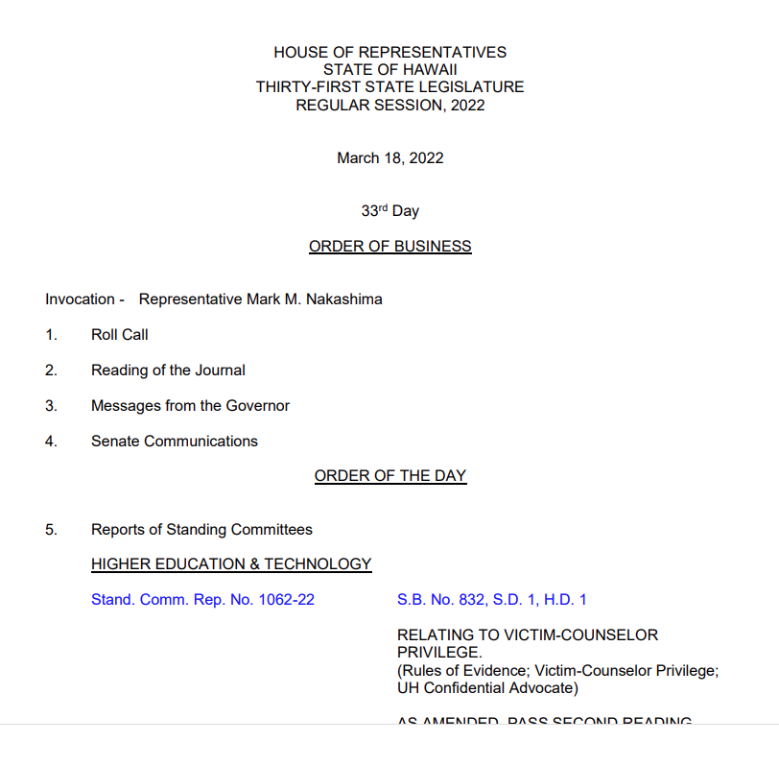
WHAT IT IS…
An AGENDA OF A DELIBERATIVE body
Notes:
What is referred to as the “Order of the Day” is the agenda of a deliberative body…

Slide 4
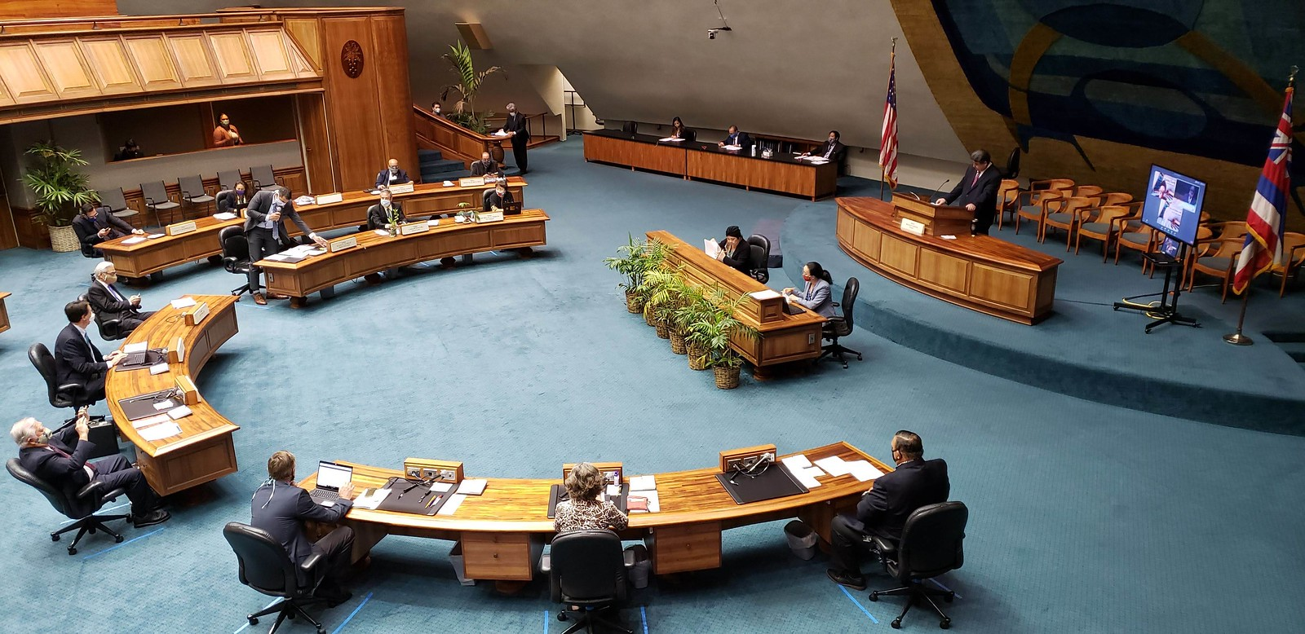
Order of the Day = AGENDA
Of either the Hawaii State Senate
  25 members
Notes:
In this case, the agenda for what is taking place on the floor of the Senate Chamber…

Slide 5
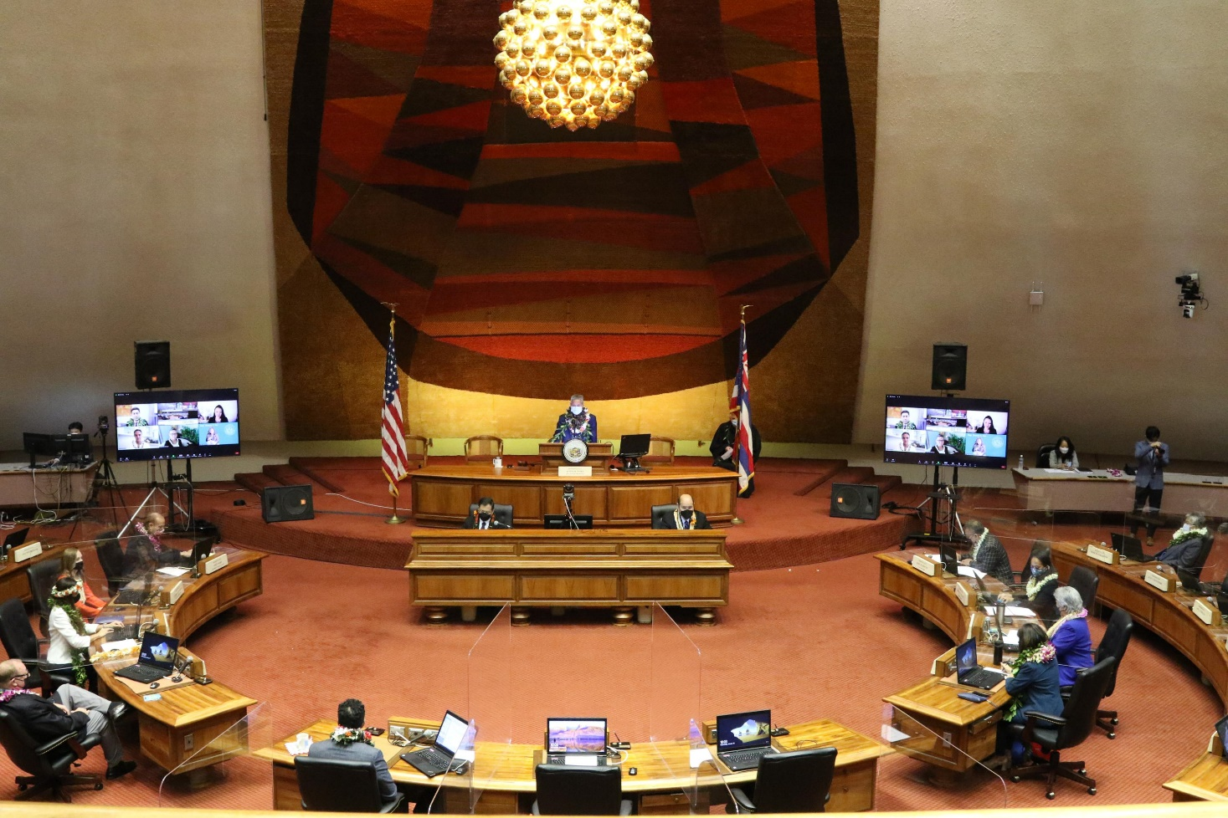
Order of the Day (o.d.) = AGENDA
Or the Hawaii State House of Representatives
  51 members
Notes:
Or on the floor of the House Chamber.

Slide 6
WHEN IS THE O.D. ISSUED?
Only on Session days (days when they actually convene in the House or Senate chambers)
No Session on:
- Recess days
- Holidays
- Weekends
Notes:
The Order of the Day is available only on days when the legislature is convening in chambers. The House and Senate do not meet in chamber on recess days, holidays or weekends.

Slide 7
RECESS DAYS?
They’re not out on the playground
While the members don’t meet in their chambers, they do have committee hearings, meet in caucus, and communicate with constituents
Notes:
Recess days are days when the House and Senate do not convene in chambers. But the term does not mean that the members are out goofing around. Instead, they participate in committee hearings, informational briefings, and caucus meetings, and otherwise perform their legislative duties.

Slide 8

WHEN IS IT ISSUED?
Session Days are indicated on the calendar
(FYI: there are 60 session days each Regular Session)
Notes:
There are 60 session days during the Regular Session, which begins on the third Wednesday in January of each year. To find out if a particular day is a session day, you can refer to the Session Calendar. Session days are indicated by a small box in the lower right-hand corner of the date box. (You’ll notice that any date that does not have a box is either noted as a recess day, a holiday, or a weekend day.)

Slide 9

WHEN CAN THE O.D. BE FOUND?
Usually just an hour or so before session starts.
Convene times appear under “Session Info” near bottom of home page)
capitol.hawaii.gov
Notes:
To obtain the current Order of the Day, scroll down on the Hawaii State Legislature’s homepage (capitol.hawaii.gov). Under “Session Info,” you’ll see the floor session convene times (the House and Senate usually have different convene times). Note: The Order of the Day is usually posted an hour or so before the chamber convenes.

Slide 10
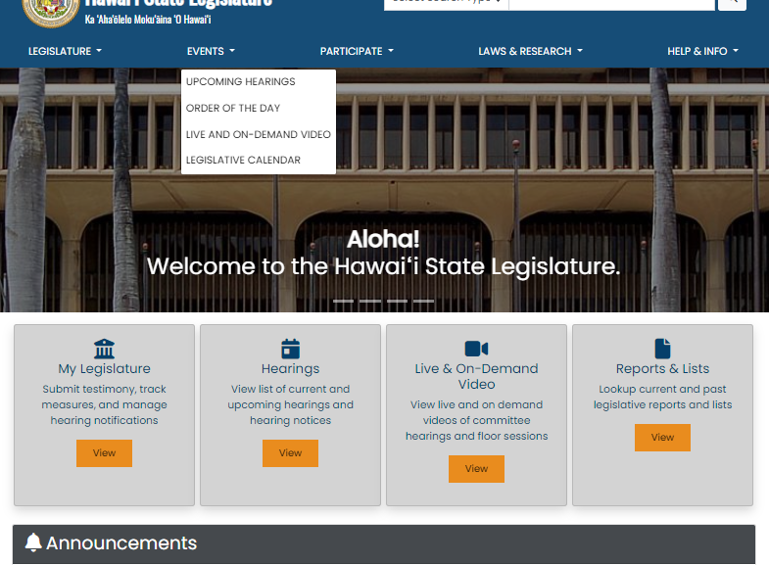
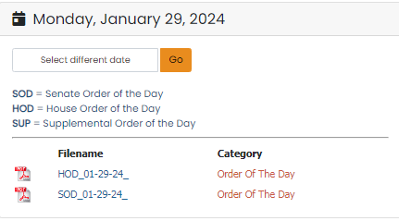
WHERE IS IT FOUND?
On the homepage, use the drop-down menu under the “Events” tab and select “Order of the Day”
You'll get links for the House and Senate Orders of the Day (abbreviated as HOD and SOD), as well as supplemental documents...
Notes:
To find the current day’s Order of the Day, go to the Legislature’s homepage (capitol.hawaii.gov) and use the drop-down menu under the “Events” tab and select “Order of the Day.” You’ll be presented with links to the House Order of the Day and the Senate Order of the Day. They’re abbreviated as “HOD” and “SOD.”
Note that if you select the .pdf version of the Order of the Day, you’ll be able to view the page numbers. This is especially helpful if it’s a long agenda, as the Speaker or President may refer to the page numbers as they proceed.
You may also see links to supplemental documents. Often, lists of referrals will appear as supplemental documents.

Slide 11
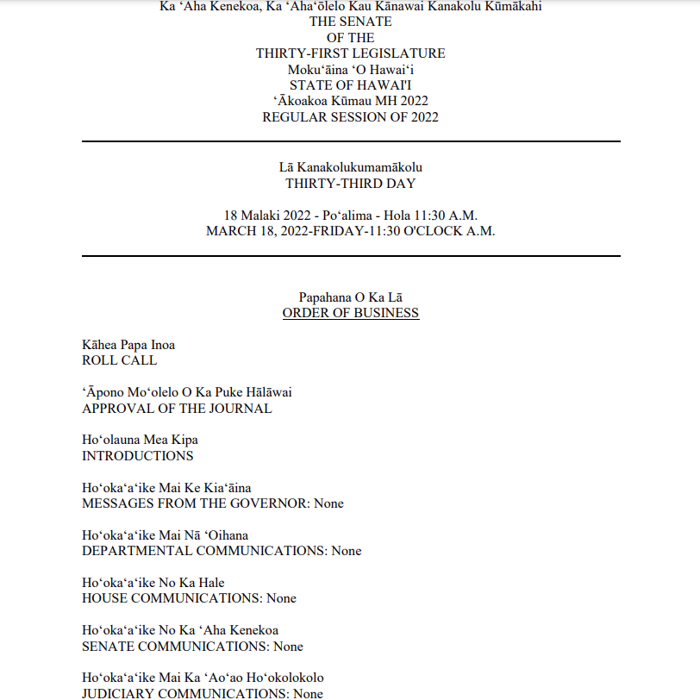
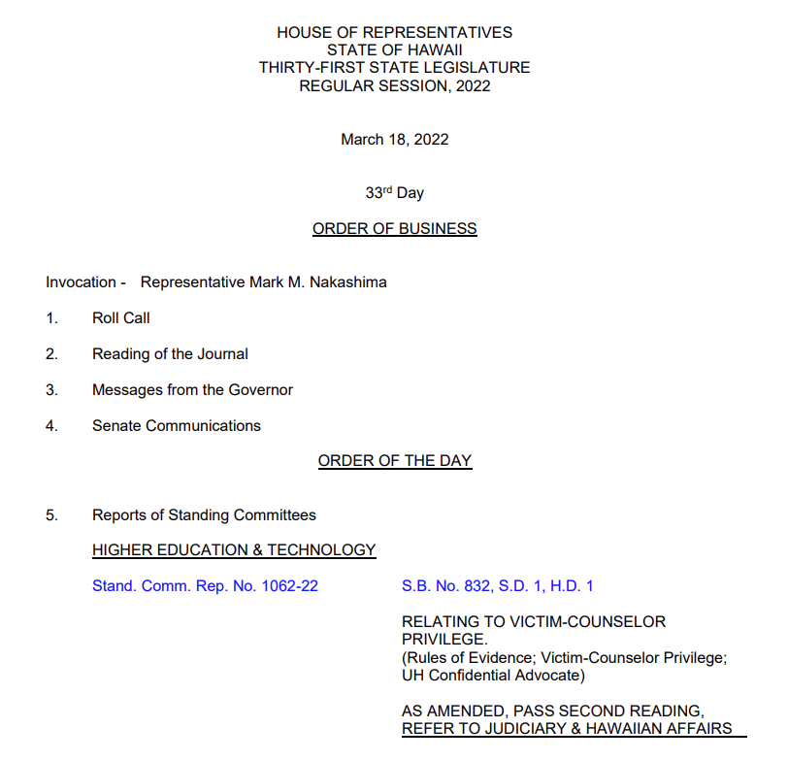
WHAT DOES A TYPICAL O.D. LOOK LIKE?
Notes:
The Order of the Day for the House and Senate will differ slightly.

Slide 12
WHAT’S IN THE ORDER OF THE DAY?
Senate and House do things differently
  Order of items
  Format / wording
  Links
  Customs /decorum
  Attachments / supplemental documents
Notes:
The House and Senate do things just a bit differently from one another. The order of the items that appear on the Order of the Day differ – the order is specified in the House and Senate rules (available by clicking on the “House” or “Senate” bars in the upper-right-hand side of the Legislature’s homepage). In addition, the format and inclusion of links differ between the chambers, as do the naming and formatting of supplemental documents.
Senate uses Hawaiian language.

Slide 13

INVOCATION/MOMENT OF CONTEMPLATION
ITEMS ON THE ORDER OF THE DAY
Brief speech, words of wisdom, prayer
Used to be different…a formal part of the agenda… much discussion…
Remarks are delivered before they gavel in
House indicates on its agenda who is scheduled
Notes:
The Invocation (in the House) or moment of contemplation (in the Senate) is a tradition held by the House and Senate which grants each legislator an opportunity to speak to their colleagues to provide encouragement or enlightenment.
Once upon a time, the Order of the Day began with an invocation as a formal part of the agenda. Now, any invocation occurs before the presiding official gavels the Session in to order. As a result, presence in chamber during the invocation is entirely voluntary.

Slide 14
ROUTINE ITEMS
ITEMS ON THE ORDER OF THE DAY
Roll Call
Approval of Journal
Messages/Communications (from Governor, Judiciary, other chamber)
Other regular business items
Notes:
The routine items are dealt with first. The House or Senate Clerk will assist the presiding officer as the Order of the Day is followed. A roll call to record who is present starts things off.
Messages from the other chamber, the Governor, and the Judiciary are noted on the Order of the Day.
Messages from the other chamber may communicate passage of or action on bills or concurrent resolutions, enrolling of legislation to the governor, agreement or disagreement with measures, and conference committee assignments and actions.
Governor’s messages may convey notification of signing of bills, allowing bills into law without signature, intent to veto messages and veto messages. Governor’s messages may convey nominations which are subject to the advise and consent function by the Senate. They may also relay departmental reports.
Judiciary messages may convey judicial nominations which are subject to the advise and consent function by the Senate. They may also convey reports and other communications.

Slide 15
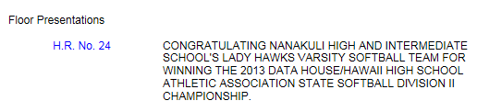
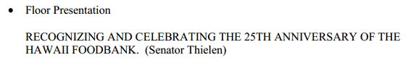
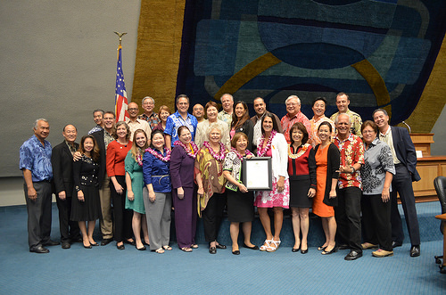

FLOOR PRESENTATIONS
ITEMS ON THE ORDER OF THE DAY
Notes:
If any floor presentations are scheduled, they will take place at the beginning of the agenda, usually followed by a “recess” to allow members to greet any honored guests. There are internal procedures that legislators follow to request floor presentations. The House may present formal resolutions honoring organizations or guests; the Senate procedures call for certificates rather than resolutions.

Slide 16
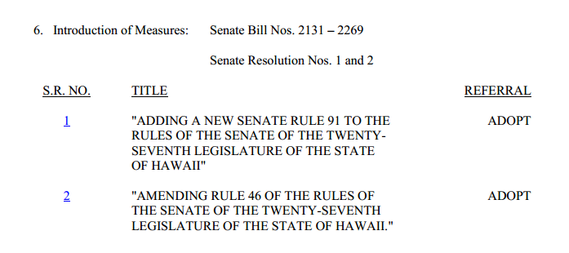
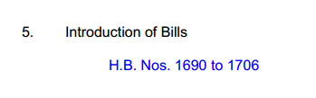
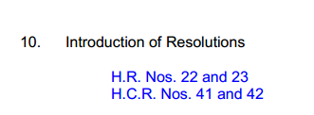
INTRODUCTION OF BILLS AND RESOLUTIONS
ITEMS ON THE ORDER OF THE DAY
Note: Resolutions are used as the mechanism to determine Leadership and Rules
Notes:
The introduction of bills, concurrent resolutions and resolutions appears on the Order of the Day. Frequently, they will be noted by number only. Legislators have access to the legislation in paper and/or electronic form.
Note:
While single chamber resolutions can take a variety of forms, one of their special uses is to establish leadership and rules of the chamber. They are adopted by a majority of the members.

Slide 17

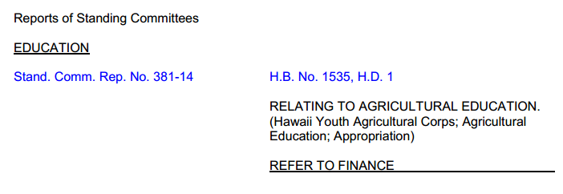
STANDING COMMITTEE REPORTS
ITEMS ON THE ORDER OF THE DAY
Notes:
When a bill is passed out of committee, the committee chair issues a committee report conveying the legislation back to the chamber and recommending further action. For a bill to proceed, the chamber accepts the report and votes to instigate the action suggested. (In rare cases, the chamber may vote to recommit the measure to the committee which it passed it out.)

Slide 18
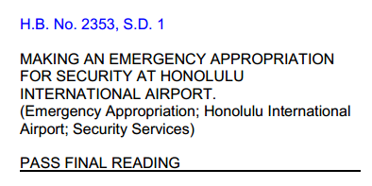
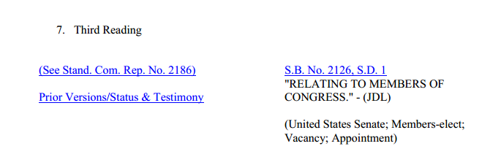
READINGS
ITEMS ON THE ORDER OF THE DAY
* Three readings in each chamber on separate days
48-hours notice prior to Third or Final Reading
For Third or Final, need
majority of members
Notes:
For a bill to become law, it must successfully pass three readings (just think of these as votes) in each chamber.
The First Reading is usually accomplished with the introduction of the bill, and there is no floor debate on the measure.
The Second Reading takes place after one or more committee hearings. Debate on Second Reading differs by chamber – it is not uncommon in the House but is rare on the Senate side.
Third Reading on bills requires 48-hours notice to members indicating that they will be asked to vote on the measure in its current form. (On the bill’s status sheet, you’ll often see an indication of “48-hours notice 3/23/2022” which advises anyone interested in the bill that this is the date that the bill is scheduled to be voted on.)
Final Reading also requires 48-hours notice to members.
Note: For Third and Final Readings, to pass a bill must obtain a majority of the number of members of the chamber. For other Readings, a majority of the present quorum of members will do.

Slide 19
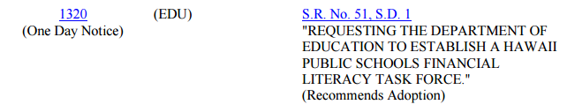
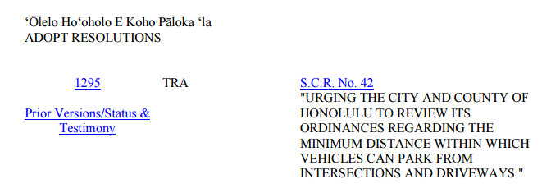
ADOPTING RESOLUTIONS
ITEMS ON THE ORDER OF THE DAY
* Usually provide one-day notice prior to vote
Only 1 vote required for adoption (if a concurrent resolution, will cross to other chamber for consideration)
Notes:
For a concurrent resolution to be adopted, it must successfully pass one vote in each chamber.

Slide 20
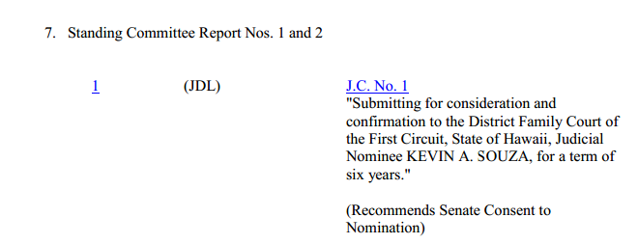
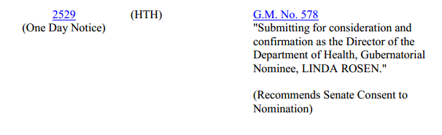
ADVISE AND CONSENT (SENATE ONLY)
ITEMS ON THE ORDER OF THE DAY
Notes:
One of the Senate’s unique roles is performed in exercising its Advise and Consent function in respect to certain Executive and Judicial appointments.

Slide 21


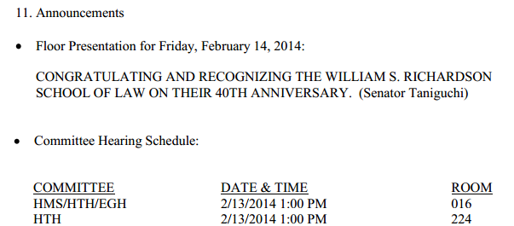
ANNOUNCEMENTS
ITEMS ON THE ORDER OF THE DAY
Not usually anything too exciting on paper…
Notes:
Announcements that appear on the Order of the Day include referral sheets, convene times, future floor amendments and upcoming hearings. Additional informal announcements may be included, wishing a member happy birthday or inviting members to attend community events.

Slide 22

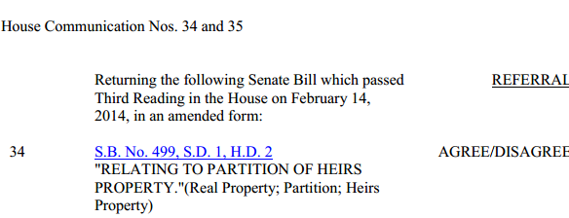
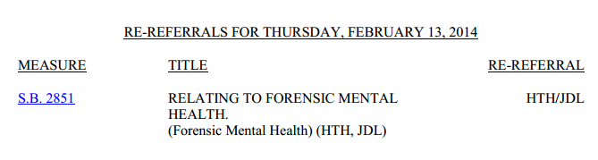
OTHER ITEMS
ITEMS ON THE ORDER OF THE DAY
Re-referral
Agree/Disagree
Recommitment
Recall
Waiver of
notice for
hearing
Notes:
In moving legislation, numerous other items and actions may appear on the Order of the Day.
Agree/Disagree: The chamber votes to agree or disagree with changes the other chamber has made to a piece of legislation.
Recall: The chamber may vote to recall a bill from a committee and bring it to the floor for action.
Recommitment: The chamber may also vote to move a bill back into a committee.
Re-referral: The chamber may change the committees to which a bill is referred.
Adopt resolutions: The chamber may vote to adopt a single chamber resolution (HR or SR), or a concurrent resolution (HCR or SCR). Resolutions do not have the force and effect of law but do express the will and intent of the chamber or Legislature.

Slide 23
AGREE/DISAGREE
HB426 (2009) & House Journal
When bill returns to its originating chamber, default option is to ‘disagree’ with any changes
Internal procedures for members who would like to have chamber ‘agree’ on a particular bill instead
Reconsideration of the disagree decision may be made following conference committee
Notes:
When an amended bill returns to its originating chamber, the chamber can either agree or disagree to the amendments made. If there is disagreement (which is usually the case), those bills are referred to a conference committee for further consideration of areas of disagreement. The chamber can also reconsider their disagreement. In such cases, a vote to agree is taken and the bill is considered passed by the Legislature and is sent to the Governor.

Slide 24
RECALL FROM COMMITTEE
HB444 (2009)
House: Rule 37
Senate: Rule 52
Bills may be recalled from committee twenty days after referral, if 1/3 one-third of the members to which the House or Senate is entitled vote in favor of the recall.
Notes:
Bills that are currently in committee can be recalled from committee for floor action. Bills can be recalled twenty days after referral if 1/3 of the chamber supports the recall.

Slide 25
Re-comMitment
SB137 (2013)
Requires a floor vote
May be used after substantially changing a bill (short form bills, for example)
Or may effectively kill the bill by declining to vote it forward
Notes:
The action of sending a bill back to its last committee. Requires a floor vote.
When a bill is reported out of a committee, it usually goes to the floor of the chamber to be voted on or moved to its next committee. A motion to “recommit” may be offered when the bill is under consideration on the floor of the chamber; it requires a floor vote to succeed. Bills are recommitted for further work (for example, a short form bill may have been amended but its content still needs to be heard by the committee) or a problem with a bill is identified after it has been reported out of committee.

Slide 26
RE-REFERRALS
HB825 (2015)
Rules of Senate and House differ, but ultimate authority rests with leadership
A chair may wish to have the opportunity to hear (or not hear) the bill
Subject matter may have changed, making referral to different committees appropriate
Deadline may have passed – bill is dead unless a committee agrees to step aside
Notes:
Re-referrals are listed on the OD. There are a couple of reasons for bills to be re-referred:
A chair may want to hear a bill or waive their committee’s right to hear a bill.
The subject matter of a bill may have changed in which case a re-referral is necessary.
A re-referral can be made to bring bills that have died back to life.

Slide 27
WAIVER OF HEARING N0TICE
Doesn’t appear on Order of the Day; coordinated with the clerk
Request made to the President or Speaker, in accordance with Senate and House rules
Notes:
Requests to waive hearing notice requirements are made on the floor. These won’t appear on the order of the day. Requests are made to the Senate President or House Speaker. After waiver requests are accepted, the requestor lists the date and time of the hearing.

Slide 28
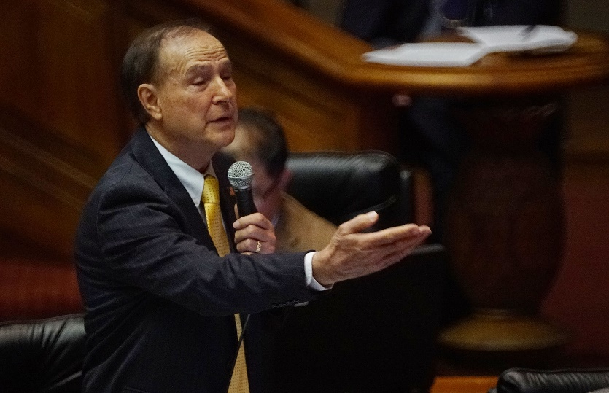
WHO GETS TO SPEAK?
Must be recognized by presiding officer
  Member must rise, “Mr. Speaker” or “Ms. President”, after being recognized may proceed with remarks, question or motion
  Limit on number of times may speak in debate on subject
  In House, time limit (other members may yield their time)
Notes:
When a member wants to speak, they rise and wait to be recognized by the presiding officer (the Senate President or Vice President, or the House Speaker or Vice Speaker). There may be limits on the number of times they may speak on an issue and the amount of time they are allowed in doing so.

Slide 29
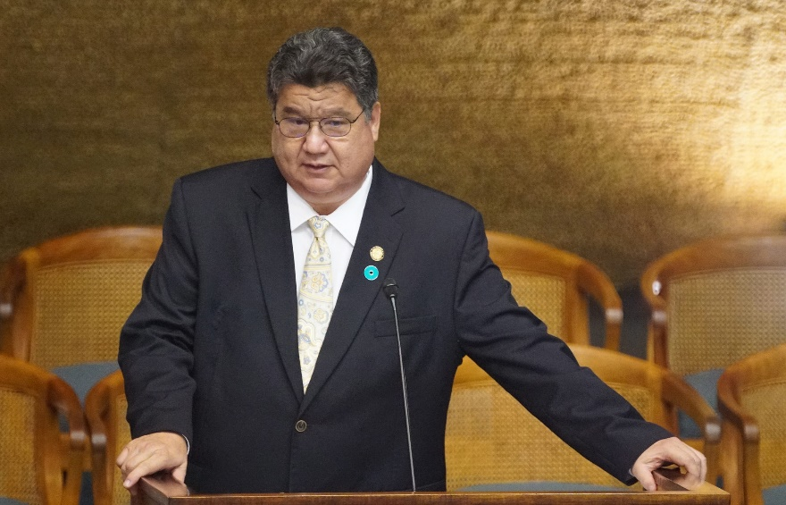
PROCEDURES
Motions/Seconded
  Proposals for action requiring a decision (to postpone, to amend, etc.)
“Interruptions”
  Point of Order, Request for Information, etc.
Rulings on conflict of interest
Notes:
Procedures are followed to maintain orderly debate and decision making. Motions are made and seconded. Members may rise for a “Point of Order” if they question the rules are being properly followed. Members are expected to rise and ask for a ruling on any possible conflict of interest.

Slide 30
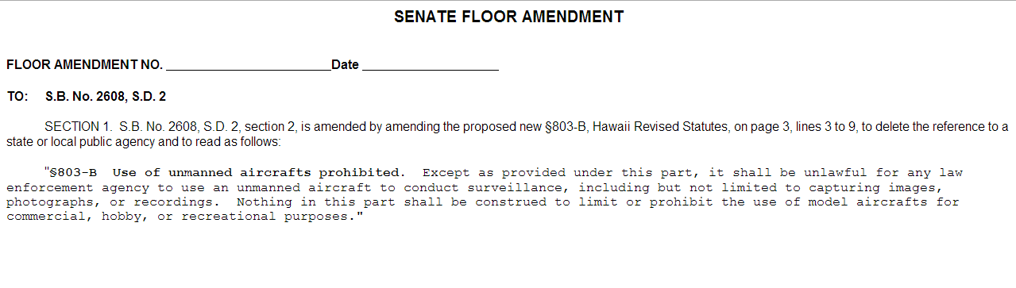
FLOOR AMENDMENTS
An amendment offered by a member from the floor during consideration of a bill or other measure (usually on third reading – if amendment passes, requires 48 hours before bill can be voted on again)
Notes:
We are used to seeing bills changed by committees – they are passed with amendments, and the amended version of the bill is published with the subsequent committee report. But bills can also be amended on the floor of the House or Senate.
If a bill is amended on third reading, it requires 48 hours before the bill can be voted on again.

Slide 31
VOTES
Consent Calendar/Modified Consent Calendar
Items may be moved to ‘end of calendar’ if message passage is uncertain – time to rally support!
Notes:
Items to be voted on may be listed on the Order of the Day under a “Consent Calendar.” In these instances, there has been previous discussion (perhaps in a Caucus meeting) which determined that these items have considerable support and may be passed without debate. The presiding officer will call for a vote on a list of measures, and if the vote is successful, all measures on the list will be noted as having passed.

Slide 32
VOTES
voice
Ayes
  Ayes with reservations
  Kanalua (pass or undecided – but if repeatedly kanalua, ends up counting as an “aye”)
Noes
Excused
roll call
unanimous consent
raising hands
standing
Notes:
All members are required to vote, unless they are excused. Votes that are “Aye with reservations” will be counted as “Aye” votes. Members may vote “Kanalua” if they are undecided on a measure; however, if they continue to vote “kanalua” (twice on a measure in the Senate, three times in the House) rather than “aye” or “nay,” their vote ends up being counted as an “aye” vote.
The way the vote is taken ranges from voice votes, roll call votes, unanimous consent, raising hands, and standing or rising.

Slide 33


CUSTOMS
Members must dress in “court attire”
Aloha wear on Fridays
Referring to other members
Submit written comments
Comments entered as my own
Notes:
A few practices you may notice as you watch the floor proceedings.
Members must dress in court attire during floor sessions (except for Fridays, where Aloha Attire can be worn.) "Court attire" means coat and tie for men and jackets for women.
On the floor, members do not refer to one another by name – instead, they refer to “my colleague from <District number or area>” or “the previous speaker.”
To move proceedings along, it is customary for members to ask to “submit written comments” that will appear in the House or Senate Journal.
Additionally, legislators may ask to “adopt the comments of the previous speaker (or my colleague from __) as if they were my own.”

Slide 34
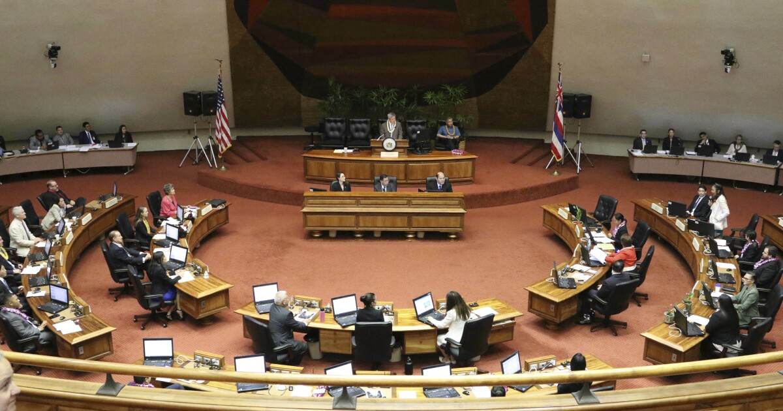
STAFF
Clerk –record keeping, journal, communications to and from the chamberbody
Sergeant-at-Arms – maintains order, decorum, escorts guests
Notes:
A note on the staff present on the floor.
Seated immediately in front of the presiding officer’s podium are the Chief Clerk of the House or Senate and his or her aides. In addition to administration of the proceedings, they are charged with record keeping (roll call, votes, the journal) and communications to and from the chamber.
The House and Senate Sergeants-at-Arms and their assistants may appear at various positions on the floor and in the gallery. They maintain safety, order, and decorum, and escort any guests on and off the floor.
House and Senate Majority and Minority staff are also present.

Slide 35
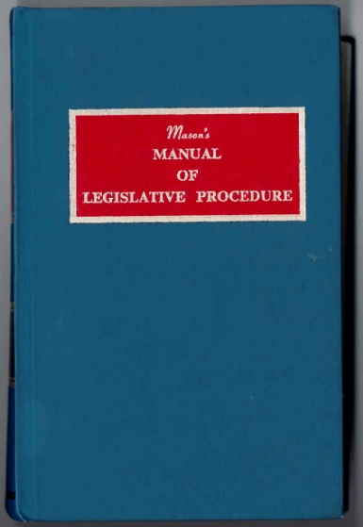
WHAT GUIDES PROCEEDINGS/BEHAVIOR?
State Constitution
House and Senate Rules
Mason's Manual of Legislative Procedure
Notes:
The proceedings on the House and Senate floor are guided by the Constitution of the State of Hawaii, as well as the rules adopted by the House and the Senate. In addition, Mason’s Manual of Legislative Procedure is called on for questions not addressed by the previous sources.

Slide 36
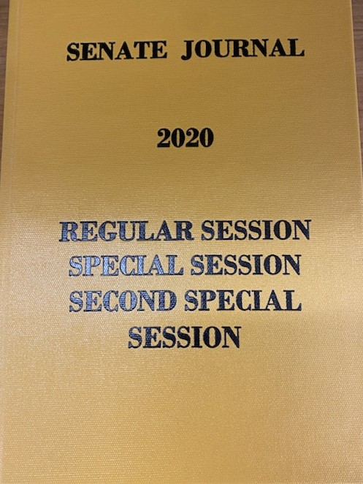
JOURNALS
Provides a written record of
all the floor actions.
Past House and Senate Journals
can be viewed online.
House draft journals posted
as session proceeds; for current
Senate journals, contact Senate Clerk’s office.
Bound volumes of House and Senate Journals are available in the LRB Library.
Notes:
The House and Senate publish journals of the proceedings on the House and Senate floor. They are published annually in large volumes, and copies are available in the Legislative Reference Bureau Library, located on the Chamber Level of the capitol. Additionally, House journals can be viewed online. (For current House and Senate journal entries, click on “House” or “Senate” on the upper-right-hand side of the Legislature’s homepage. Select the year you’re looking for, and then the appropriate date.)

Slide 37
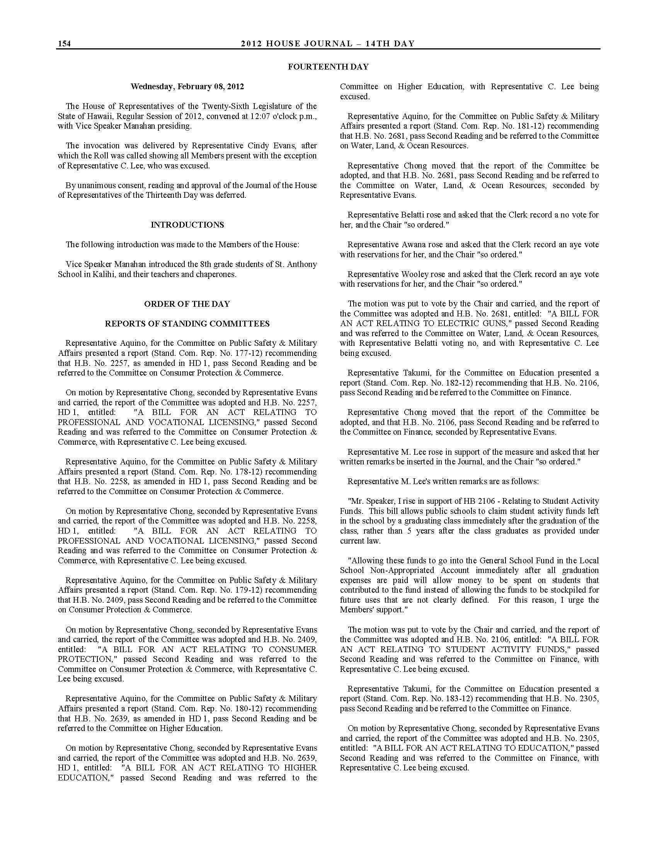
JOURNALS
Notes:
The journals record all actions on the floor. Online versions of the journals appear on the “House” and “Senate” pages – find those pages under the “Legislature” tab on the Legislature’s website. Scroll down a bit, and you’ll find a drop-down menu so that you can select the year of the journal you’re looking for.

Slide 38
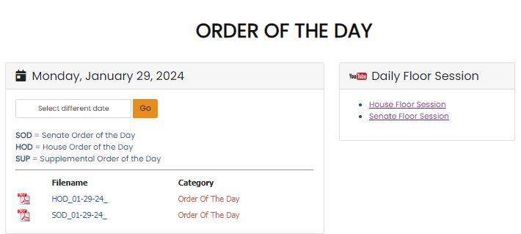
WATCH THE PROCEEDINGS
Video of Session
Either use the links on the “Order of the Day” results page…
Or use the “Live and On-Demand” video page to access the House or Senate YouTube pages
Notes:
Floor proceedings are streamed live and are available on the House and Senate YouTube pages. From the Capitol website, click on the live and on-demand video tab Select the House or Senate YouTube channel, Then select the House or Senate Floor Session you want to watch. Or use the links that appear on the “Order of the Day” results page.

Slide 39


ADJOURNMENT
Public Access Room (PAR)
587-0478
par@capitol.Hawaii.gov
lrb.Hawaii.gov/par
Notes:
That was a quick overview! For more information, or if you have questions, please contact the Public Access Room (PAR) at 808/587-0478 or email us at par@capitol.hawaii.gov. We are happy to help you learn more about the legislative process and how to participate in making the best laws for the state of Hawaii. You’ll also find helpful information on PAR’s website: lrb.hawaii.gov/par/

