Slide 1
USING THE
Public Access Room (PAR)
808/587-0478 par@capitol.hawaii.gov
lrb.hawaii.gov/par
Notes:
Thank you for joining us for this “Using the Interim” presentation.
In this presentation, we’ll talk about some of the things that happen during the interim and how you can best use this time to prepare for next year’s session.
This business of lawmaking is a year-round process, and the interim is an important part of that process.

Slide 2
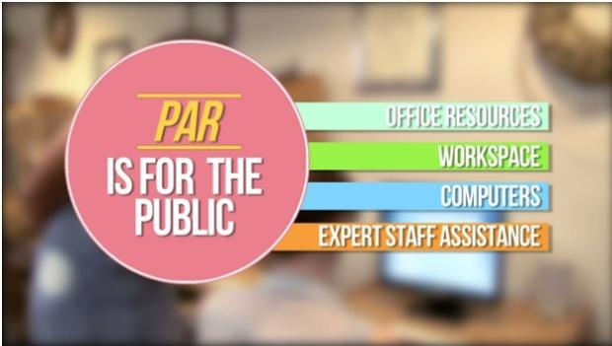
Public Access Room (PAR)
Help, information and training
Non-partisan
Lots of resources!
Guidance on process
Computers with internet
Wireless access & recharge station
Copies of testimony
Helpful handouts
Workshops and tutorials
Notes:
The Public Access Room is a nonpartisan, taxpayer funded office that is set up to help enhance the public’s ability to participate in the legislative process. We are staffed year-round and always available to assist.

Slide 3
TOPICS OF DISCUSSION
Governor’s Role & Deadlines
How to Find the Acts (and The Law)
Regrouping and Reassessing
Working with Legislators During the Interim
Q & A
Notes:
In this presentation, we’re going to talk about the following topics:
The Governor’s Role in the bill-to-law process and his deadlines for this year in reviewing bills passed by the Legislature.
Finding the Acts and other relevant information on bills passed.
Regrouping and reassessing after Session
Working with Legislators in the Interim.
And we’ll finish the discussion with a Q&A.

Slide 4
GOVERNOR’S ROLE
Governor plays an important role in the bill-to-law process
Procedure for enactment is defined in Article III, Section 16 of the Hawaii State Constitution
Approval or Veto
Contacting the Governor
Notes:
Let’s start by talking about the Governor’s role in the bill-to-law process. The Governor plays a very important role in the enactment of state legislation. When a bill successfully passes through the Legislature, it needs to be presented to the Governor (except constitutional amendments)
The procedure for enactment, which is defined in Article III, Section 16 of the Hawaii State Constitution, varies based on when a bill is delivered to the Governor and the Governor’s subsequent action or inaction in considering the bill. We’ll discuss that in the next slide.
Every bill that passes the legislature is certified by the presiding officers and clerks of both houses and presented to the Governor. If the governor approves it, the governor will sign it and it will become law. If the governor does not approve the bill, he may return it, with his objections to the legislature. Except for items appropriated to be expended by the judicial and legislative branches, the governor can veto any specific item or items in any bill which appropriates money for specific purposes by striking out or reducing the same; but shall veto other bills, if at all, only as a whole.
The Legislature can successfully override a veto in special session by a 2/3 vote in each chamber. The Legislature can also amend a bill to answer the governor's objections. For it to become law, a majority of the members in each chamber would be required to vote in favor of the amended bill, and the governor would then have 10 days to sign it.
You can contact the Governor to express support or opposition on bills that have been sent to him. We’ll show you how to do that a few slides in.

Slide 5
July 11
Sign
Veto
Allow to Become Law
Must submit intent to veto list by June 26th
Notes:
The Governor has until Jully 11th (45th day after adjournment sine die) to either sign a bill into law, to veto it, or allow it to become law automatically. If the governor intends to veto a bill, he needs to let the legislature know by June 26th.

Slide 6
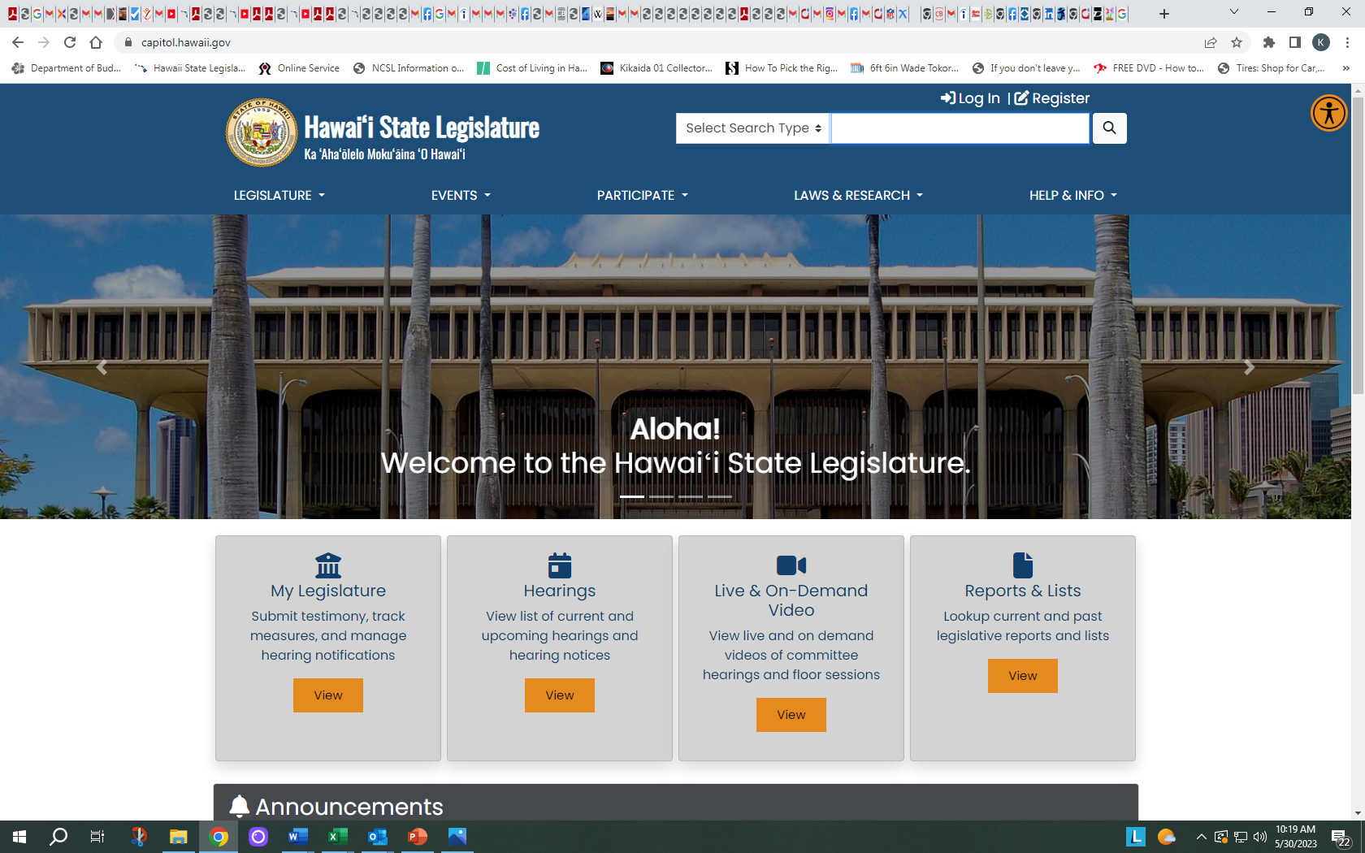
CONTACTING THE GOVERNOR
Notes:
If you want to contact the governor regarding legislation that has been sent by the legislature, you can use the link from the legislature’s website, which is located on the bottom of the homepage, or you can get there directly by going to governor.hawaii.gov.

Slide 7
Notes:
From the homepage of the governor’s website select the “contact us” tab to get to the contact page.

Slide 8
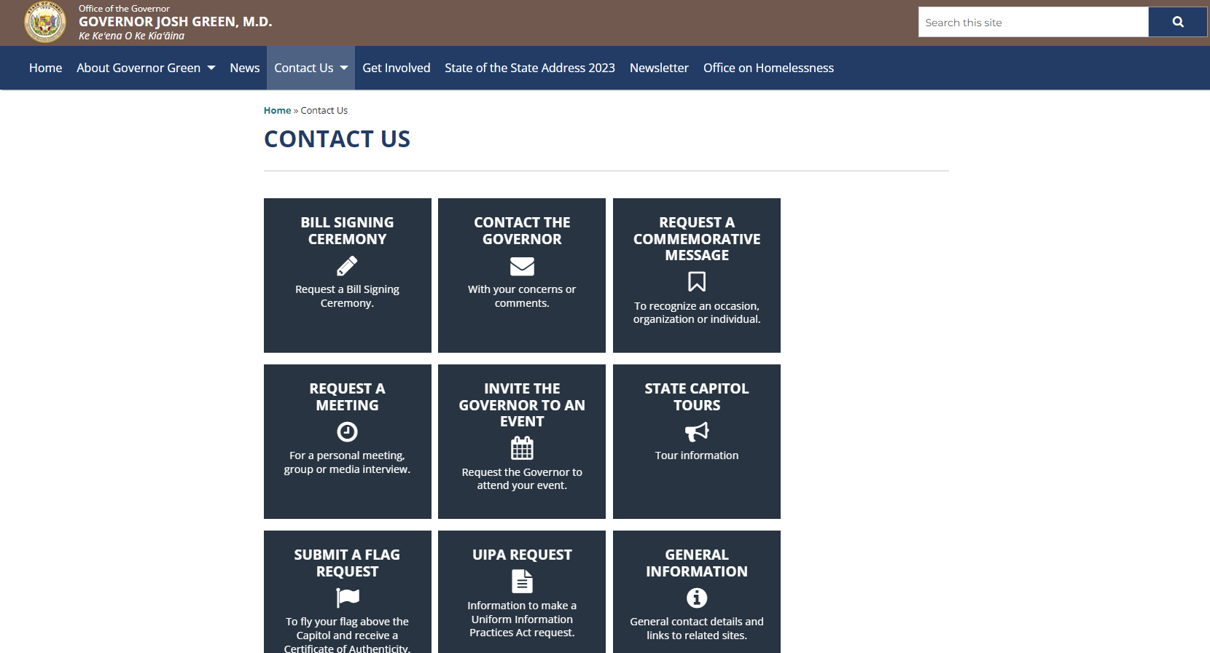
Notes:
Once here, you can request a bill signing (if you supported a bill that made it) or using the contact the governor box to ask for his support or opposition on a bill sent by the legislature.

Slide 9
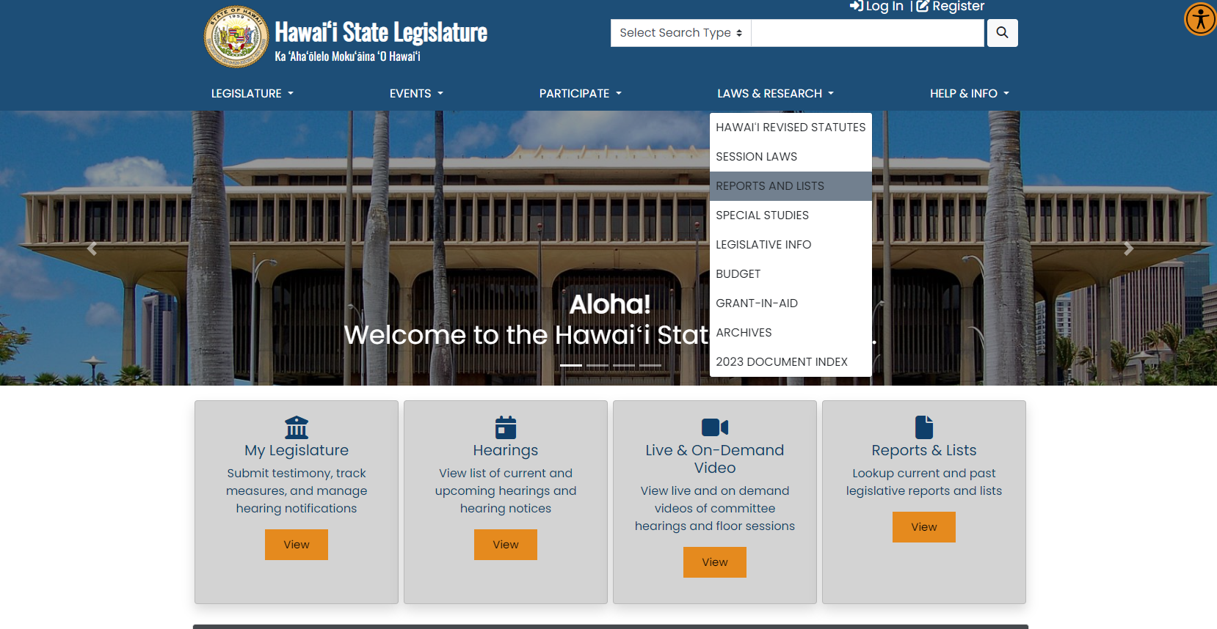
FINDING THE 2023 ACTS
Notes:
To see what’s happening with all the bills that were sent to the governor, click on the “Laws & Research” subject heading, then the "Reports and Lists” Icon on the website.

Slide 10
Notes:
On the “Reports and Lists page, scroll down to “Governor’s Actions.” The first link is to the 2023 Acts. You can also find links to other information on bills enrolled/transmitted by the Legislature. The links will update as the Governor takes action on the pending bills.

Slide 11
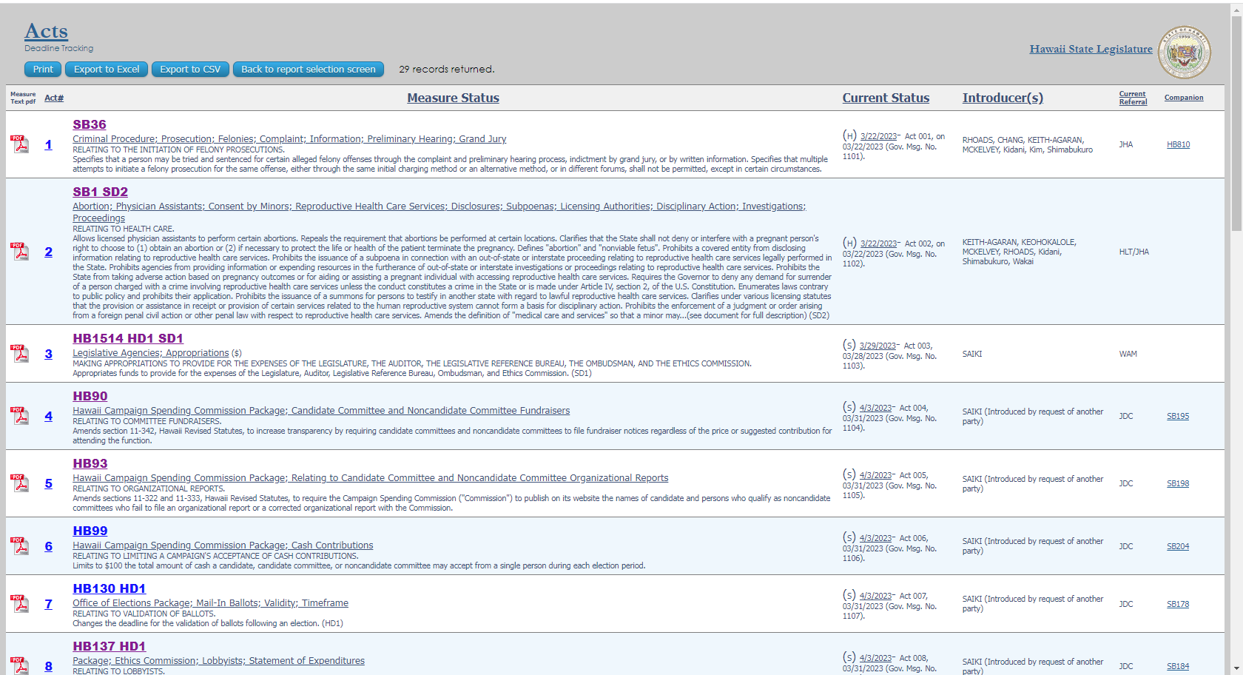
Notes:
This is how it’ll look like in the report. Click on the Act number to see the Governor’s Message and the Act…

Slide 12
Notes:
And it will look like this…. With the governor’s message and the bill approved by the governor with the act number on the upper right portion of the bill.

Slide 13
Notes:
Here’s a better look the Governor’s Actions portion of the Reports and Lists page. If you clicked on the Bill’s pending Governor’s Action link. It will take you to that report.

Slide 14
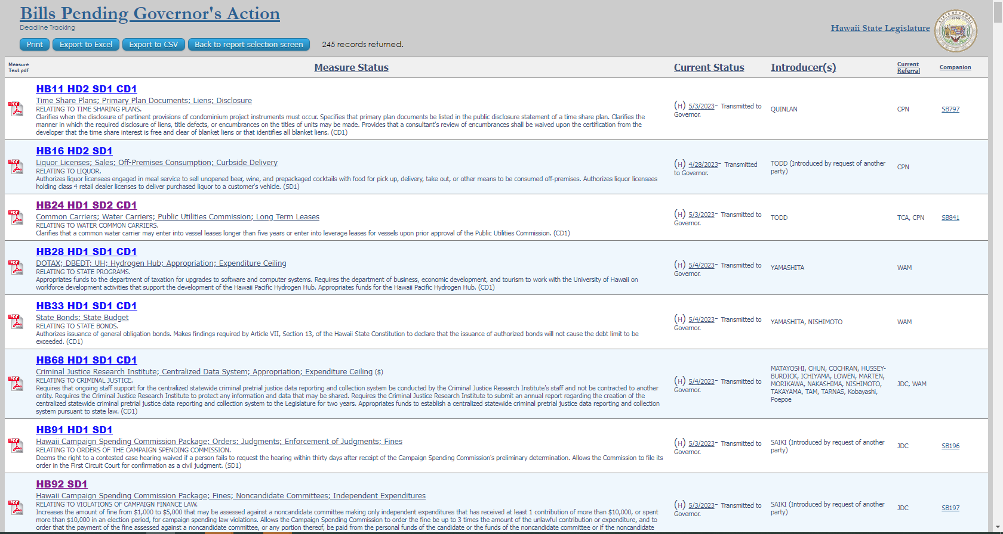
PENDING BILLS
Notes:
Which will look like this. You can use these links to see all the bills that the governor hasn’t acted on. The measures in these links will decrease based on the action taken.

Slide 15
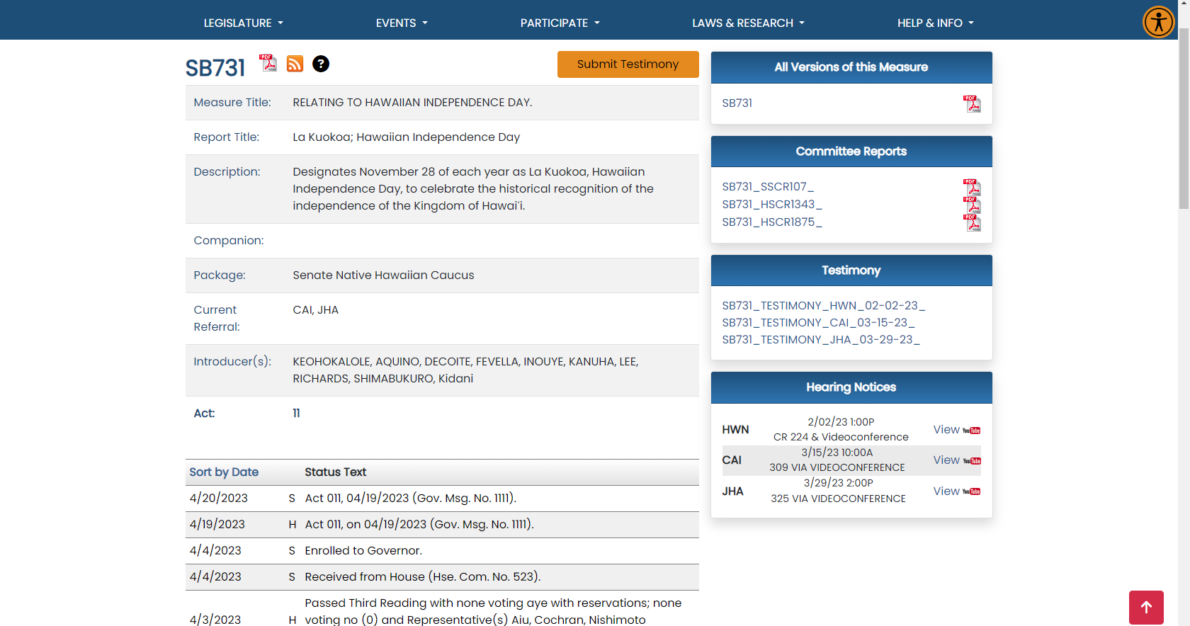
Notes:
If you just want to follow your own bill, you can see the updates on your bill’s status page, where the history is updated to include the bill becoming an act (like in our example here.)

Slide 16
FINDING THE LAW
Session Laws of Hawaii (SLH)
Hawaii Revised Statutes (HRS)
*2023 laws will not be reflected until later this year
Notes:
Each year, all the bills that become law are compiled in the Session Laws of Hawaii (SLH). If the new law adds to or amends any of the codified laws (the laws arranged in a systematic code) of the State of Hawaii, it will also be reflected in the Hawaii Revised Statutes (HRS), where the laws of a general and permanent nature go.
Not all new laws impact the HRS. For example, if the law is applicable only for a limited amount of time or contains temporary provisions (as is the case with legislative appropriations), it will be published in the Session Laws but not codified in the HRS.
Note that there are also rules published by the State departments governing how the new laws will be implemented – those are the Hawaii Administrative Rules (HAR) but we won’t get into that.

Slide 17
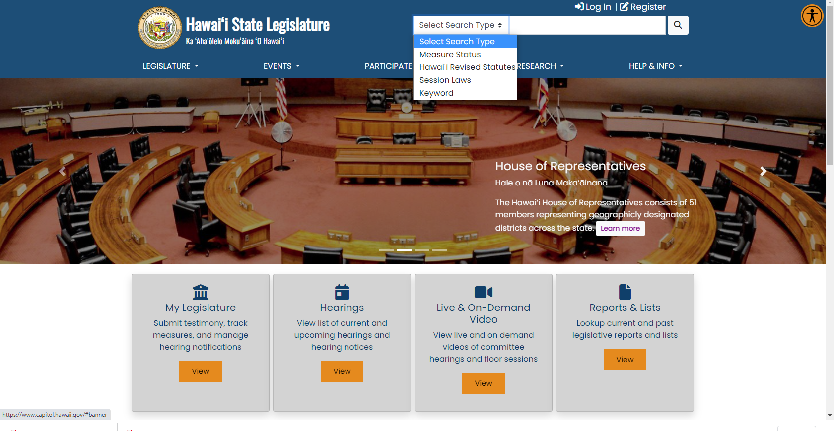
Notes:
To find the laws, head over to the Legislature’s website and click in the search box on the top of the home page. You can select “Hawaii Revised Statutes” to find permanent laws and “Session Laws.”

Slide 18
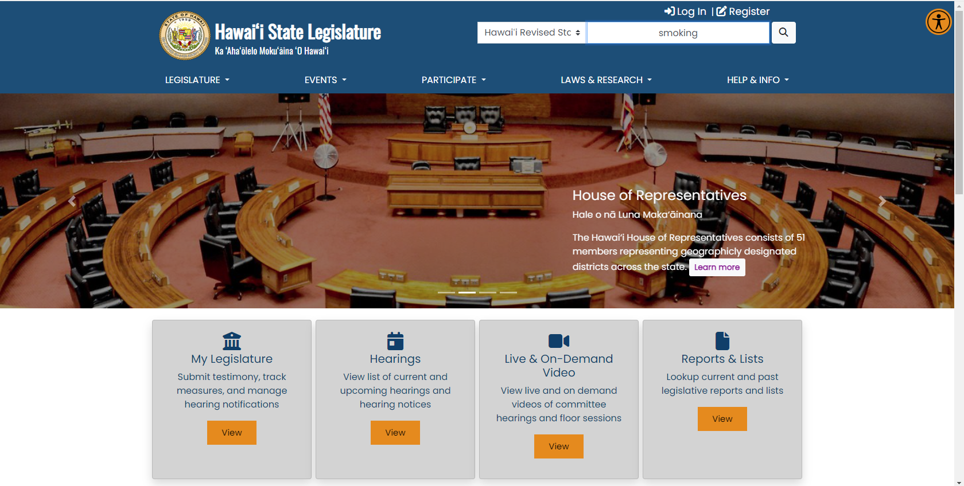
Notes:
To find a subject in the HRS, just type a subject to search for, like smoking in this example.

Slide 19
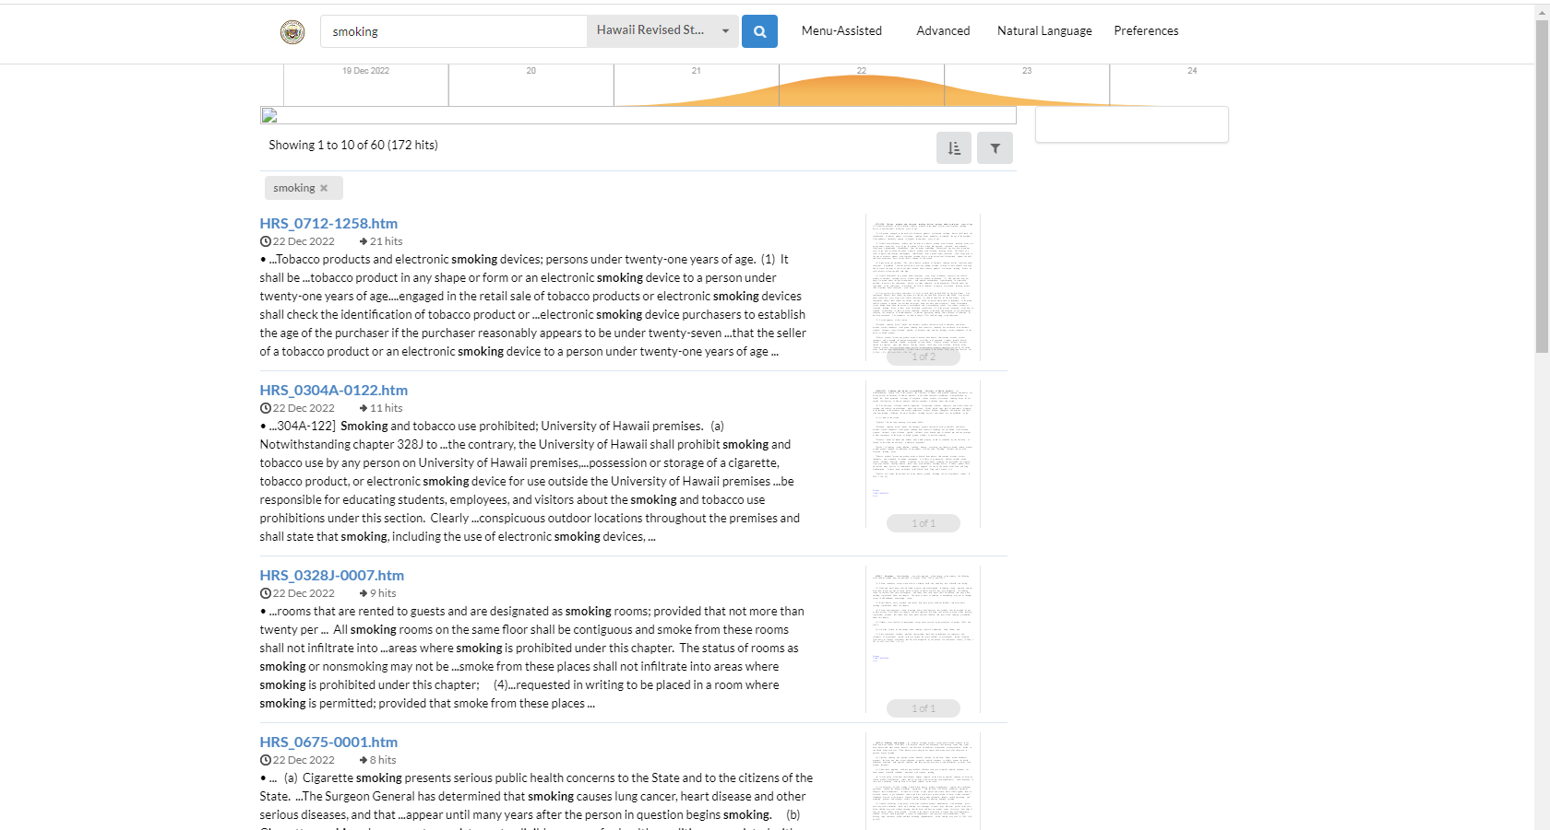
FINDING STATUTES
Notes:
And the parts of the HRS that refer to smoking will come up. You can then go directly to the HRS section by using the section hyperlinks. Let’s click on the first link…

Slide 20
Notes:
And here is HRS section 712-1258 (Regarding Electronic Smoking devices.)

Slide 21
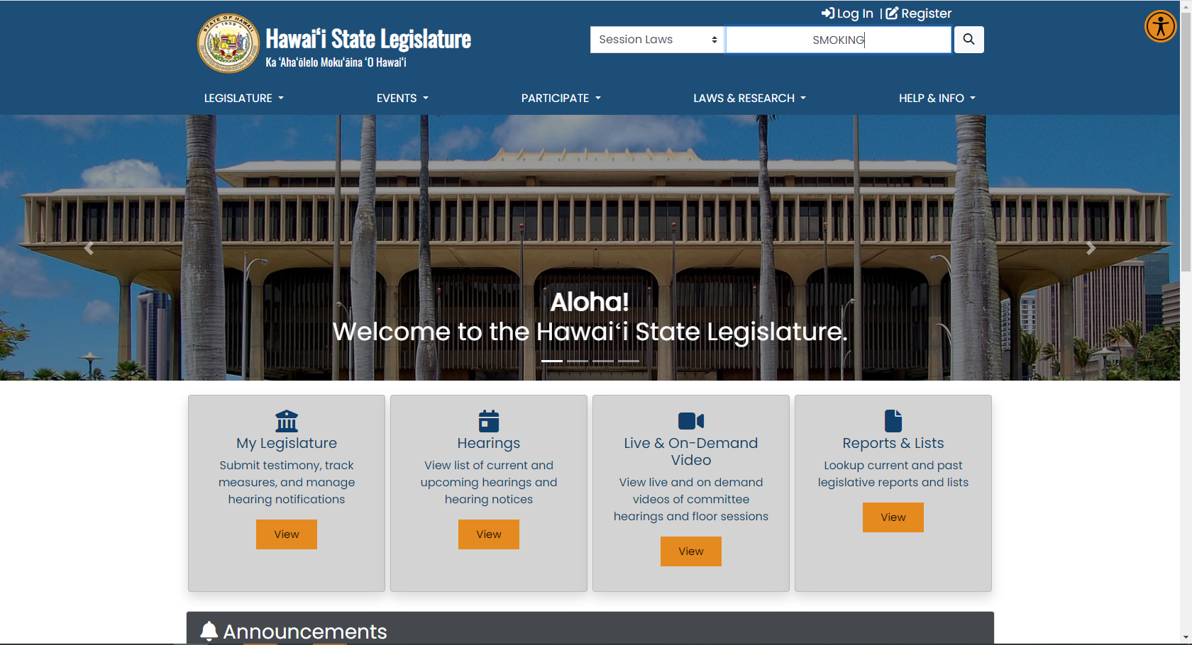
Notes:
Now let’s use the same subject to search through the Session Laws.

Slide 22
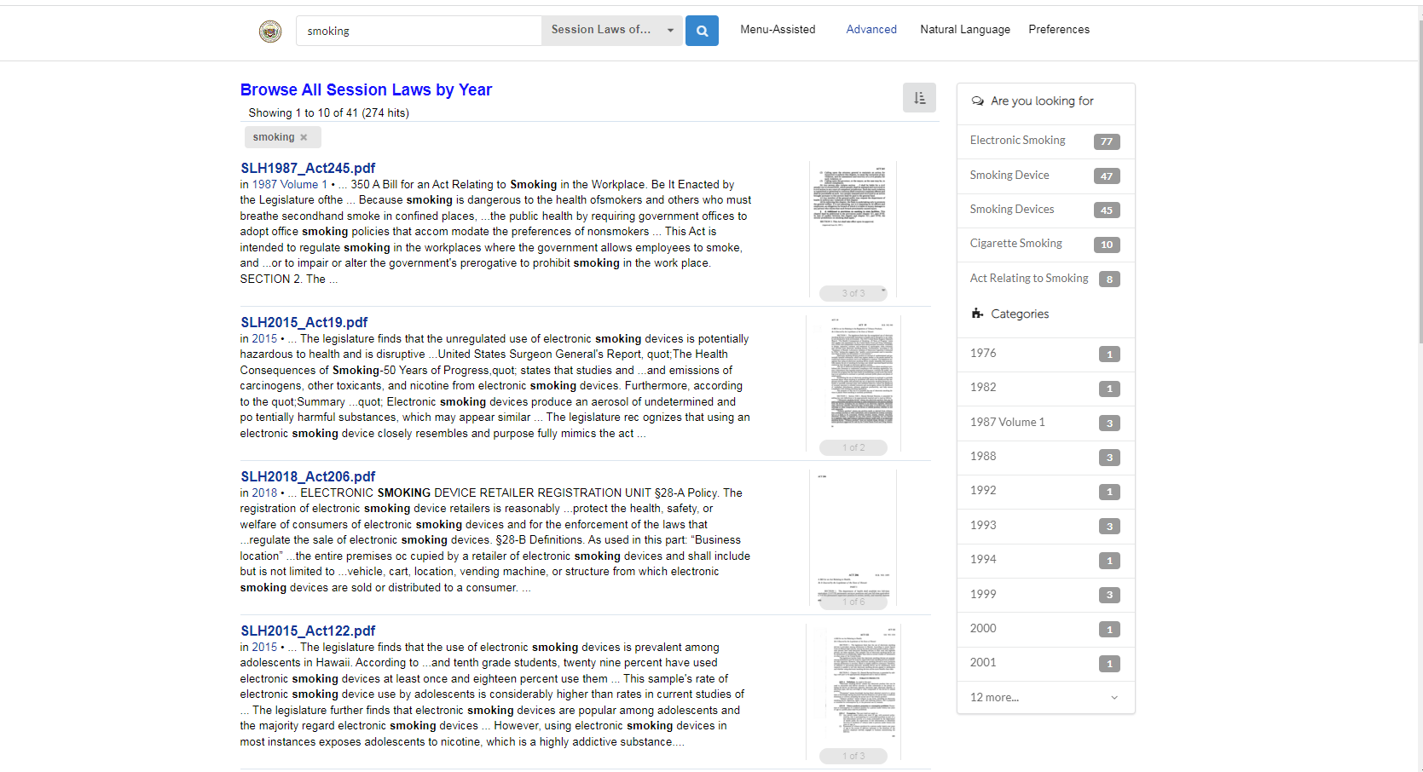
Notes:
You can sift through the results. You can even use the subset links on the right side of the page to narrow your search further by subcategory or by date. Then click on the link for the act you want to see (Act 245 SLH 1987 in this example)….

Slide 23
Notes:
Like so.

Slide 24
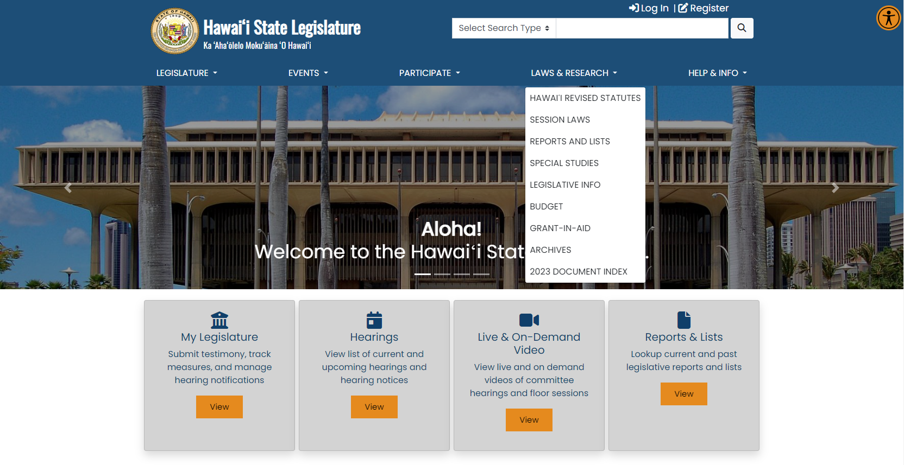
Notes:
We’ve shown how you can access the HRS and Session Laws using the search box at the top of the homepage, but you can also access the HRS and Session laws from the “Reports and Lists” tab, which is our favorite tab. You can select either Hawaii Revised Statutes or Session Laws…..

Slide 25
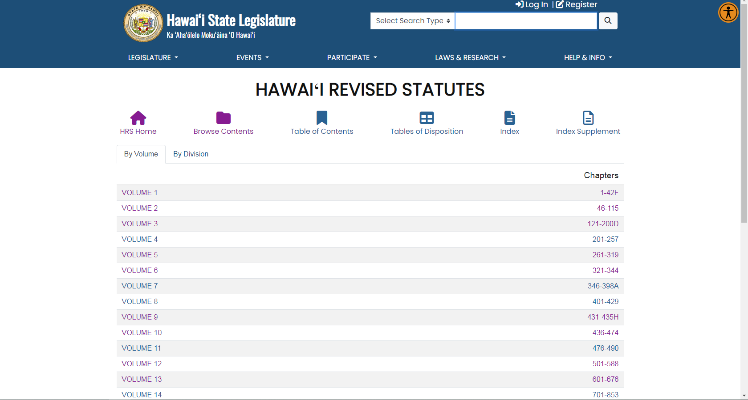
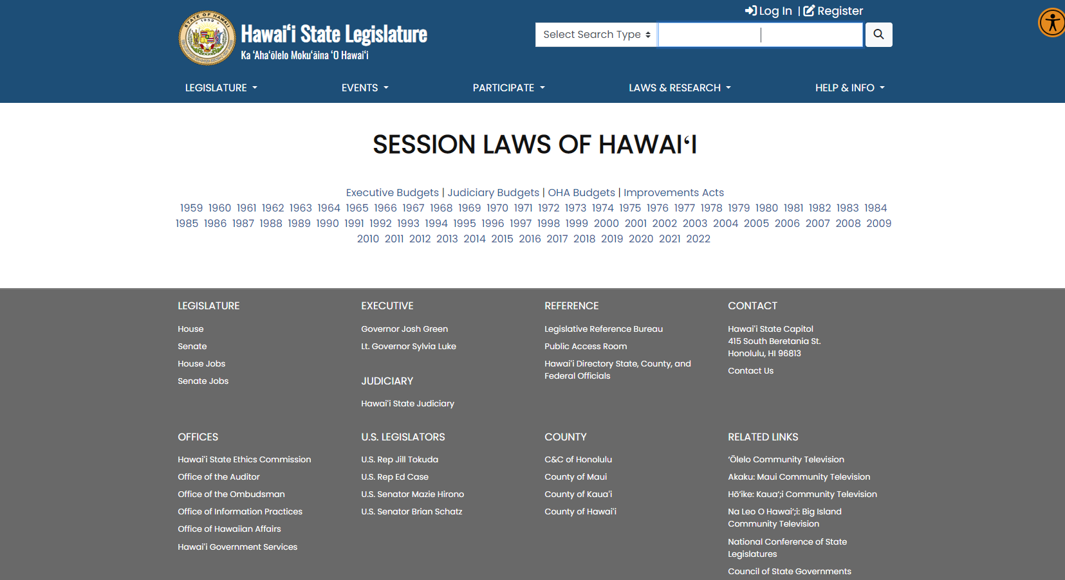
Notes:
And go directly to the HRS section or Session Law year. These can be handy places if you know already know what HRS section you want to view or which year the Act you are interested in was created.

Slide 26
Supplemental Information Relating to Bills Passed
lrb.hawaii.gov
Notes:
The Legislative Reference Bureau produces a “Supplemental Information Relating to Bills Passed” report that provides table of laws affected by the bills passed (but not necessarily enacted) during a particular session and is helpful for the current year before the SLH is published and posted. You’ll be able to find this report on the Legislative Reference Bureau’s website off the “Session Reports” tab.
This report is especially helpful if you’re trying to see the HRS sections affected by 2023 Acts.

Slide 27
Notes:
You’ll click on the “Supplemental Information” report.

Slide 28
Notes:
And this is what the report looks like. You’ll see subject matter and the bills passed that relate to those areas.

Slide 29
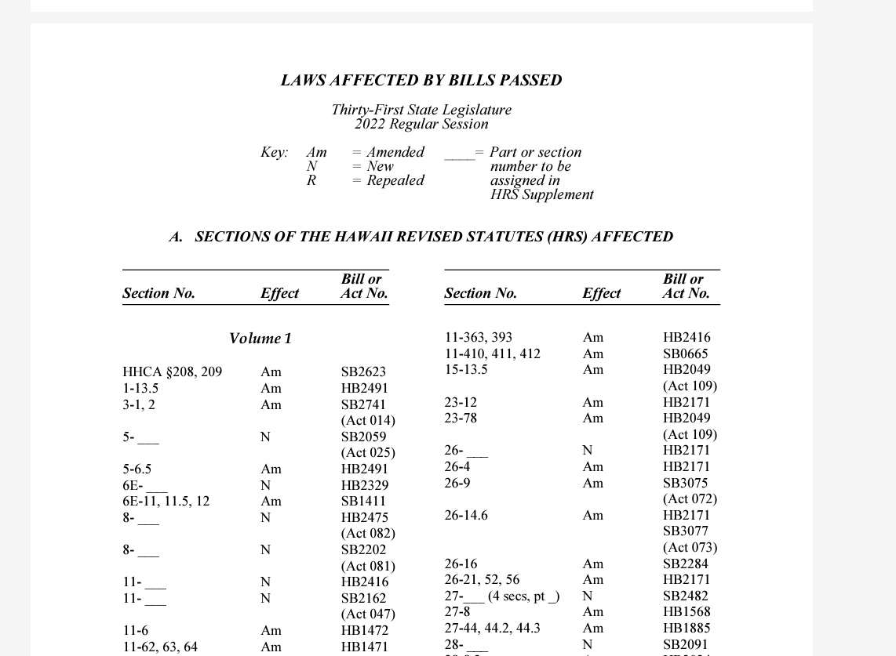
Notes:
You can also see what HRS sections were affected by this year’s bills.

Slide 30
REASSESSING & REGROUPING
Debrief after Session
Sketch out a gameplan
Network
Notes:
One of the first things you’ll want to do after Session is to debrief.
Based on your debriefing notes, you’ll want to sketch out a gameplan for the interim and next session
Finally, if you’ve identified network opportunities, reach out and make connections.

Slide 31
Notes:
In doing a review of the past session, here are some areas of focus:
What worked? What didn’t work?
What could be done differently next year?
What ideas did you have that you just didn’t have the resources to follow through on?
What challenges were you not equipped to counter?
What research information do you wish you had?
What advice would you give someone trying to do the same thing next session ?
What do you know now that you wished you had known ?
Did you identify any potential supporters?
Jot it all down

Slide 32
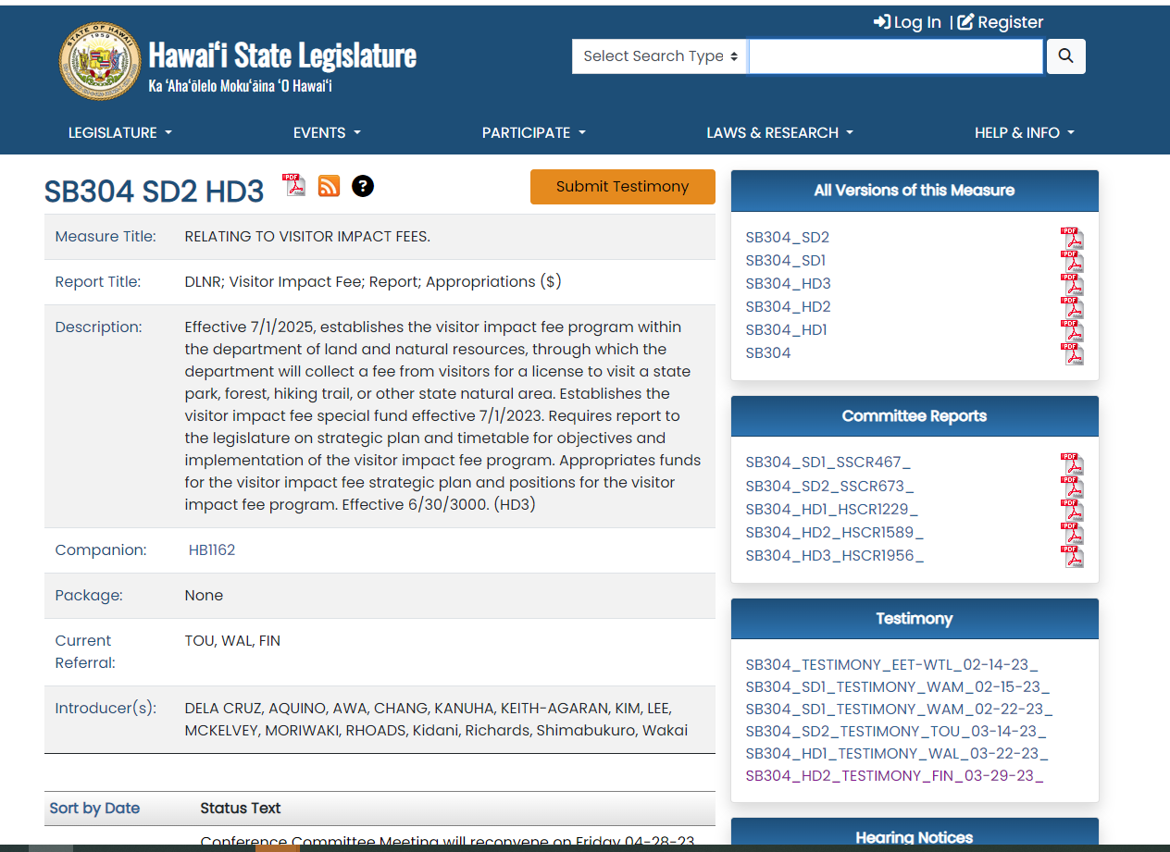
Notes:
If you were following a bill that received testimony in support and opposition, you can scan through the testimony to find allies. You can also read testimony from people/groups on the opposite side to better understand their position and try to find some common ground. These are things you can do during the interim to better prepare for next session.

Slide 33
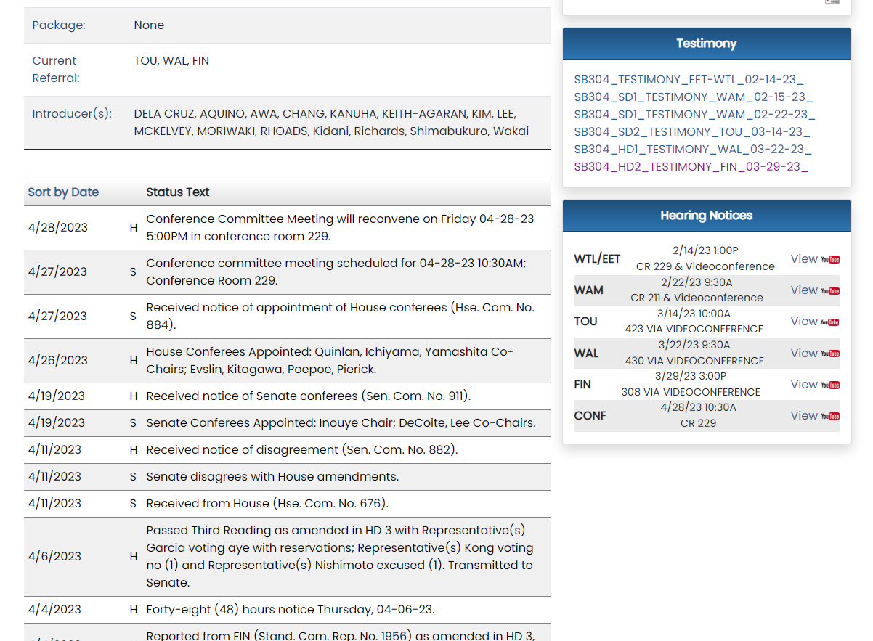
Notes:
It may be beneficial to watch the discussion on the bill in Committee. You can use the YouTube link under the “Hearing Notices.” That’ll take you to the hearing.

Slide 34
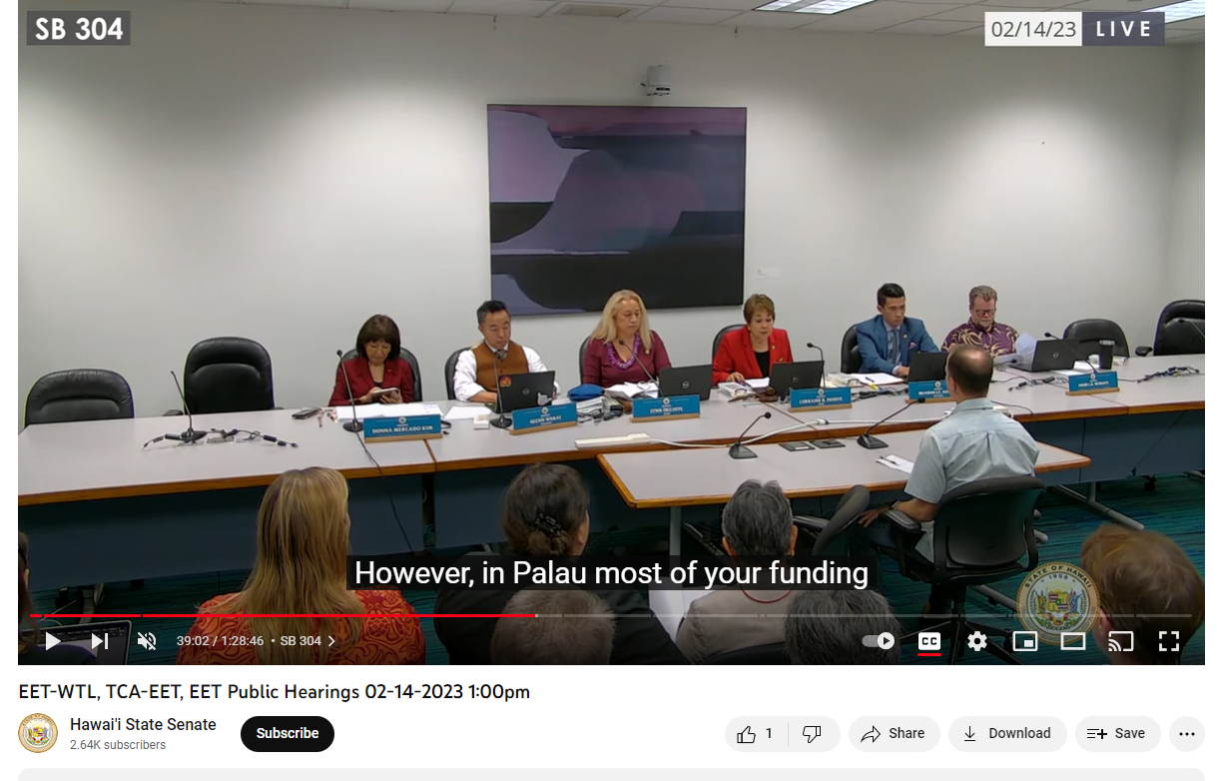
Notes:
Then just move the cursor of the video to the portion of the recording when your bill is being discussed.

Slide 35
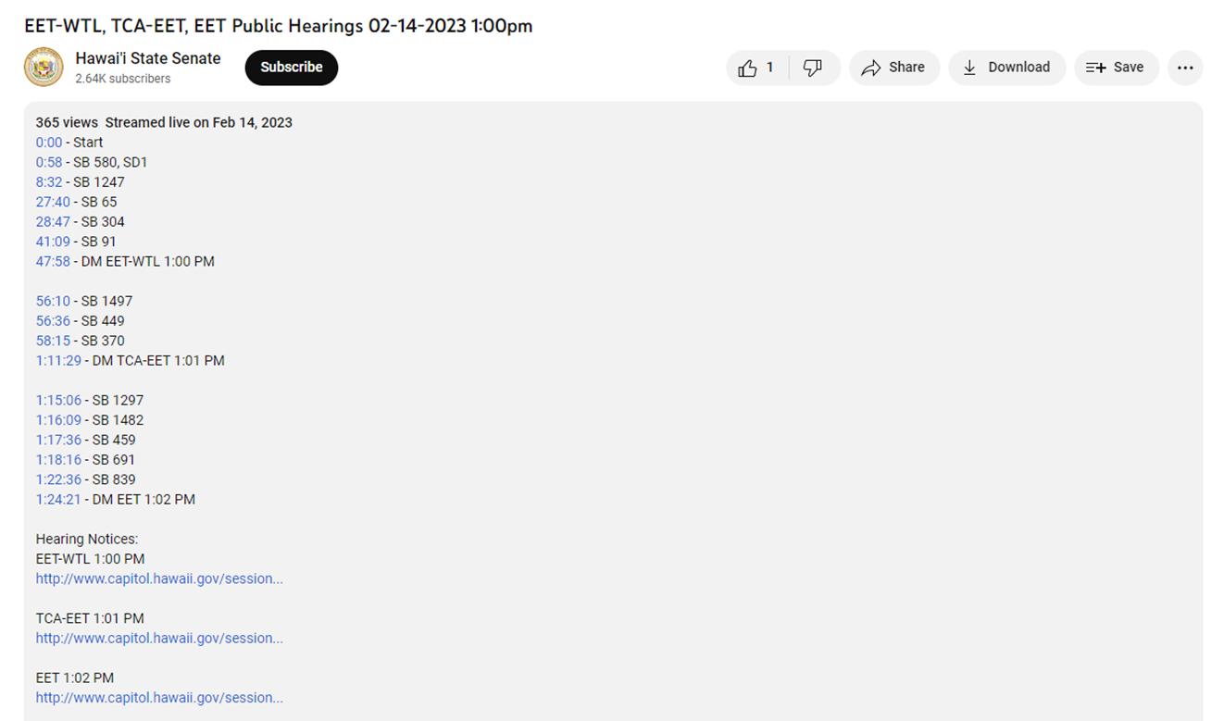
Notes:
For Senate committee videos, they link to start times for discussion on each billon the agenda, which is very helpful.

Slide 36
Sketching out a gameplan
Notes:
Take what you learned and sketch a gameplan to continue your advocacy into the interim and plan for next session.
Set up meetings during the interim with the legislators who sit on relevant committees in order to communicate your ideas to them. Provide them with as much information as possible to help support your position and ask for feedback and advice.
Conduct research on your issue. Look through similar legislation that was introduced in the past. Read through the testimony and find out who supported and opposed the issue.
Map out a tentative timeline showing key “to do” items – and schedule a follow-up review to evaluate how things are progressing.
What new ideas can you bring into the fold?
And remember, use PAR during the interim — the computers, convenient workspace, informational handouts and helpful staff are all here to assist you.

Slide 37
Networking
Notes:
Networking with others will help you better manage and focus your advocacy efforts:
Identify key advocacy groups or individuals who you would like to involve in your efforts
Identify key legislators that can help
Find allies to help divide up the research and outreach tasks.
Use social media to get the word out

Slide 38
WORKING WITH LEGISLATORS
Stay connected
Request a bill
Notes:
Staying connected with your legislators during the interim to shore up support for an issue or discuss any concern is a good idea. Building relationships goes a long way towards helping you become a successful advocate.
If you have an idea for a bill, you can work with your legislators during the interim to get a bill drafted.

Slide 39
Working with Legislators during the interim
Meeting with your legislators
Communicating via email, phone, or letter
Following up
Notes:
Meet with legislators during the interim. They are more available to meet in the interim as they don’t have to deal with the rigors of session. Election years are a bit trickier though as your legislator may not be running for reelection or they want to wait until after the elections to meet with you. Meeting with them in person is a good way to build a relationship. And don’t forget the importance of staff.
Here’s a few tips when meeting with legislators in-person:
Prepare an outline of what you want to talk about. Bring along any supplemental information to help make your case.
Be on time, courteous and positive.
Be clear and factual when discussing your issue or ideas with them
Know what you want and expect
Be ready to answer questions or provide more information if it’s requested. If you don’t know, say so, and agree to follow up
Don’t spend the whole time talking, allow enough time for the legislator to provide feedback
If you were supporting a bill that didn’t make it, you can talk to your legislators and ask for their advice. You can talk to your legislators about anything that the state has influence over, including district issues and policy issues. Here are some tips when communicating with your legislators via email or letter:
Identify yourself as a constituent
Explain why you are writing (concern, problem or opportunity), be specific
Keep your communication short and simple
Be respectful and thank the legislator and their staff. Legislative office hear complaints all the time, let them know they’re appreciated.
If writing a letter write legibly and include your contact information so they can get back to you.
When making a call:
Let the staffer know why you’re calling.
In leaving a message or voicemail, speak slowly and clearly.
Repeat your name and phone number at the end of the call and let them know you’d appreciate a follow-up.
If you want to speak to the Senator or Representative directly, make the ask

Slide 40
Requesting a Bill
Summing Up Your Proposal
When should I approach legislators about my bill idea?
Who to approach?
Following up?
Notes:
Requesting a bill be introduced can be a fundamental part of your advocacy efforts. Your ideas (and the ideas of others) are key in helping to shape state law. While it may seem like a daunting task, it is not as difficult as it may seem. You do not have to be an attorney to get a bill introduced. You just have to have a firm understanding of the problem you are trying to address or opportunity you are trying to create
Summing Up Your Proposal
Before you take your idea to a legislator, there are a couple of things to consider:
What policy are you trying to create or change?
What result(s) do you hope to achieve with your bill?
Does your proposal need to be a law or is it an issue/opportunity that can addressed via a memo to a state agency or achieved via the rulemaking process?
Consider jurisdictional issues: Is this a state, federal, or county issue? If it is not a state issue, consider contacting your congressional delegation or your county council members
Is there legislation from another state that could serve as a model?
When should I talk legislators about my bill idea?
Late May through October is a good time to approach legislators about your bill ideas as things tend to be a bit slower at the Capitol during this time. Getting your proposal in early allows adequate time for a legislator to meet with you to discuss your idea and send your proposal off for drafting. The drafting agencies are busy fulfilling drafting requests in December and early January, so you will want to stay ahead of the rush. While bills can be drafted at any time, they can only be introduced during the bill introduction cutoff period which usually starts on opening day (which is always the 3rd Wednesday in January) and ends a week later.
Who to approach?
Your own Senator or Representative
Chairs/members of committees
Legislators who have supported the issue (or a similar issue) in the past
Following up
If you are working with a legislator on a bill draft, make sure you follow up with them. Work with them on the draft and ask for their commitment to introduce the legislation. Even if they commit to introducing the bill, Thank them during the bill introduction period as a subtle way to remind them of their commitment.

Slide 41
Important Dates
Early October- Departments submit budget requests to DB&F for review
Sometime in December– GIA Applications released
Late December/Early January–Release of 2024 Session Calendar
January 17th – Opening Day 2024 Session
January 24th –Possible bill introduction cutoff
Notes:
Here are some of the dates to be mindful of (outside of the election dates)
Early October- Departments submit budget requests to DB&F for review
Sometime in December– GIA Applications released. Information on GIA’s or Grant-in-Aids are available on the Legislature’s website off the “Legislative Information” tab. Information may also be found on the “Recent Update box on the homepage of the Legislature’s website.
The Session calendar should be released sometime in the latter part of December or early January. As you know, the session calendar will list the deadlines.
January 18th- the most important date to remember as that is the first day of the 2023 session.
Bill introduction cutoff will probably come on or around January 25.

Slide 42
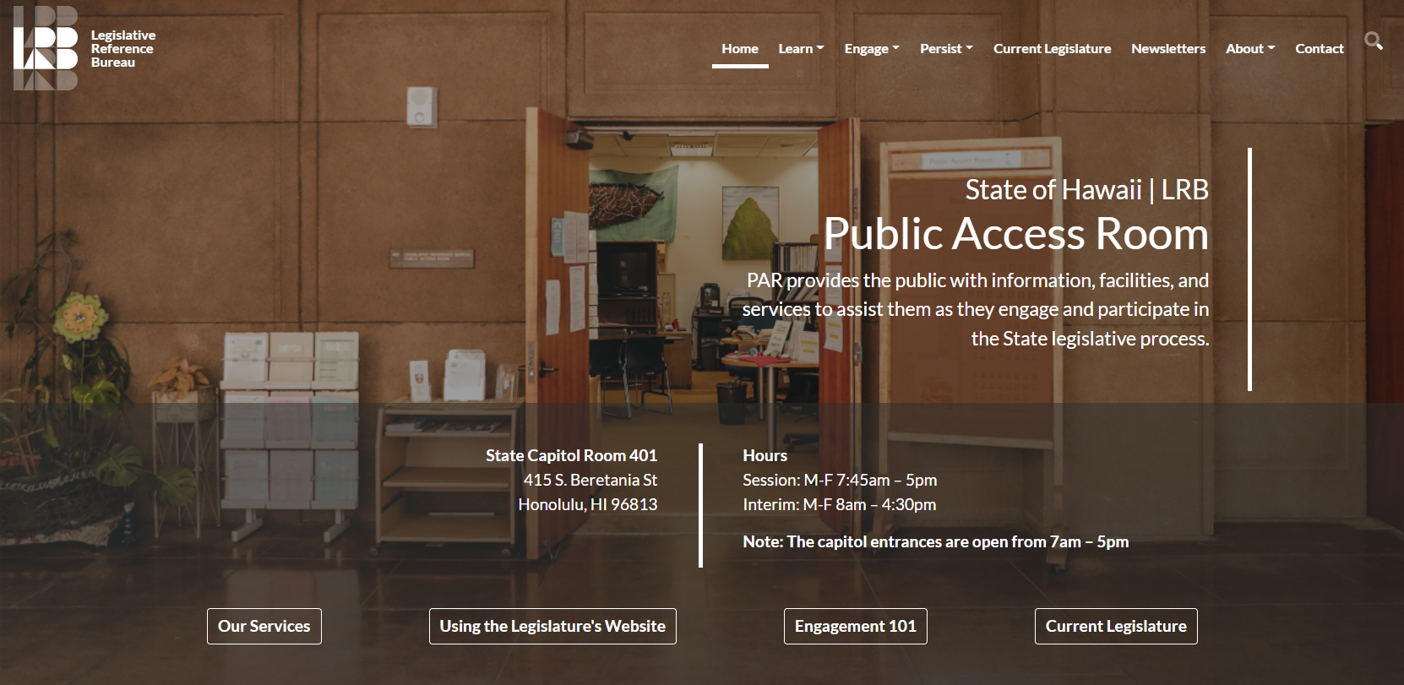
lrb.hawaii.gov/par
Notes:
Our website (lrb.hawaii.gov/par) has a wealth of information. Looking at everything we have available on our website is a good way to spend some of your time during the interim.

Slide 43
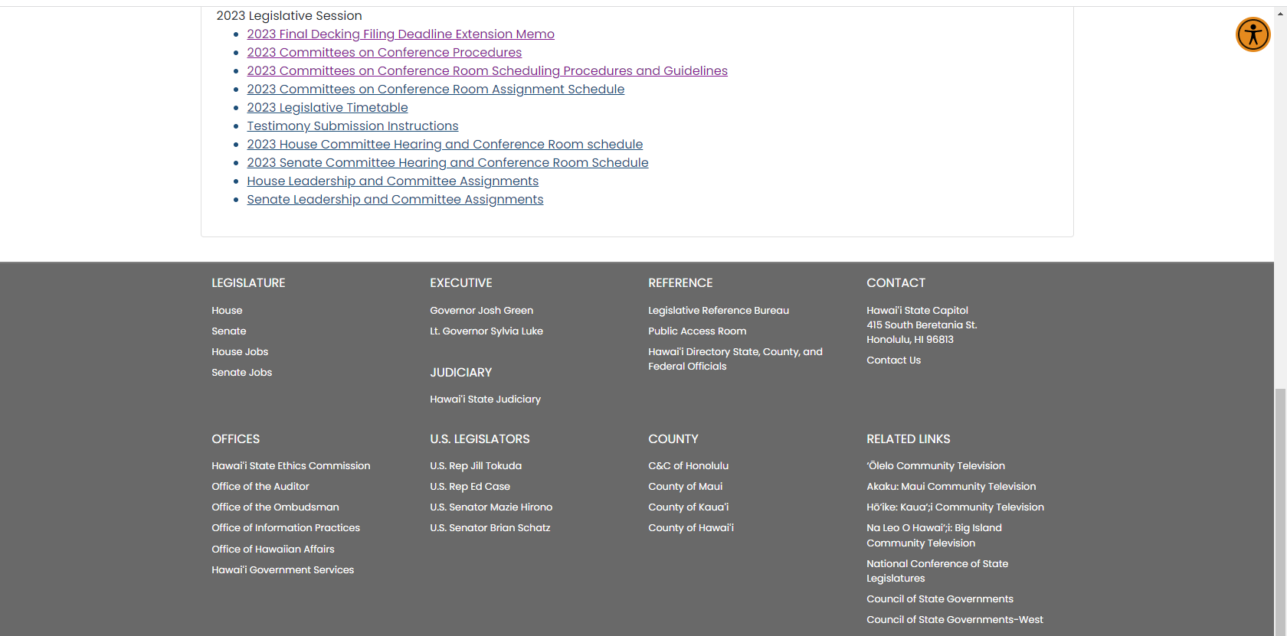
Notes:
You can also get to both the Legislative Reference Bureau’s website and the Public Access Room’s website via the links on the bottom of the home page on the Legislature’s website.

Slide 44
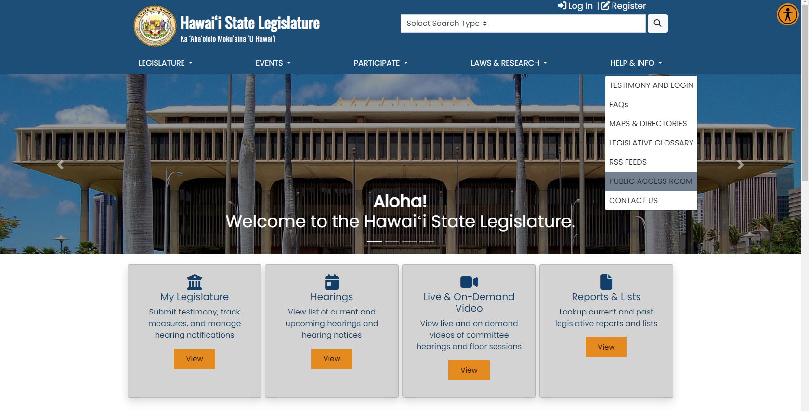
Notes:
And, via the Help & Info menu, just select “Public Access Room.”

Slide 45
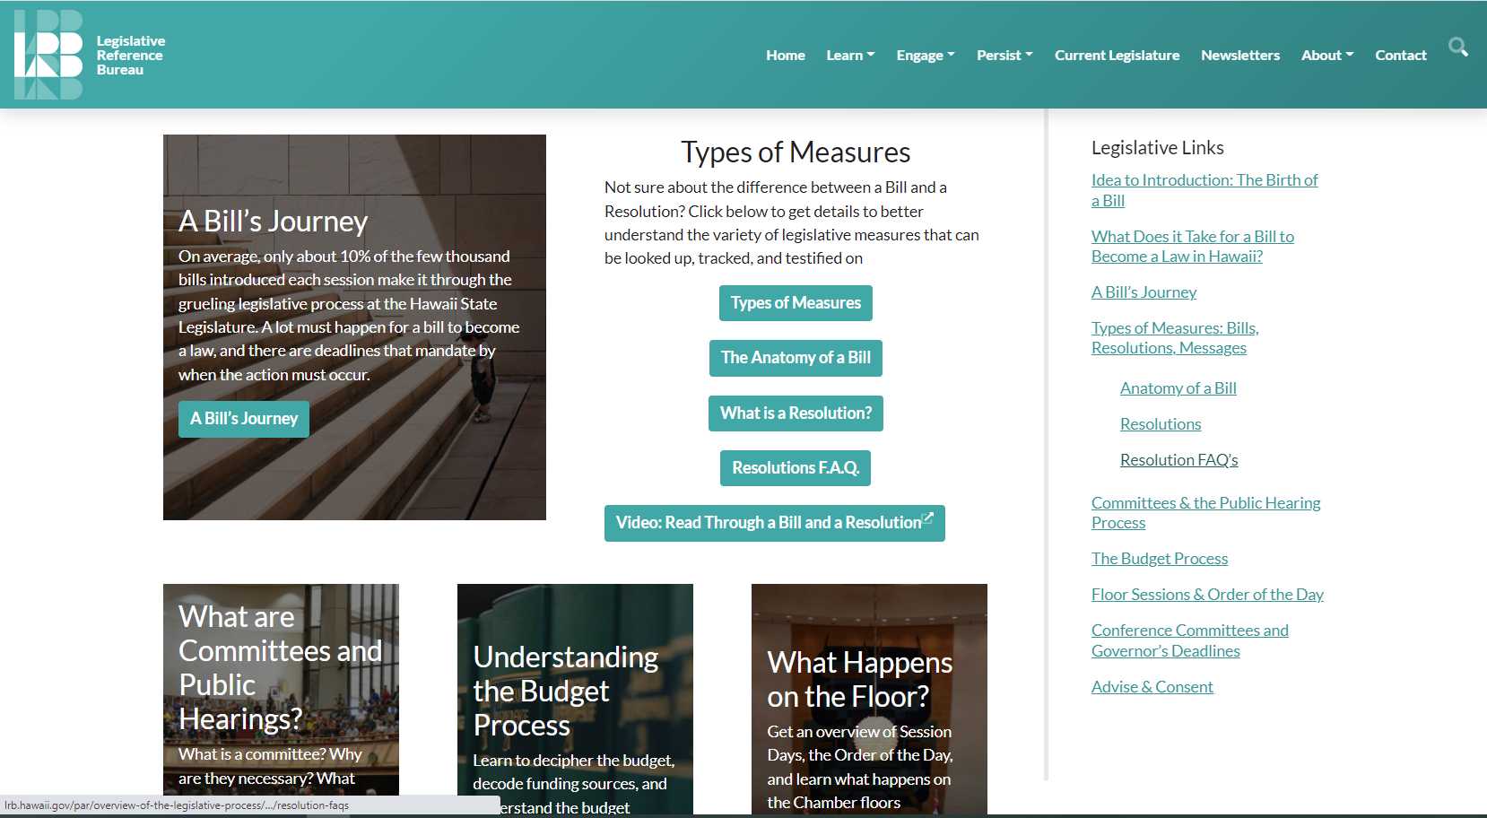
Notes:
Some of the information on the learn tab can be very informative, even for people who have experience with the legislative process. And it provides a good foundation for people who are not familiar with the process.

Slide 46
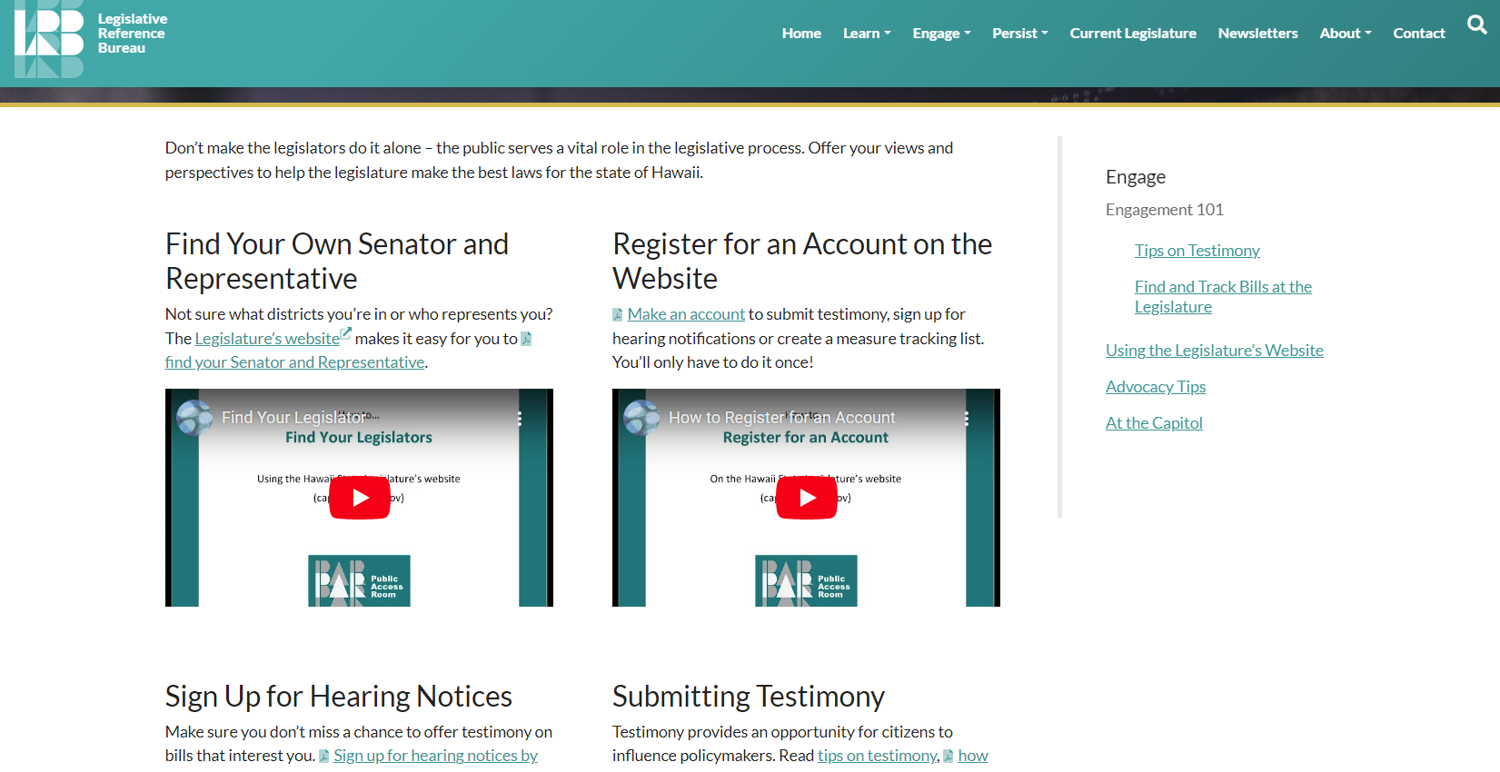
Notes:
The “Engagement 101” page walks people through the interactive features of the legislature’s website. This page can be especially helpful for new users.

Slide 47
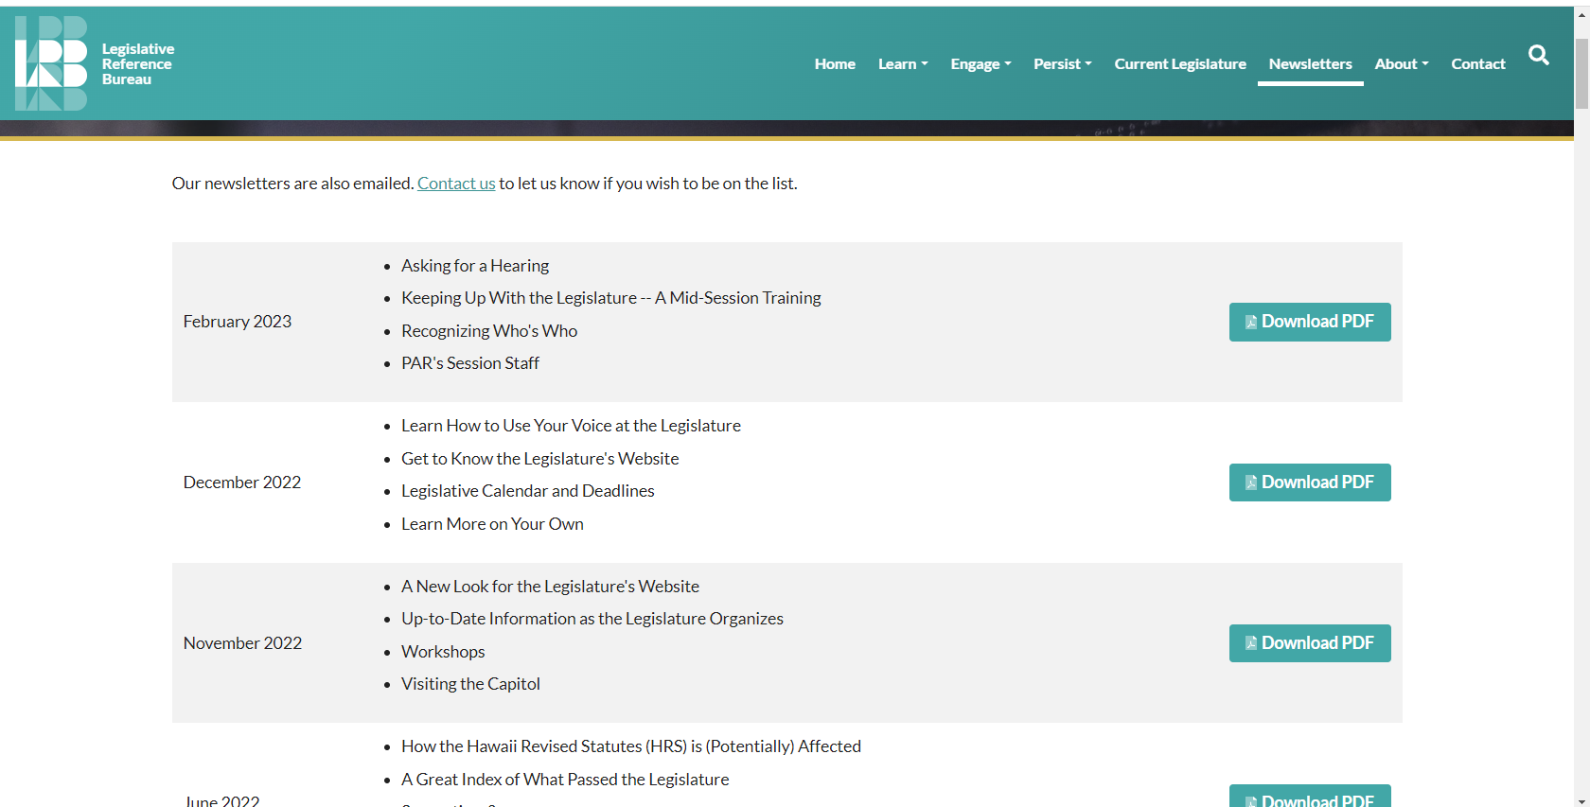
Notes:
Our “Newsletters” page is also extremely useful. We discuss a lot of different things, and it’s information that can be time-applicable.

Slide 48
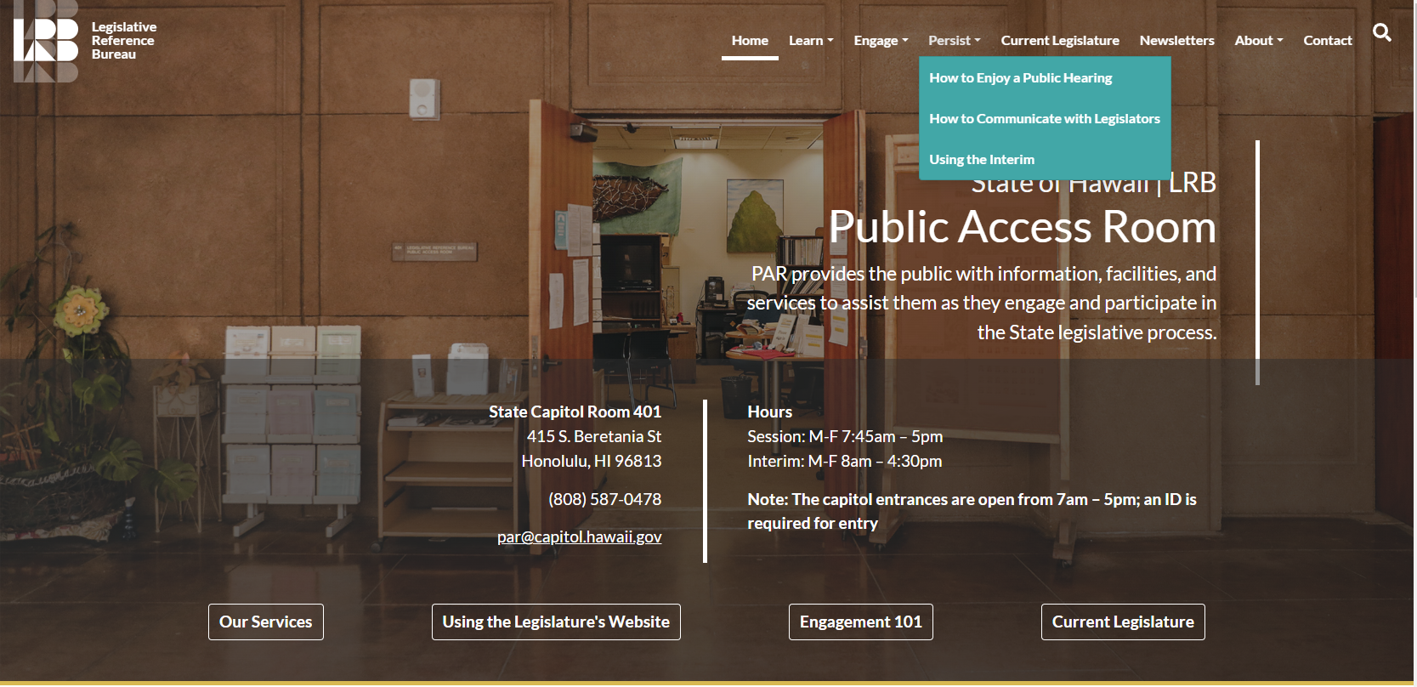
Notes:
The persist page on our website has some helpful information on Interim prep.

Slide 49
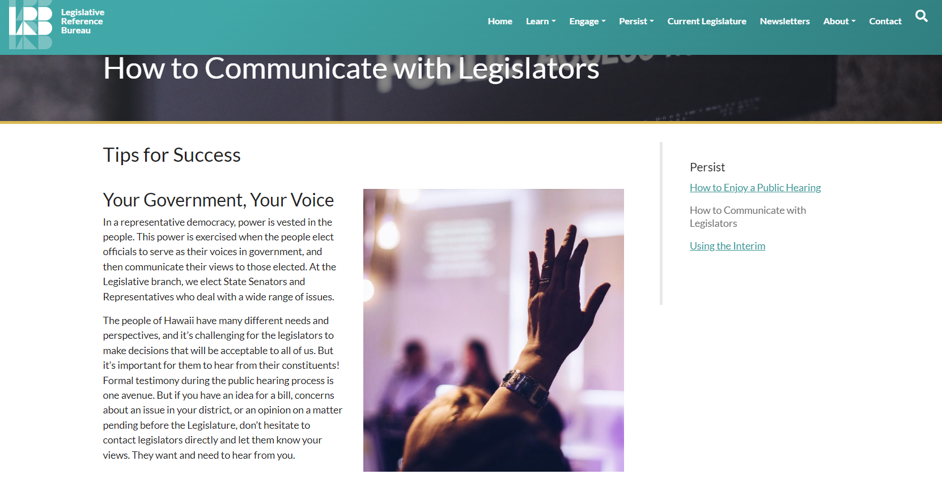
Notes:
And tips on communicating with legislators. The trick is do figure out what works best for the legislators you want to talk to.

Slide 50
Notes:
The Legislative Reference Bureau Library is a good resource for conducting research. They also have a friendly staff. You can get to their website off the main LRB website- lrb.hawaii.gov, clicking on the “Divisions” heading, then selecting “Library” from the dropdown menu. This will take you to the LRB library’s website:

Slide 51
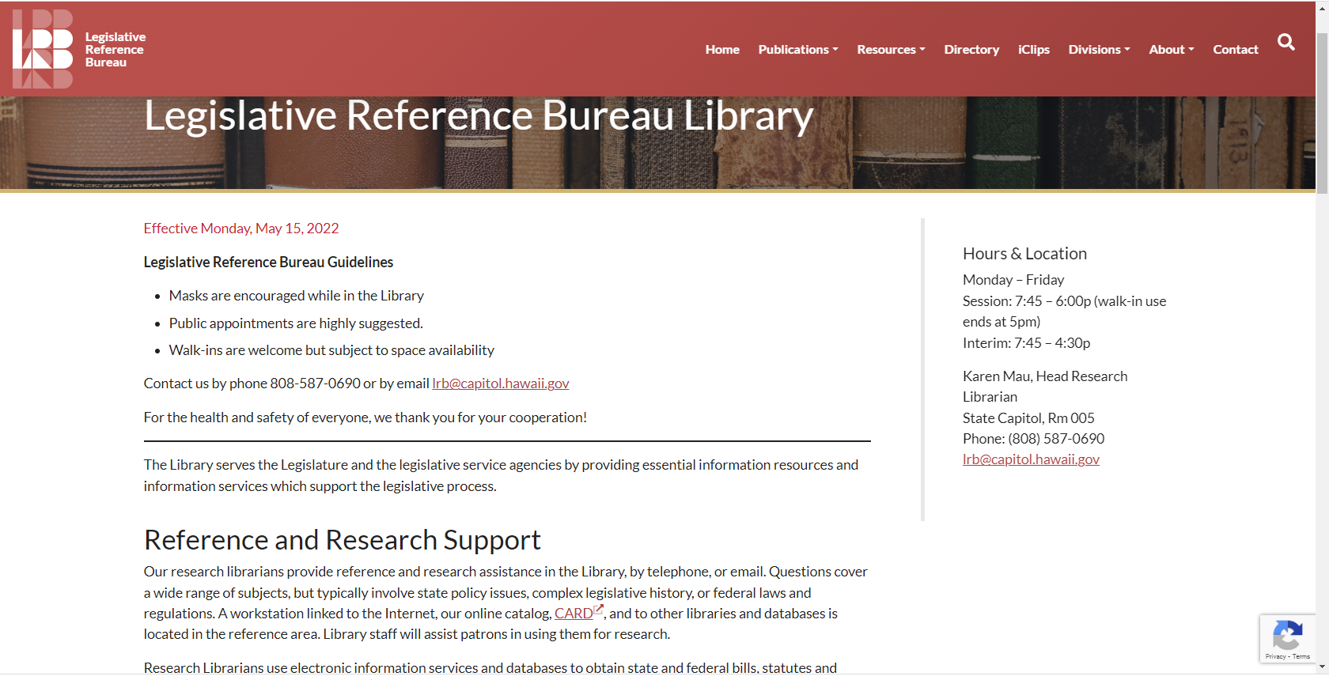
Notes:
Their contact is listed on the right side.

Slide 52
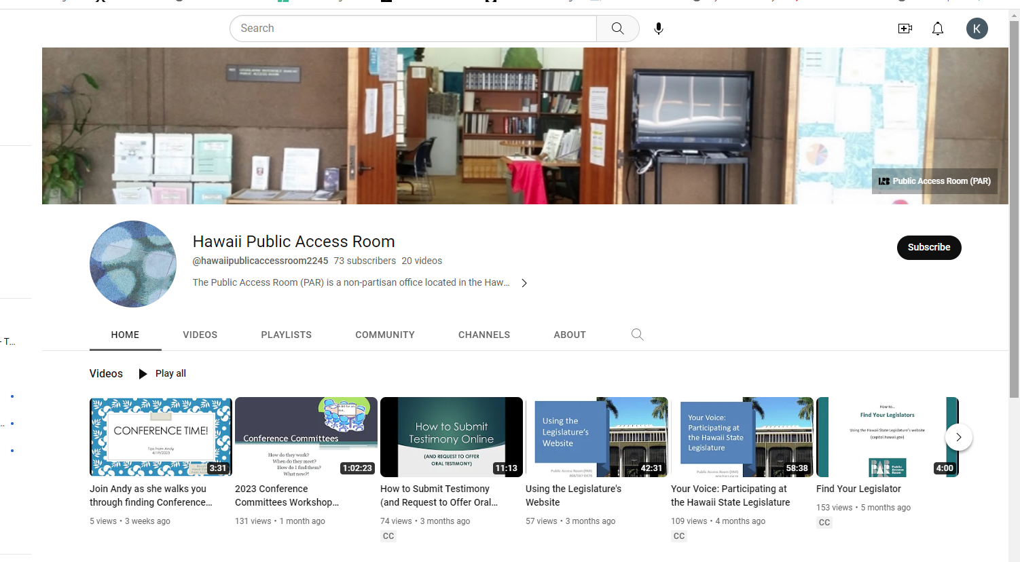
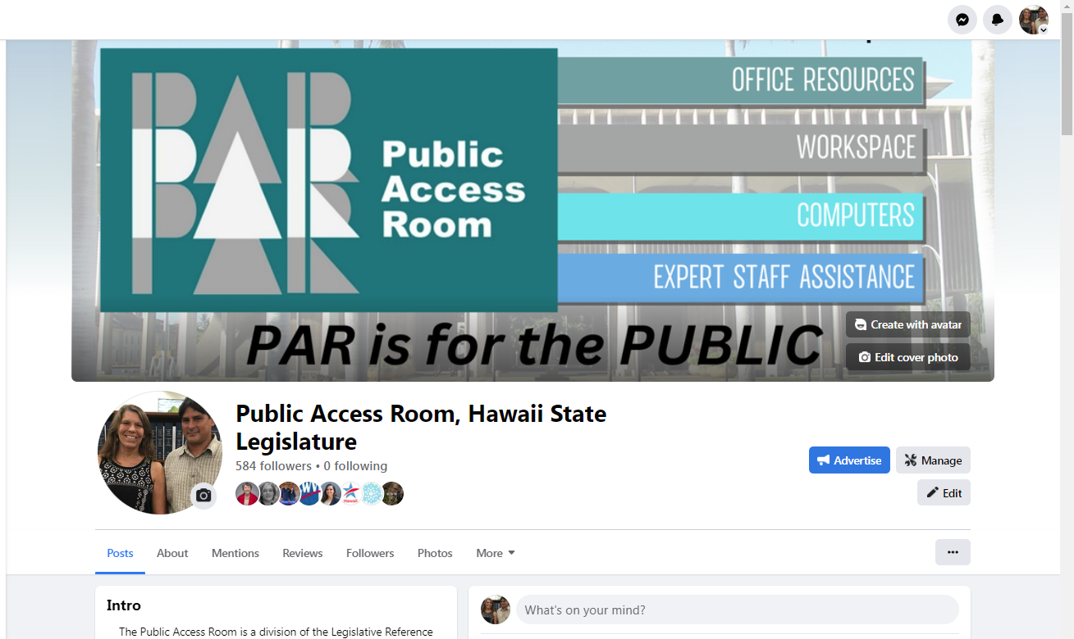
Hawaii Public Access Room
@PublicAccessRoom
@Hawaii_PAR
https://lrb.hawaii.gov/par
Notes:
Aside from our website, we also have a YouTube channel where we archive many of our past presentations. We also have a Facebook page and a Twitter account.
Contact us with any questions, or if you’d like more information.
Public Access Room (PAR)
(808) 587-0478
room 401
par@capitol.hawaii.gov
Facebook @PublicAccessRoom
Twitter @ Hawaii_PAR
Website https://lrb.hawaii.gov/par

Slide 53
Interim Hours
Monday- Friday
8:00 a.m. - 4:30 p.m.
Public Access Room (PAR)
A Division of the Legislative Reference Bureau (LRB)
State Capitol, Room 401
415 S. Beretania St.
Honolulu, HI 96813
Phone: 808/587-0478
TTY: 808/587-0749
Email: par@capitol.hawaii.gov
Website: lrb.hawaii.gov/par/
Notes:
Here’s our contact information. Please use us as a resource in the interim. Our interim hours are 8:00 a.m. to 4:30 p.m. This concludes the slide portion of the presentation. I’ll be happy to answer any questions that any of you may have.

