Slide 1

Your Voice: Participating at the Hawaii State Legislature
Public Access Room (PAR)
808/587-0478 par@capitol.hawaii.gov
lrb.hawaii.gov/par
Notes:
Your Voice: Participating at the Hawaii State Legislature. Presented by the Public Access Room (PAR), 808/587-0478, par@capitol.hawaii.gov. Our website is lrb.hawaii.gov/par.

Slide 2



Public Access Room
Your Office
at the
State Capitol
4th Floor, Room 401
808/587-0478
par@capitol.hawaii.gov
Notes:
Our physical office – the public’s office – is in Room 401 of the State Capitol building (at 415 South Beretania Street, Honolulu, Hawaii 96813) at the corner of Beretania and Punchbowl streets.
When there are no COVID-19 concerns, we fan out across the islands to offer workshops like this one. Now, we offer the workshops virtually.
(By the way, the Hawaii State Capitol is a beautiful building with a lot of symbolism built into its open architecture. Check out the virtual tour that’s available on the governor’s website: https://histategis.maps.arcgis.com/apps/MapJournal/index.html?appid=25a003ed53c5404eadddbab1561745b1 )

Slide 3

Add Your Voice
Talk with legislators
Suggest a bill
Ask for a hearing
Testify
Lobby the chamber
Contact the governor
Keep at it!
Notes:
So, there’s a lot you can do at the legislature, and this is what we’re going to cover. First off, simply communicate with the people in office. Let them know your views and priorities. You can also suggest a bill to change a law. When you see the bills being discussed, you can ask for a hearing for ones you’d like to see move forward. If bills you’re concerned about do come up for a hearing, you can offer your written and oral testimony. Sometimes, you may want to lobby the entire chamber or legislature – they all need to vote on legislation. Finally, you may want to contact the governor. And most importantly, keep at it! It can take some time to see change at the capitol.

Slide 4


Hawaii Government
3 equal branches
Legislative
Makes laws
Executive
(Governor & Departments)
Implements laws
Judicial
(Courts)
Interprets laws
Notes:
Let’s start with the big picture. Our democracy is set up with a balance of power – three different, equal branches of government that help to keep one another in check. Roughly speaking, the Legislative branch makes the laws, the Executive branch implements those laws, and the Judiciary branch interprets the law.
In this workshop, we’ll be focused on the Legislative branch, the branch of government concerned with making the laws.

Slide 5

NATIONAL
STATE
COUNTY
Notes:
We’re going to be examining just one level of the legislative branch – the State legislature, which makes the laws that govern the state of Hawaii.
There are other levels – at the broadest level, there’s the U.S. Congress that convenes in Washington D.C. – they’re concerned with passing laws that govern the whole country. Laws they pass apply to you whether you’re in Iowa, California or Hawaii. This is the level where you’ll find Hawaii’s U.S. Senators Hirono and Schatz, and our U.S. Representatives Case and Tokuda.
The County level is where you’ll find the Councils – the City Council for the City and County of Honolulu, and the County Councils for Kauai, Maui, and Hawaii Island’s counties. Ordinances that are passed at this level relate only to that specific county.

Slide 6

Hawaii State Legislature = two chambers
Senate | House of Representatives
State Senators (25) | State Representatives (51)
4-year terms | 2-year terms
Notes:
The Hawaii State legislature is made up of two different chambers (this is called a “bicameral” legislature) – the Senate is the group of 25 senators serving 4-year terms, and the House of Representatives is the group of 51 representatives elected to 2-year terms.
Roughly speaking, a senator’s district is roughly twice as large as a representative’s district.
We can use the term “legislator” to refer to either a senator or a representative.
In this presentation, we’ll be focusing on how the chambers work to make the laws that govern the state, and both chambers operate in roughly the same way. But be aware that they actually each have special powers and responsibilities (for example, the Senate has the ‘advise and consent’ power over Governor’s appointment of department directors).

Slide 7
What do these lawmakers do?
SERVE
  as their constituents’ voice, vote on legislation
SERVE
on committees focused on particular subject matter
SERVE
in leadership roles
Notes:
First off, we’re a representative democracy, and the legislators actually “speak” for you. Each address in the state is represented by one member of the House of Representatives and one member of the Senate. They serve as the voting districts’ ‘voice’ at the legislature as they consider legislation and may also be able to help constituents with a variety of issues.
Secondly, in order to make the whole complicated process a little more manageable, the House and Senate each organize themselves into various committees that focus on legislation in particular subject areas. As you’ll see, the chairs of these committees have quite a bit of power. Who decides who is on which committee and who gets to be each committee’s chair?
That would be leadership. Each chamber elects who will be their leader (the President in the Senate, the Speaker in the House, the Vice President or Vice Speaker, the Majority Leader, and Majority Floor Leader). The reason leadership is so important? Power. They influence a great deal, as you’ll see in the slides ahead.
FYI -- When we use the term “Majority” it refers to the political party that has the most members in the chamber – in Hawaii currently, for both chambers that would be the members of the Democratic Party. The “Minority” party (here, the Republican members) also elect one another to leadership positions, to better coordinate the actions of their members.

Slide 8
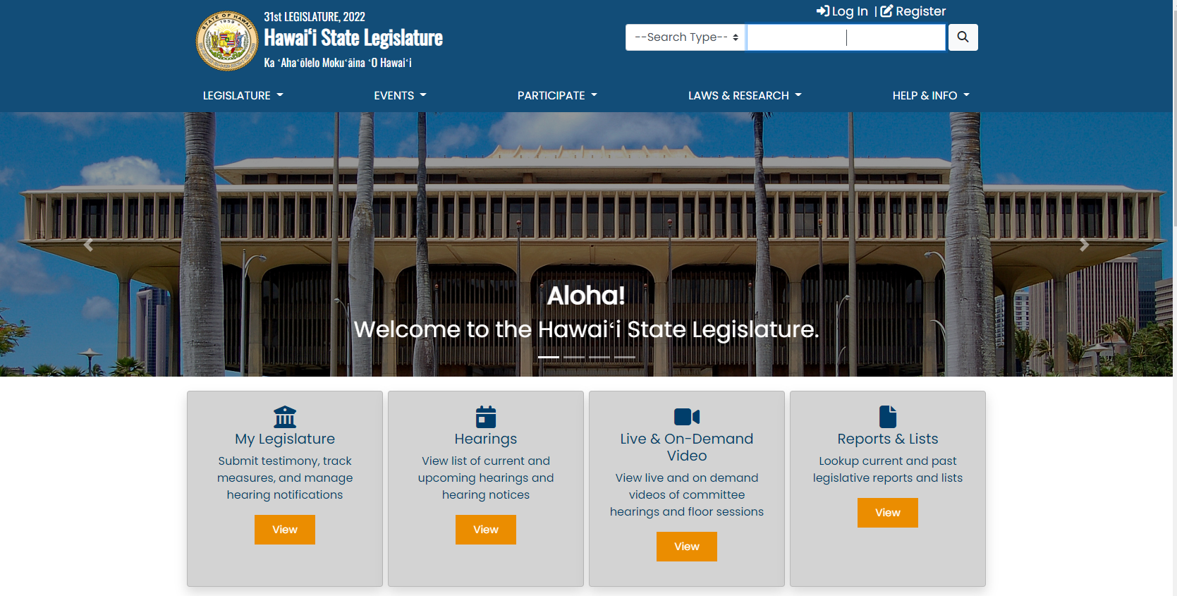
Find Who Represents You
capitol.hawaii.gov
Notes:
To find out who your own representative and senator are, it’s as simple as going to the legislature’s website, capitol.hawaii.gov .

Slide 9
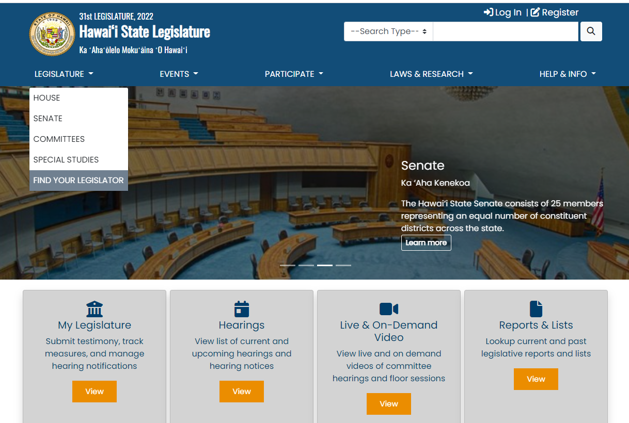
Notes:
From the capitol homepage, click on the ”Legislature” tab. Then select “Find your legislator” from the drop-down menu.

Slide 10
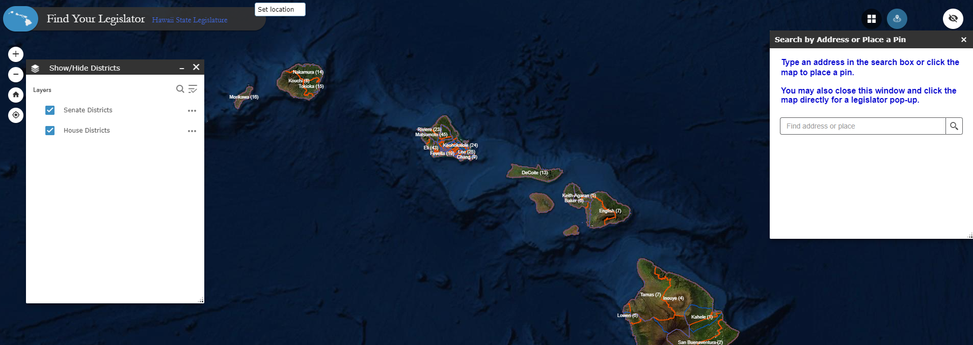
Notes:
You’ll come to this screen where you can type in your address or navigate on the map to a particular location

Slide 11
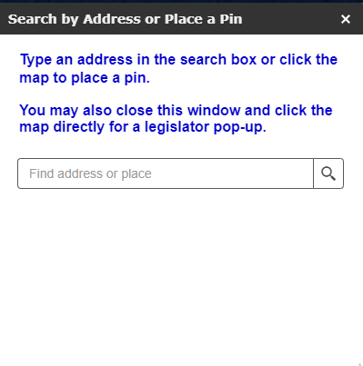
Notes:
Let’s put in an address

Slide 12
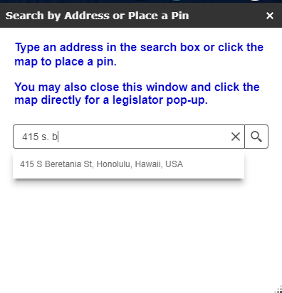
Notes:
We’ll pretend we live at the state capitol, 415 S. Beretania Street

Slide 13
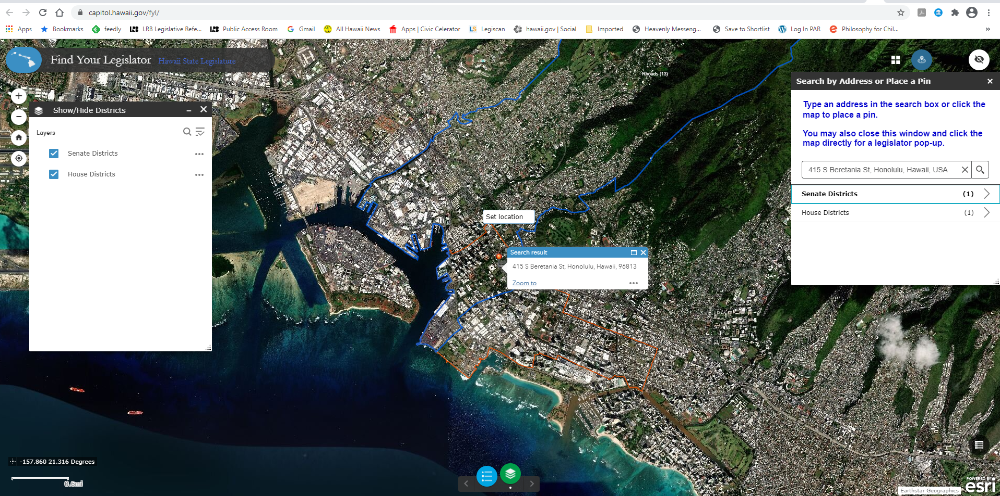
Notes:
As soon as we put in the address, the map locates the address and shows us the boundaries of the House and Senate districts it falls in. To see who our elected officials are, just click on “Senate Districts” or “House Districts” in the box on the right. We’ll choose to find our senator…

Slide 14
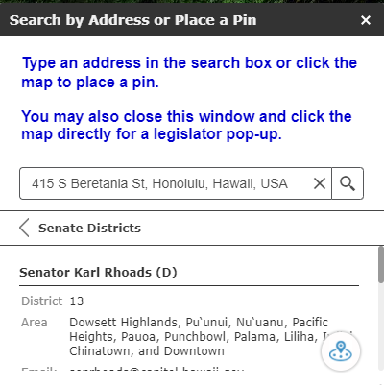
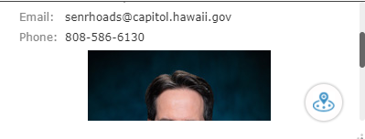
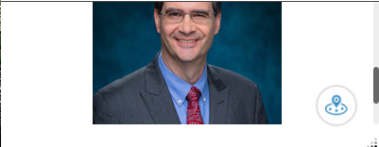
Notes:
When we click on Senate Districts, we find that our senator would be Sen. Karl Rhoads, and are provided with his contact information and even a photo.

Slide 15

capitol.hawaii.gov
Notes:
The legislature’s website, capitol.hawaii.gov, is a portal to all sorts of helpful information. It’s also where you’d go to signup for hearing notices and submit testimony.

Slide 16
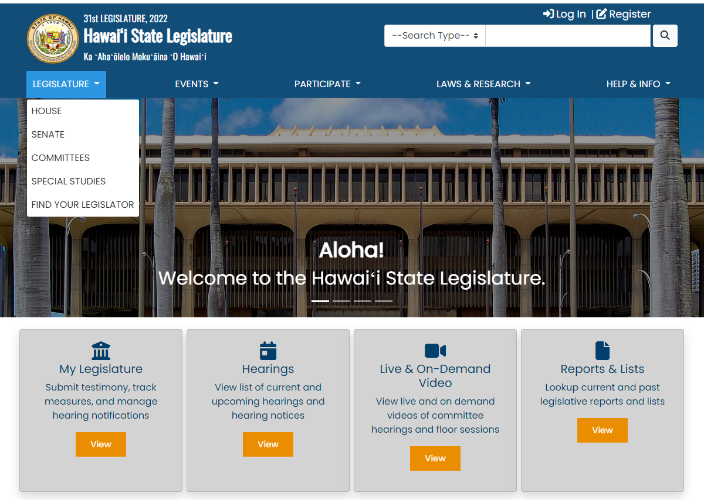
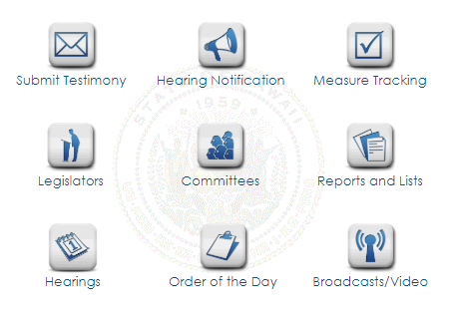
LEGISLATURE
Notes:
To view the legislators, click on the “Legislature” tab and select either House to view all the Representatives, or Senate to view all the Senators.

Slide 17
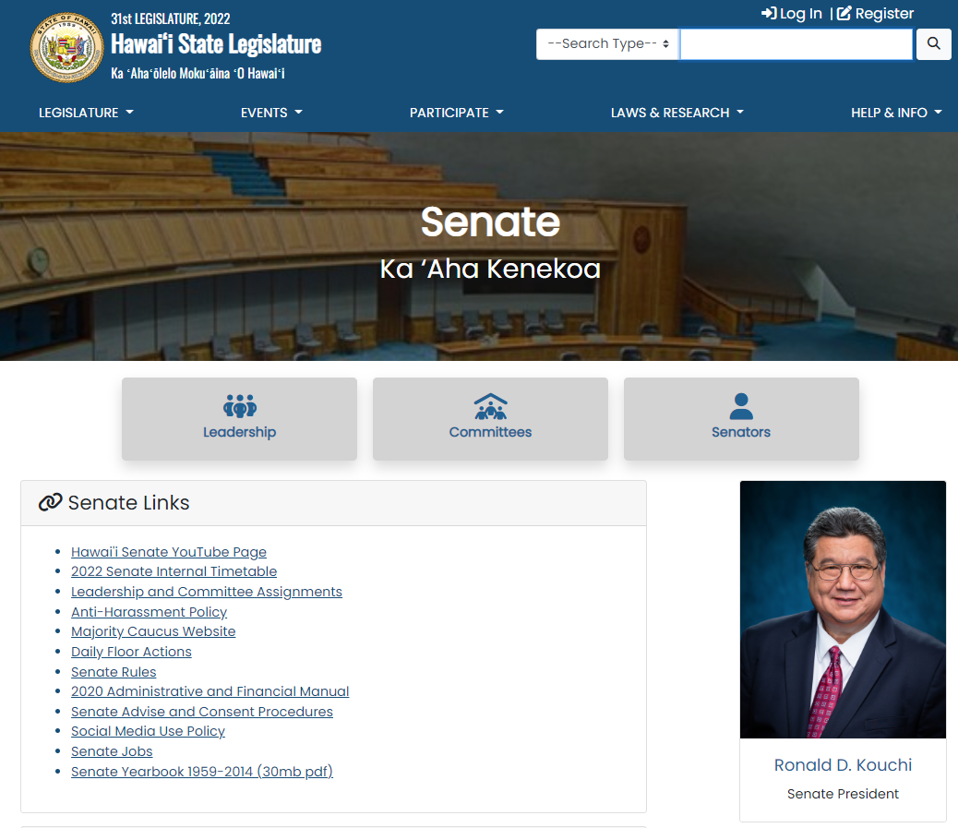
Notes:
From this page, you can view the chamber’s leadership information, the committees, or all members by clicking on the button you want to view.

Slide 18
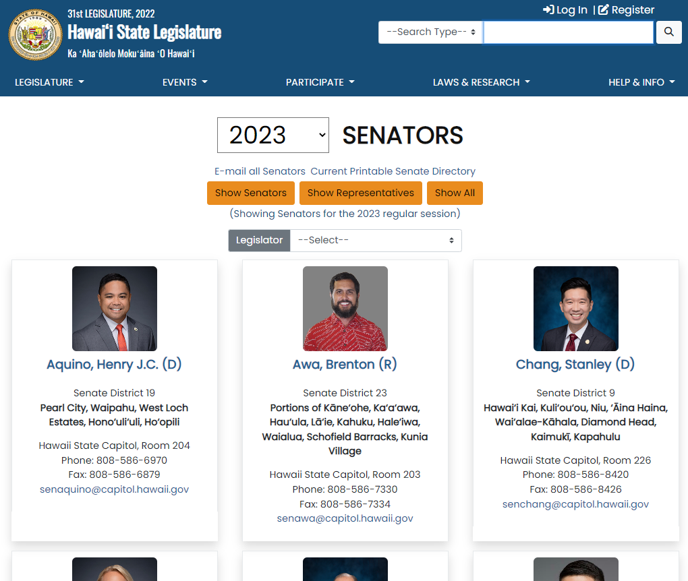
Notes:
Here’s the page we get when we select “Senators.” We can click on their name to get to their own web page.

Slide 19
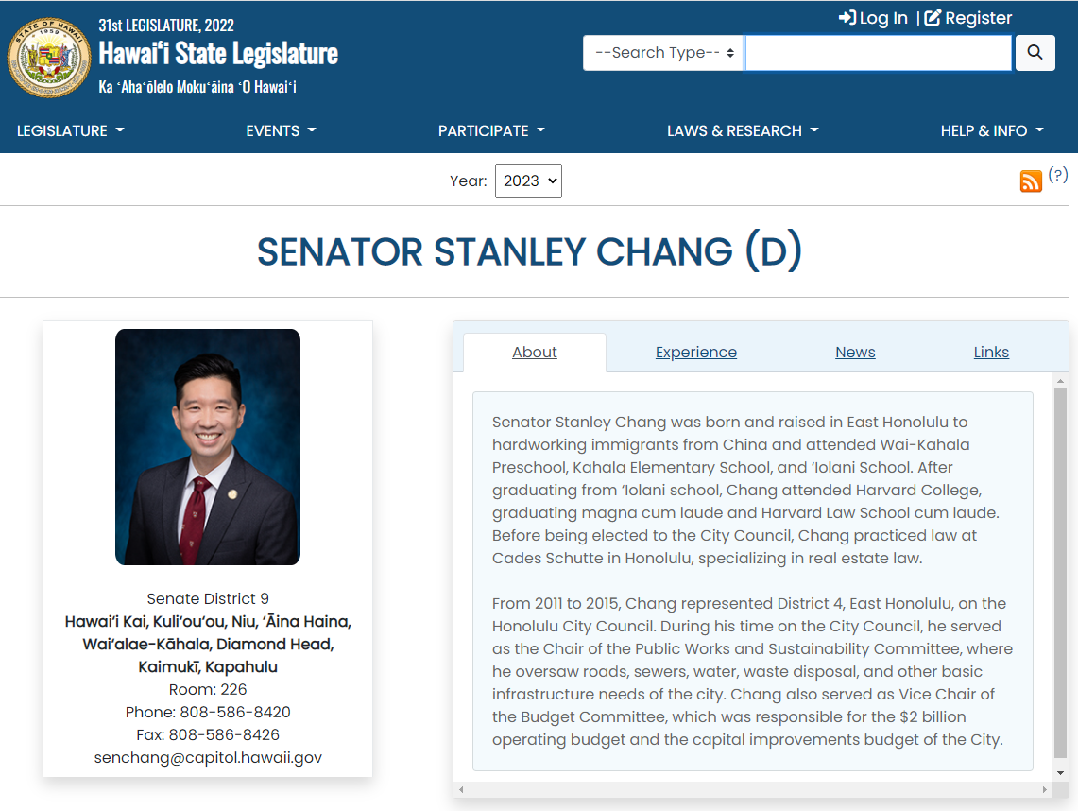
Notes:
And find information about them, their experience, and other helpful information.

Slide 20
Don’t forget the most important participants in State legislative government…
Notes:
Before we go any further, we want to remind you that for this whole system to work, it needs participation by…

Slide 21






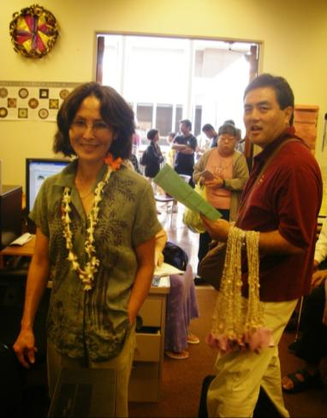
People like you!
Notes:
YOU!
Without the public, it just doesn’t work.

Slide 22

What can you do?
Vote!
  State Senator (every 4 years)
  State Representative (every 2 years)
  Proposed Amendments to the Hawaii State Constitution
Run for office (or help someone else)
Communicate with legislators
Offer testimony
Join with others
Notes:
Here’s a reminder of some of the things that we as everyday citizens can do to be part of our own governance.
We vote the senators and representatives into office – senators serve 4-year terms, representatives are elected to 2-year terms. We also vote on proposed changes to the Constitution.
You can run for office or help someone else to do that – you don’t need to be a political science major or a lawyer. People with all sorts of experience and backgrounds serve in these positions. Also, we have what is called a part-time legislature (in session from January to May), and many members keep their positions outside of the capitol while they serve. Of course, things get very busy during session, so you’d need to plan on that!
You can also communicate with the people that are in office, letting them know your priorities, views, and concerns. In PAR, we concentrate on helping you with that, as well as offering testimony and reminding you to join with others to amplify your voice. We’ll get into all this as we move forward.

Slide 23
Your Voice
Communicate with
Your Legislators
Appropriate any time!
Notes:
We’ve already mentioned voting – which is an important way of expressing your voice – but how about communicating with the people who were elected to represent you? Let them know what you think they should focus on – environmental policy, education issues, transportation infrastructure, housing, tourism, public safety issues – what seems particularly pressing to you? What would help or affect you and your family, neighbors, and colleagues? Are there particular issues in your neighborhood that concern you?
It’s always appropriate to communicate with your own representative and senator about such matters – you don’t have to wait for them to be in legislative session – their offices are open year-round.

Slide 24
COMMUNICATE YOUR POSITION
Time for a Letter…
Email…
Phone call…
- “But they won’t listen to me!”
- “Have you contacted your senator and
representative to let them know what you
think?”
Notes:
Legislators like to hear from their constituents. And even though they may not do what you’d like them to do, they really do listen! Give them a chance – let them know what you think.
Is it better to write or call? Either one – just do it! Writing provides a written record, while calling allows for a dialogue.
By the way, if you want to hear back from them, let them know. “I’d appreciate a call back.” or “I look forward to hearing from you.”

Slide 25

Keep
It
Short and
Simple
Notes:
Think through what it is you want to say… Are you asking the legislator to take a particular action? Is there a situation that is a cause for concern? Do you want the legislator to hear your views and respond with his or her own?
Short and simple is usually a great place to start. If it’s a complicated situation, offer an overview and a willingness to provide additional details. Help the legislator or staff member understand what you are asking for – make your request clear.

Slide 26
PAR
can help
you!
Psst… tell your friends!
Notes:
PAR can help you as you engage with the legislature and the legislative process. Unsure if you should contact your legislator? Call us, and we’ll help you focus. And we’re one of the best kept secrets in the state – tell your friends!

Slide 27

When does all the
lawmaking happen?
Notes:
Now, how about this matter of making laws. When does all that happen? When does the legislature meet to discuss what laws should be passed?

Slide 28

Regular Session starts on
the 3rd Wednesday in January…
Session starts mid-January
Jan
+
Ends late April or early May
Oct
Apr
Interim
Jul
Notes:
As mentioned, in Hawaii we have what is called a “part-time legislature.” About 2/3 of the calendar year is the ‘interim’ period between regular legislative sessions. But that doesn’t mean they’re not busy being your legislators year-round.
It’s crucial to use this time between sessions well, so you’ll be ready for the fast-moving session when it starts (which is always on the 3rd Wednesday in January). About 3,000 bills are introduced each year, in roughly one week…you can imagine the frenzy!
Each of the wedges in this illustration signifies a major deadline – and is intended to show you just how fast things move during session.

Slide 29


The Legislative Calendar
Usually in late December or early January
Notes:
The legislative calendar with the specific dates that will rule our lives during session is published prior to the beginning of a session – and usually not much before-hand.
The calendar is established by the Senate President and the House Speaker, working together.
By the way, the Public Access Room takes that calendar and creates an annotated version that’s color coded and has helpful definitions so you can sort out what the deadlines mean. You can find the most recent version on PAR’s website (click on the “Current Legislature” tab).

Slide 30

Public shares ideas
for new laws
-- well before the start of session!
Legislators also hear from lobbyists, interest groups, and other legislators
Notes:
Another way to use your voice is to share an idea for a new law with a legislator. The legislator can take your idea, have it drafted into a bill, and if the bill is successful, it will become an act of law. You need to know it’s a tough road – over 90% of bills introduced each year don’t become law. But if you’ve got a good idea and the time is ripe…!
NOTE: If you would like a legislator to introduce a bill on your behalf, you’ll be wise to make the request during the interim months. It’s usually easier to meet with legislators then and gives you a chance to discuss the matter when there is enough time to talk it over in an unhurried and thorough way. Most likely, if you wait until January…(sorry)…you’re likely to be too late.

Slide 31
Summarize the problem
(or the opportunity)
This law would make ___ mandatory…
It is needed because…
Other states that have instituted similar laws include…
Website with data on this subject: …
Notes:
Start fleshing out your idea…
First, identify the problem or opportunity. (It sounds simple, but sometimes this one takes a little work). See if you can summarize it into a short paragraph (just a few sentences).
Then list what you think a law would do.
If you’ve got research, know of a group that’s behind the idea, or a state that has enacted similar legislation, you can let the legislator know that, too.
It helps to think this through prior to speaking with a legislator…

Slide 32
To get a bill introduced, must find a legislator
Start with:
Your own
Subject matter committee chair
Members who have supported similar issues
Notes:
In Hawaii, all bills must be introduced by a legislator. Other states may have different procedures, but that’s the way it is in Hawaii. So, the next step is to find a legislator who likes the idea and who agrees to introduce the bill on your behalf.
If you’ve done your research as to why this bill is a good idea, you’ll be much more likely to get a legislator’s agreement to introduce your bill. The PAR staff can help point you in the right direction in finding someone to approach.
It’s often a good idea to start with the senator and/or representative serving your district. That’s good protocol but isn’t an absolute rule at all.
You could also go to the members of the subject matter committee to which your potential bill would probably first be referred – the Senate and/or House transportation committee for a transportation idea, for instance.
Or perhaps we know or can help you find out who’s supported similar legislation or issues in the past. That might be a good legislator to approach.
[The legislator may also ask a colleague in the other chamber to introduce an identical bill (called a “companion bill”), just to help the idea’s chances of moving ahead. While introduced with identical language, the bills can quickly change from one another and live or die on their own.]

Slide 33
This year, Regular Session started on January 18, 2023.
Jan
Session starts mid-January
+
Ends late April or early May
Oct
Apr
Interim
Jul
Notes:
The bill can only be formally introduced (start its way through the pipeline) when the legislature is in session (though of course it is written – “drafted” – in advance).
The legislature always starts its Regular Session on the 3rd Wednesday in January – this year, that will be January 18, 2023.

Slide 34



Opening Day
party!
Notes:
But the first thing we do is have a party! And we want to make sure you know that you’re invited to our Opening Day party on the third Wednesday in January. Mark your calendars!
Usually, but not always, Opening Days are quite festive – there are floor speeches and entertainment in the chambers; legislators greeting people at their offices and offering pupus; and PAR’s annual party, a potluck with our “almost famous” punch!
Unfortunately, with the COVID-19 pandemic, this all changed. We’re hoping things get back to normal before the 2023 session opens!

Slide 35



Here’s a brief glimpse of what’s to come in a bill’s life…
Pass through all committees it’s referred to
and
Pass three “readings” on floor of each chamber
and
Agree on exact wording
and
Be signed or allowed to come into law by Governor, or Legislature overrides veto
Notes:
The bill has a lot of hoops to jump through to become law:
Survive all the committees it’s referred to. It’s during the committee process that the bill is “heard” (that’s why we show the disembodied ear here) – public hearings or decision makings are scheduled so that the public can have their voice heard regarding whether the legislation is a good idea. The number of committees a bill needs to go through in each chamber varies. As we’ll see, it may be amended as it moves along.
Pass 3 readings (votes) in each chamber by the full House (51 members) and the full Senate (25 members). This is a constitutional requirement for a bill to become law. The readings take place before, during, and after the bill makes it way through the committees.
Both chambers must agree on the exact language of the final version.
Be signed into law by the Governor, or become law without his signature, or if the bill is vetoed, have his veto overridden by 2/3 of the House and 2/3 of the Senate (or amend the bill to meet the governor’s objections).
It’s a high bar for a bill to become a law!

Slide 36
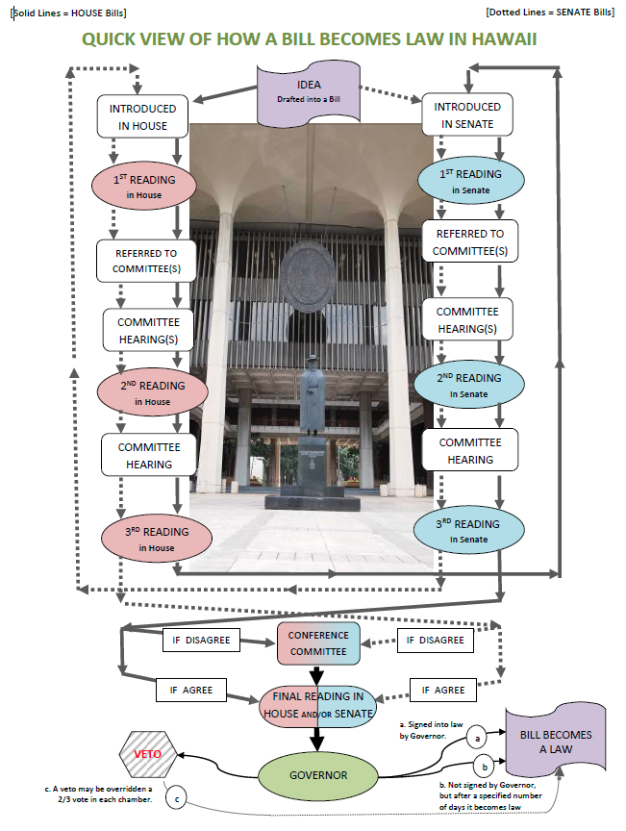
This is what the legislative process in Hawaii looks like…
Notes:
This is what the legislative process in Hawaii looks like… Goes through three readings while it makes its way through committees, crosses over to the other chamber and goes through the same process, and then make sure both chambers agree on the final wording of the bill that will go off to the governor. The governor can then sign the bill, veto it, or allow it to become law without signature. (If he vetoes it, the legislature does have a mechanism so they can override the veto and still have the bill become law.)

Slide 37


DEADLINES
Notes:
And it must do all of that by certain deadlines! Which is why that session calendar is so important. Over 90% of bills die – they don’t pass one of the deadlines… They’re called “dead”-lines because they’re designed to “kill” bills and narrow down the field of legislation being discussed.

Slide 38


Bill introduction
Bills are introduced in a one-week period at the start of session
Notes:
Approximately 2,500-3,000 bills are introduced each year (Senate and House combined). There is a narrow window when bills can be introduced, beginning with the first day of session and usually lasting about a week.
In our state, only legislators can introduce bills. So, if you have an idea that you think would make a good law, make sure to let your legislators know. They can send your idea to a drafting agency at the Capitol where researchers can take your idea and put it into bill form. If your bill is drafted and a legislator introduces it, it has a chance to become law.

Slide 39

The legislator will have the idea drafted into a BILL that will be INTRODUCED at the start of Regular Session.
1 SECTION 1. The legislature finds that an increase in bicycling among the
2 state’s population would help to decrease the number of cars on our roads,
3 improve air and water quality, and encourage a healthier lifestyle among large
4 portions of Hawaii’s population. Ownership of a bicycle greatly increases the
Notes:
When a legislator agrees to introduce a bill, he or she will then work with one of the five bill-drafting agencies in the Capitol to have the bill written up.
When the bill is submitted by your representative or senator, it is promptly given a number, which will be the tool you use to keep track of it. The prefix “HB” begins a House bill number; “SB” begins a Senate bill number. If your bill is changed by various committees along the way, different draft numbers will be tacked onto the end of the bill number to help you keep track of the new versions.
When the bill was drafted, it was given a bill title – “A Bill for an Act Relating to Transportation,” for example. The bill title can not change, and it must reflect the bill’s contents. (The bill’s content may change as it goes through the legislative process, but it must always be appropriate to the bill’s unchanging title.)
Bills can be short or long, simple or complex. Usually, the first section will state what the bill intends to do, the following sections outline what exactly is being done (revising the law books, for example, indicating [deleted] or added language), and the final section specifies when the law will take effect if enacted.

Slide 40

First Reading
Constitutional requirement: Bills must pass 3 readings (votes) on the floor of each chamber
Notes:
The First Reading vote is nothing to get excited about. All the bills pass their first vote on the floor.

Slide 41
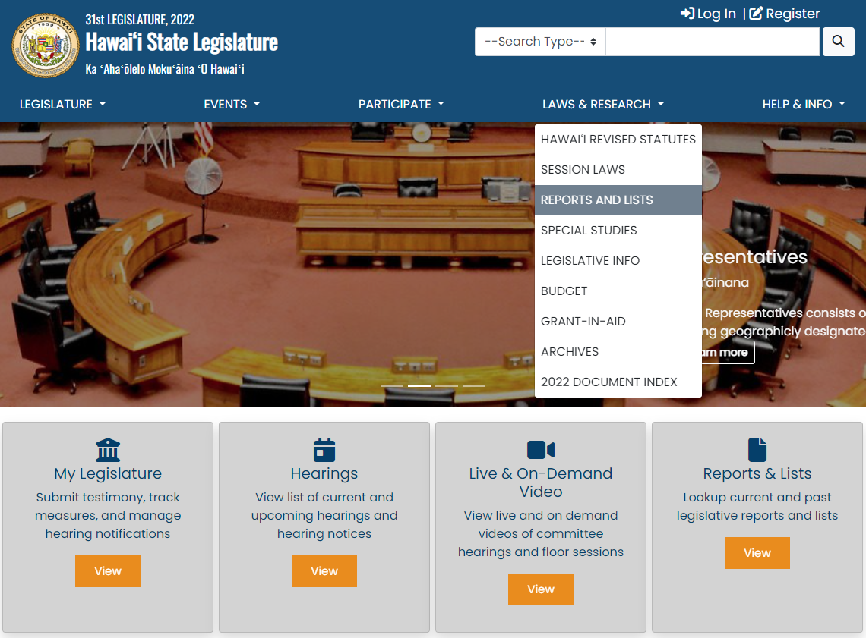
To Find Bills
& Bill Numbers
Notes:
Say we’ve gotten our bill introduced – how do we find out its bill number? While you can use the “Keyword” type in the search bar at the top of the page, it’s often much easier to use the “Reports and Lists” page to find bills. Often, when you’re looking for something, this is the button that may bring an end to your quest. It’s a “list of lists” that gets updated throughout session and also has a great “Subject Search” feature. There’s a shortcut to “Reports and Lists” on the homepage, or you can find it under the “Laws & Research” tab.

Slide 42
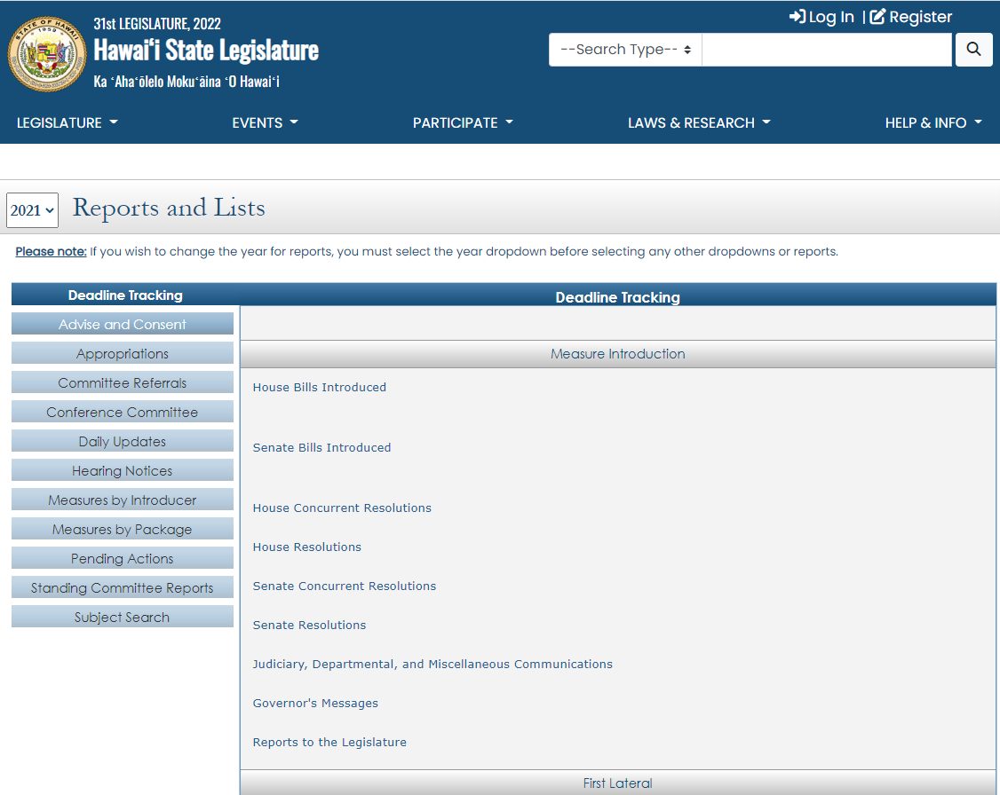
Click on a report title
Notes:
After clicking on “Reports and Lists,” on the right side of the screen, you will see the heading "Deadline Tracking."
To the right (also under the heading “Deadline Tracking”), you will see a long list of reports that are just a click away. Using these as the session progresses will give you access to sortable and downloadable lists of measures that have survived significant deadlines. It's a great way to keep up with what's still viable.
Here, for example, you can find all the House bills introduced, or later in the session, only the bills that survived first crossover.

Slide 43
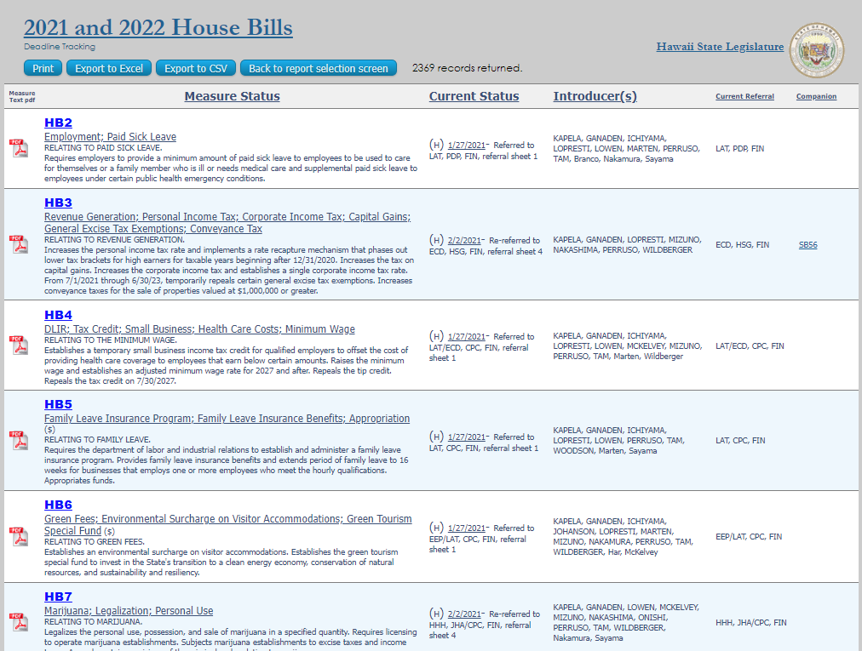
Notes:
This is the type of report you’ll see… you can browse through the bills’ keywords and descriptions. To view the bill itself you can click on the .pdf symbol on the left. To view the bill’s status page, click on the bill number.

Slide 44
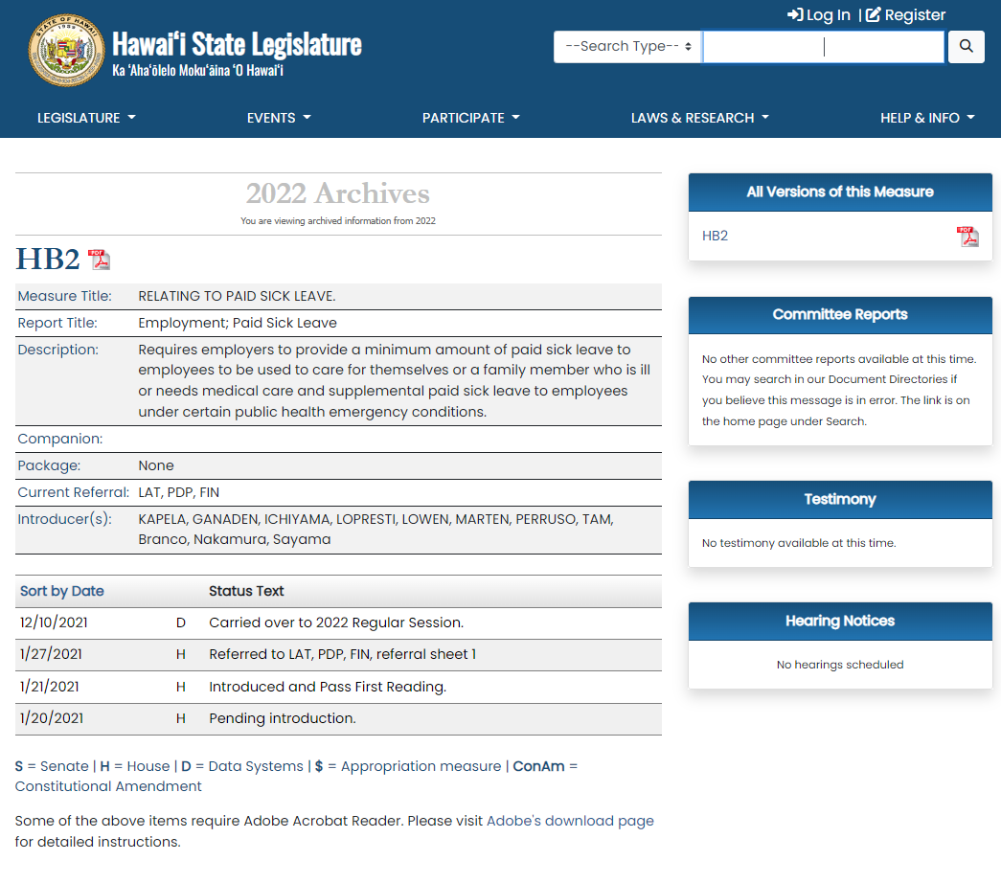
Notes:
Here’s a bill status page. Every bill that’s introduced gets its own web page where everything that ever happens to the bill is recorded. As we’ll see later in the presentation, it’s also where we can find committee reports, testimony, and other valuable information. To view the bill from its status page, click on the bill number at the top of the page or the .pdf symbol next to it.

Slide 45
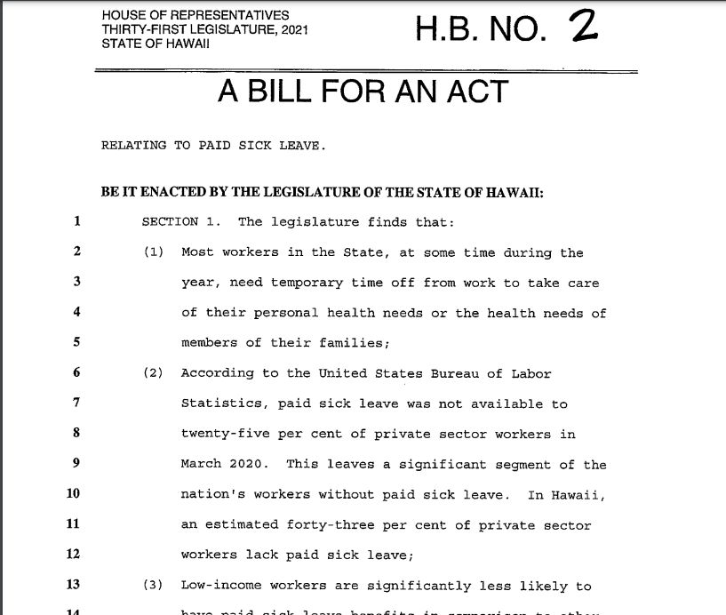
Notes:
And it will bring you to the bill itself, which you can read through.

Slide 46
Notes:
Going back to the main page, we can again go to the shortcut to “Reports and Lists” on the homepage, or you can find it under the “Laws & Research” tab.

Slide 47
Or use “Subject Search” to find bills…
Notes:
After you click on “Reports and Lists” you can use the “Subject Search” bar…

Slide 48
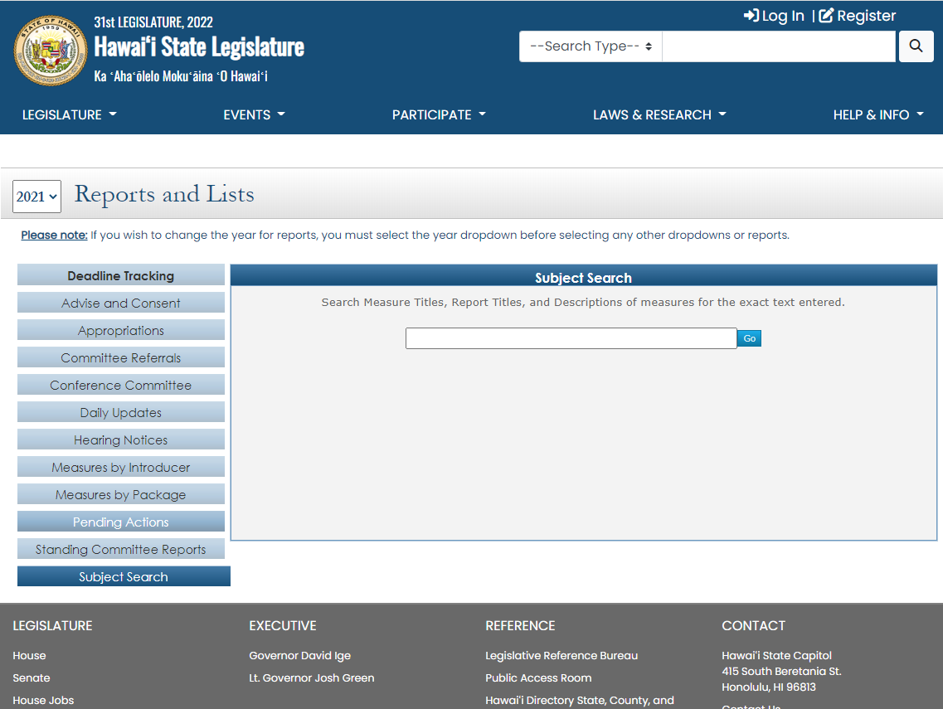
Notes:
Which brings up a search box for finding a word or phrase that appears in a bill’s title, description, or key words

Slide 49
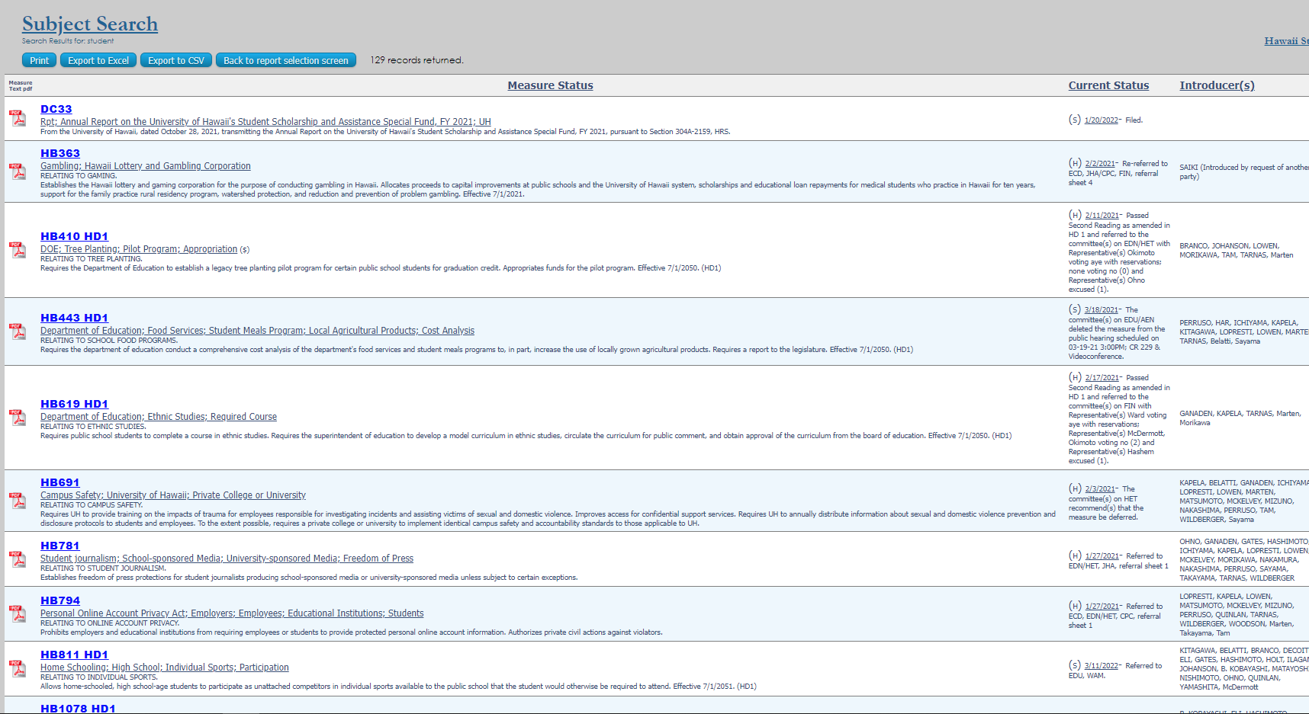
Notes:
Here are the results from searching the word “student” – the results are presented in an orderly report, easy to view the keywords and descriptions, or to further refine the results using your web browser’s search tool (often <Ctrl><F>). I could search for the word “food” for example.

Slide 50
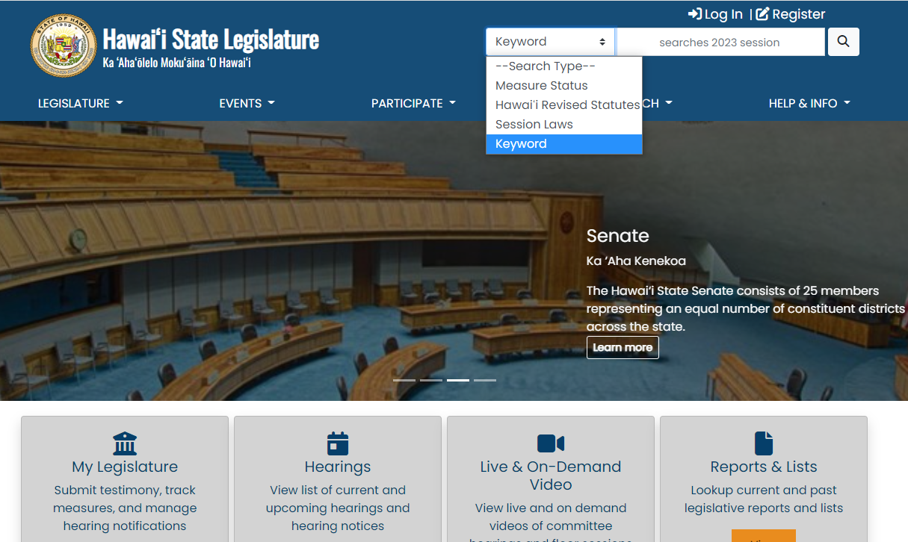
Or use the “Keyword” search type
in the search bar at top of screen
Notes:
The other option is to use the “Keyword” search type for the search bar at the top of the site. This is a more thorough search, and will look through not just the description, title, and keywords, but also the content of the legislation, committee reports, and testimony.

Slide 51
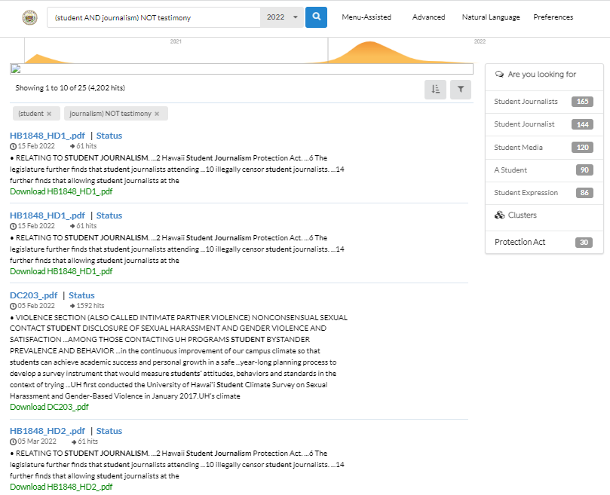
Notes:
The results take a bit to dig through if you get a lot of results. Use the suggested sub-headings on the right to refine your search or use the “Menu Assisted” or “Advanced” menus to get more focused in your search.

Slide 52
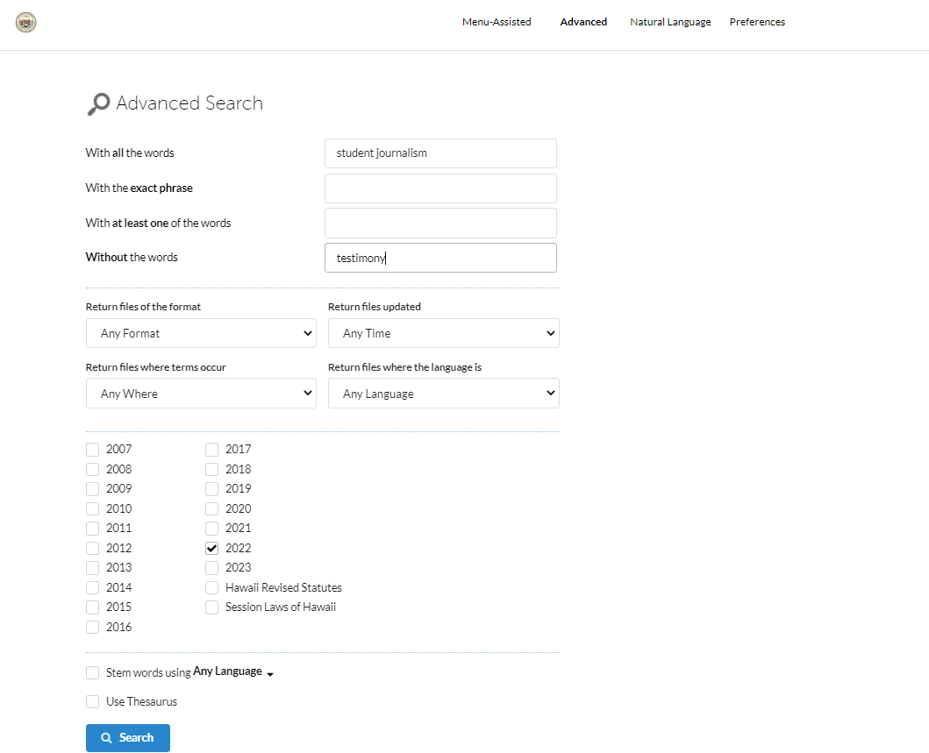
Notes:
Here’s what the “Advanced” form looks like – it makes it easy to refine your search.

Slide 53
Once you’ve found the bills you’re interested in…
Notes:
Once you’ve found the bills you’re interested in…

Slide 54
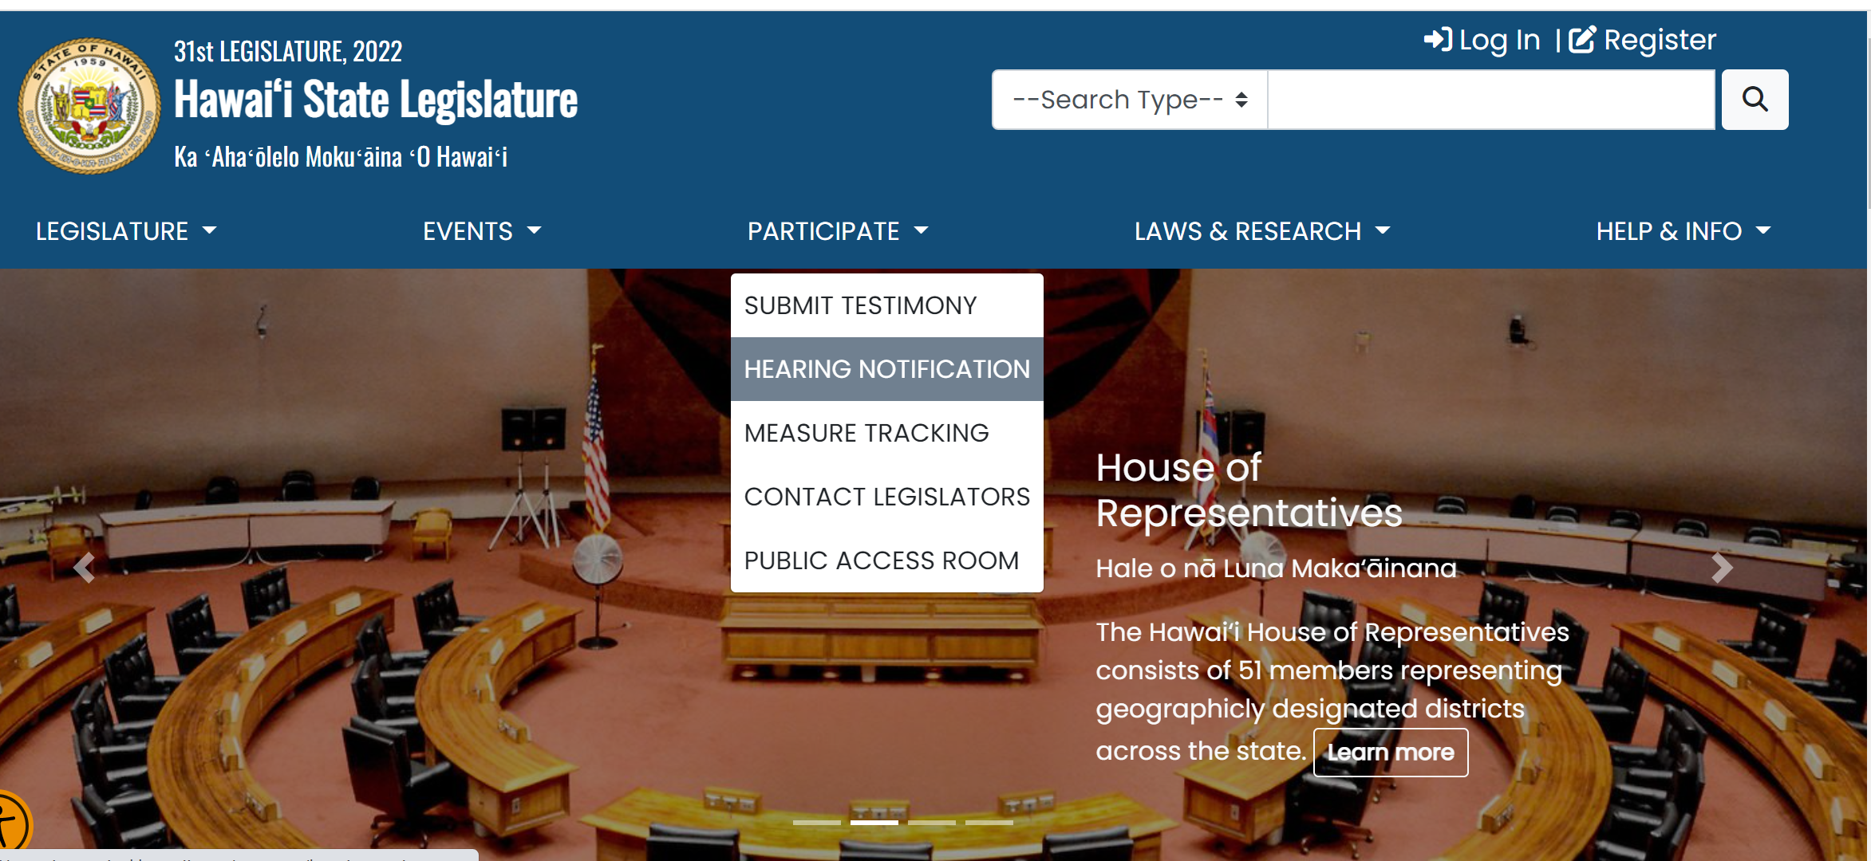
Sign up for hearing notices so you know if one gets scheduled!
Notes:
One of the first things to do when you find a bill that interests you is to sign up for hearing notices. Go to the legislature’s website (capitol.hawaii.gov) and “Sign In” – we’ll enter our email address and the password we created. We’ll then be presented with shortcuts to our interactive features. If you’ve traveled away from that page, just select the interactive buttons that appear under the “participate” tab. Here, we’ll select “Hearing Notification.”
First Time Users:
If this is your first time using the interactive features of the website, you'll have to Register. Click on "Register" and enter your name, email address, and the password you'd like to use for the website. After you've agreed to the terms and conditions, you will be directed to go to your email account and open the email sent to you by the website. (This confirms you are not a robot.) Follow the instructions for confirming your account. You'll only have to register once.

Slide 55
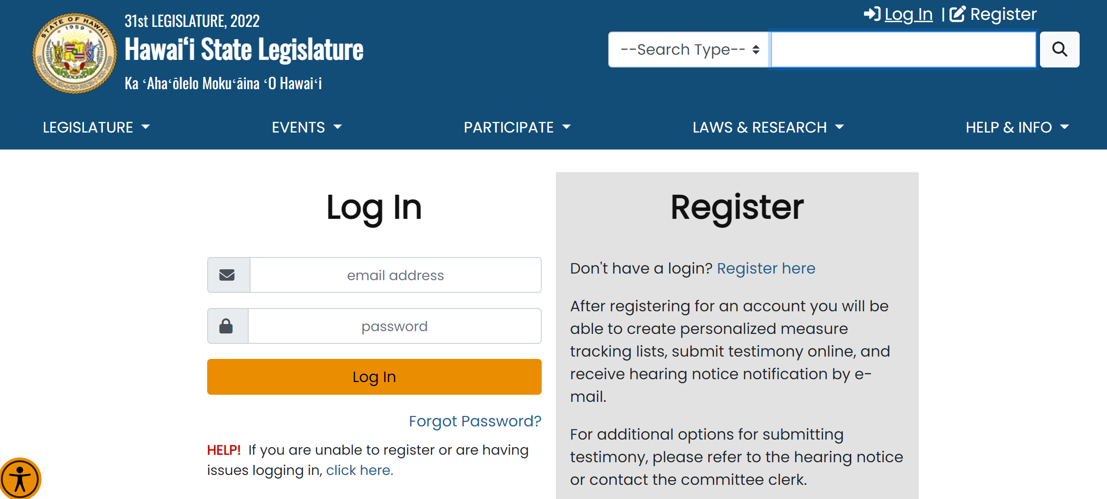
Notes:
Go to the legislature’s website (capitol.hawaii.gov). To use the “Hearing Notification” feature, first we “Log In” to the website – we’ll enter our email address and the password we created.

Slide 56
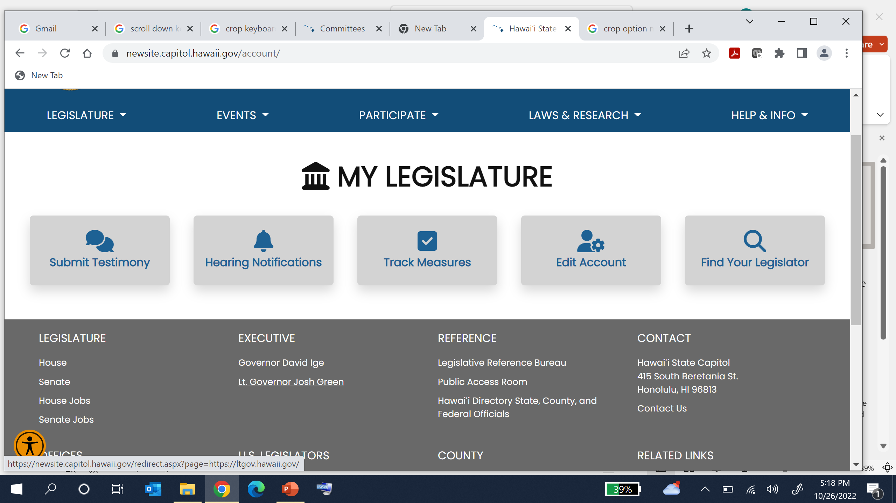
Notes:
Once you sign in, you can use the interactive features.

Slide 57
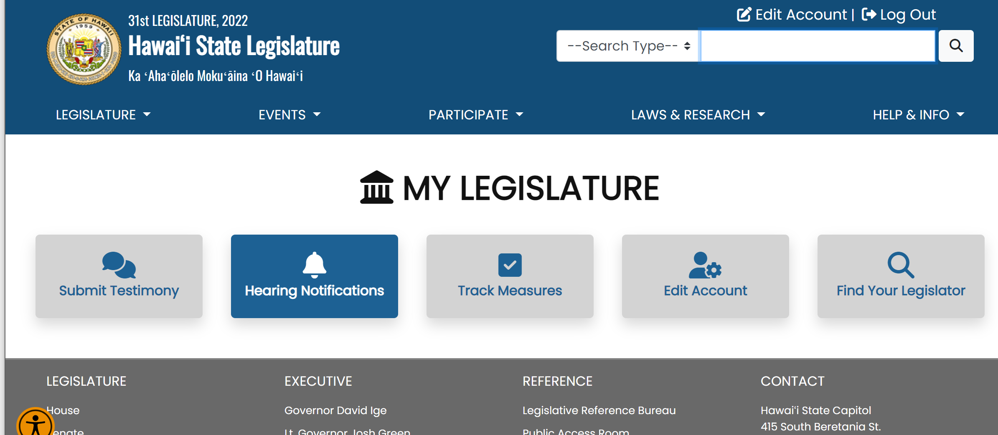
Notes:
So, if we want to sign up for hearing notices to be emailed to us, we just click on the icon, “Hearing Notification”.

Slide 58
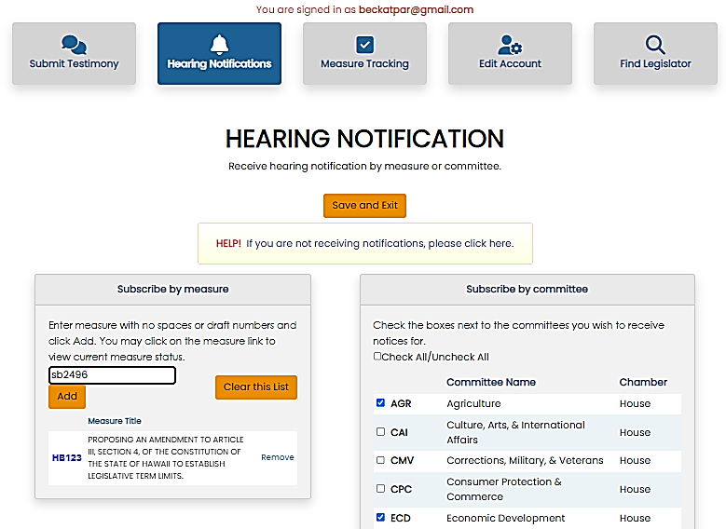
Sign up by measure
Sign up by committee
Notes:
This page appears. You can choose to receive hearing notices for certain bills or committees.
Just enter the bill number in the “Subscribe by Measure” box. Add as many bills or resolutions as you’d like. Any time one of them is scheduled for a hearing, you’ll get an email with a link to the hearing notice telling you when and where the hearing is taking place and how to offer testimony.
You may also want to subscribe to receive all the hearing notices issued by a particular committee. In the “Subscribe by Committee” area to the right, just click the boxes next to the committees you’d like to subscribe to. Be sure to select both the House and Senate committees!
Be sure to click on the “Save and Exit” button, and you’re all set. It’s easy to come back to this page and change your selections as session progresses.

Slide 59
You’ll soon find out what committees the bill needs to go through…
Notes:
After the bill is introduced, it will soon get its committee referral in its originating chamber (the House for HBs, the Senate for SBs) – the list of committees the bill will go through in order to survive. It could be that our bill is referred to three committees, or to two, or maybe just one. Sometimes, the committees may be asked to meet together (a joint referral). In any case, this list of committees is called the ‘committee referral’ and once we know what committees a bill needs to go through, we can use our voice to influence things.

Slide 60

Your Voice
Ask for a Public Hearing
Chair decides which bills will get a hearing –
there is limited time!
Notes:
We can ask for a public hearing. We’ll have to move quickly – those deadlines come up fast! Committees need to give at least 48-hours notice of a public hearing and the committees don’t all meet every day of the week.
Are there other people we can get to join our call for a hearing? If so, you’ll want them to help you move the bill forward –

Slide 61
Go to the person with the power: chair of the committee
Notes:
We ask the person with the power – the chair of that first committee – to have the bill heard, considered by the committee.
Getting your bill scheduled for a committee hearing is a big step – many bills never get that far. Contact the committee chair’s office and just ask – “Would you please make sure to schedule [bill number] for a hearing? I think it’s important because…” They should be upfront with you about whether they will. The chair’s office has a lot of things to consider – your bill is one among many that have been referred to the committee, and they’ve only got so much time to hear bills.
When a bill is scheduled for a hearing, a hearing notice is published and distributed to let everyone know what’s being discussed. This is the opportunity the public has been waiting for to provide testimony.

Slide 62

If it doesn’t get heard, it will miss deadlines and will “die in committee” (the fate of most bills)
Notes:
62
If the chair doesn’t like your bill or doesn’t think it’s a priority and won’t schedule it, it will just sit there while deadlines go by, and it will be left behind.
If the chair is not inclined to hear your bill, you may want to talk to other members of the committee – if they’re in favor of it being heard, they may be willing to advocate to the chair.
You can find lists of the committees and committee chairs on both the legislature’s website (capitol.hawaii.gov) and PAR’s (LRB.hawaii.gov/PAR/).
Remember to keep your eyes open for other bills that are being heard that may cover similar subject matter. You may want to testify on those. That involves keeping your eyes open for hearing notices.

Slide 63
If your bill does get scheduled for a public hearing…
Notes:
If a bill you’re interested in does get scheduled for a public hearing, you’ve got another chance to use your voice…

Slide 64
Your Voice
Testify!
Who testifies?
Executive Departments, Interest Groups, Lobbyists, Public
Notes:
Testify! Offer your opinion on whether the bill is a good idea.
Your testimony at those committee meetings can be very helpful to the committee members. Don’t make them have to come to decisions on legislation all on their own! Members of the public can offer a tremendous amount of experience, expertise, and variety of viewpoints that help to make better laws for us all. Also testifying will be executive departments, interest groups, and paid lobbyists.
Just a head’s up: there’s never as much time as you think you need to prepare your testimony! Just do the best you can and see if you can get other people who care about the issue to offer their testimony, too. The deadline is usually just 24-hours prior to the hearing.

Slide 65
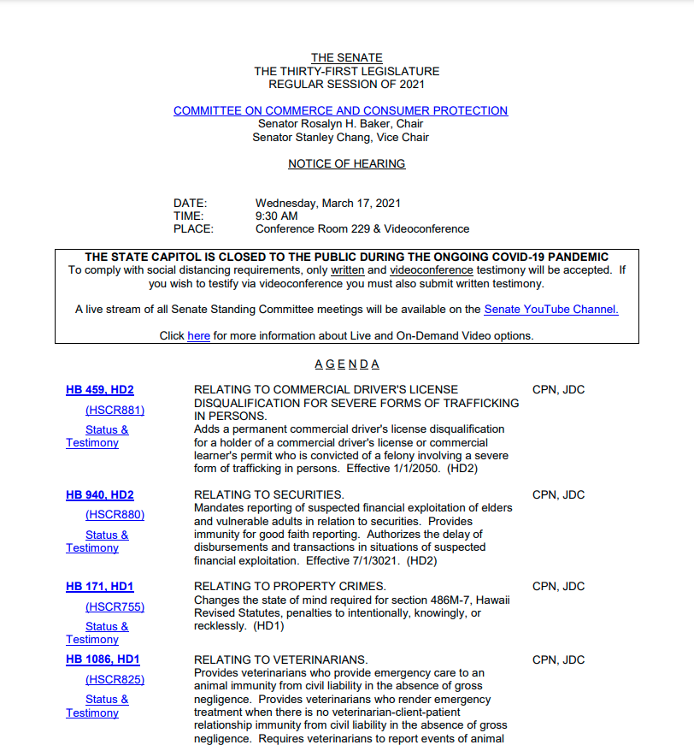
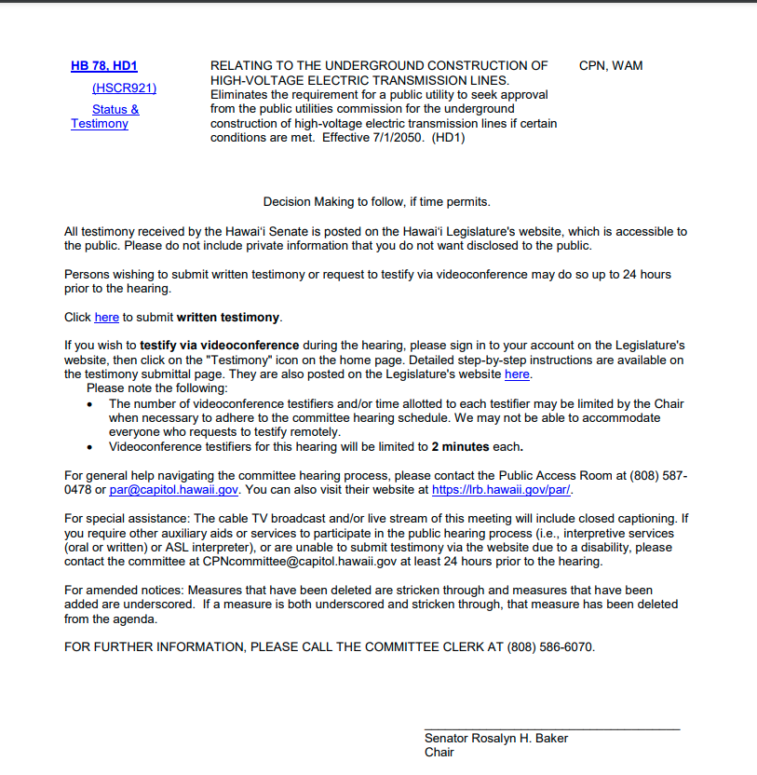
Testimony information appears at the end of the hearing notice.
Notes:
The hearing notice lists the time and place it will meet and which measures are being considered.
Guidelines and the testimony deadline appear at the end of the hearing notice.

Slide 66
No rules on what your written testimony looks or sounds like.
That’s up to you.
Notes:
In submitting written testimony, there’s no set rule as to what it should look like. That’s up to you. We do encourage you to try to keep it to a page or two. Try to make the main points immediately apparent.

Slide 67

Written Testimony
Bill number
Your name
Are you for or against the bill?
Why?
Notes:
Include the essentials: the bill number, your name, whether you are for or against the measure, and where you’re coming from. (Are you an expert? Great. But that’s not necessary. Maybe you have an experience you’d like to share. Or maybe you’re motivated by your moral or religious beliefs. Let them know where you’re coming from.)

Slide 68
Remember…
    You don’t have to be an expert
    Stories are great
    Use your own words
    Keep it short
Notes:
So, remember… You don’t have to be an expert. Stories are great. Use your own words. Keep it short. Type up your testimony and save it as a file on your computer. Now you’re ready to submit it! (Don’t have time for that? No worries – there’s a place on the webform in which you can type your testimony.

Slide 69
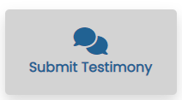
Use the web form to submit testimony…
And to sign up for oral testimony –
in person or via Zoom
Notes:
The “Submit Testimony" feature provides an easy and efficient way to submit testimony online – you just attach the file that contains your testimony, and in it goes. If you don’t want to type up your testimony as a separate document, there’s an option to add it to the testimony form instead. This is also where you’ll be able to request the opportunity to provide in person testimony or remote oral testimony via Zoom.

Slide 70
Notes:
Go to the legislature’s website (capitol.hawaii.gov). To use the “Submit Testimony” feature, first we “Log In” to the website – we’ll enter our email address and the password we created.

Slide 71
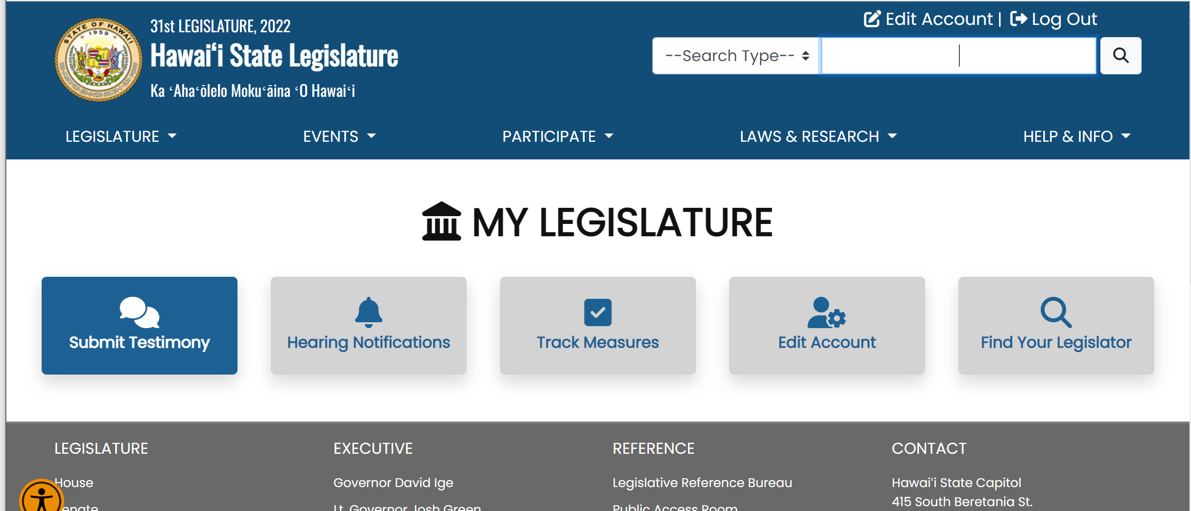
Notes:
And we’ve got shortcuts to our interactive features. If you’ve navigated away from this page, remember, you can always find them under the “Participate” tab.

Slide 72
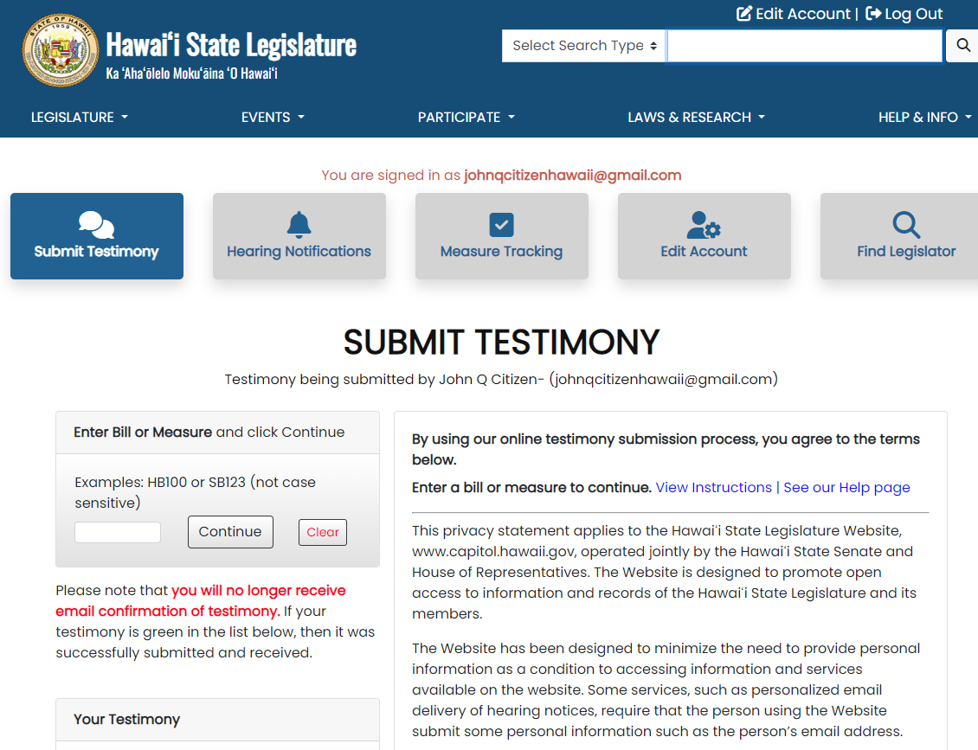
Notes:
Then, enter the bill number you want to testify on. Don’t put in any spaces between the letters and numbers, and don’t add on any draft numbers. Review the terms listed on the right. All testimony is public and will be posted to the website. Click on “Continue”.

Slide 73
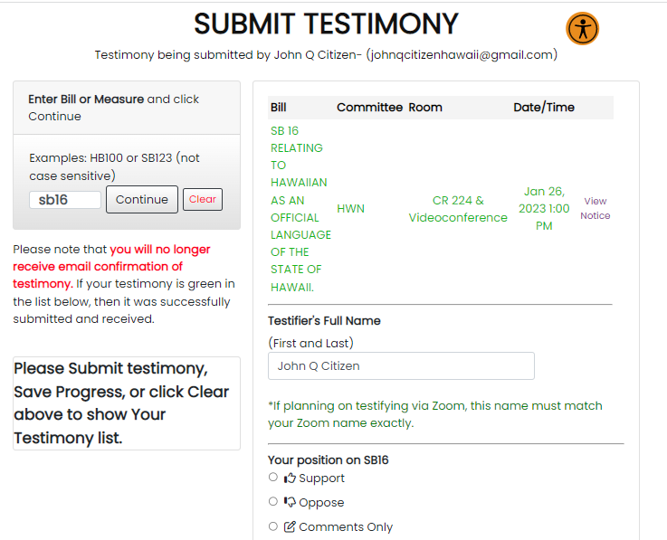
Notes:
The bill’s hearing information will appear along with a submission form.
Proceed to fill out the form that appears.
If you are requesting the opportunity to testify remotely, make sure that the “Testifier’s Full Name” field at the top of the form has the name of the person who will be offering Zoom testimony – the Zoom identity must match this field.
You’ll need to click on the little circle to indicate your position on the measure – do you support, oppose, or are you just offering comments (no position on the bill, but offering information or perspective).

Slide 74
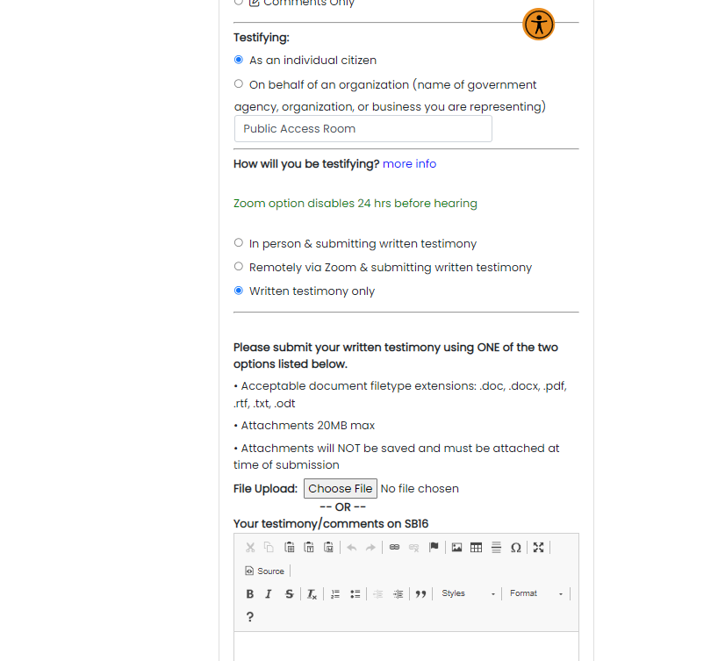
Notes:
Then, indicate whether you’re testifying as an individual or on behalf of an organization and whether you’ll just be submitting written testimony or if you wish to also offer oral testimony, either in person or remotely via Zoom.
Now you’re ready to add your written testimony.

Slide 75
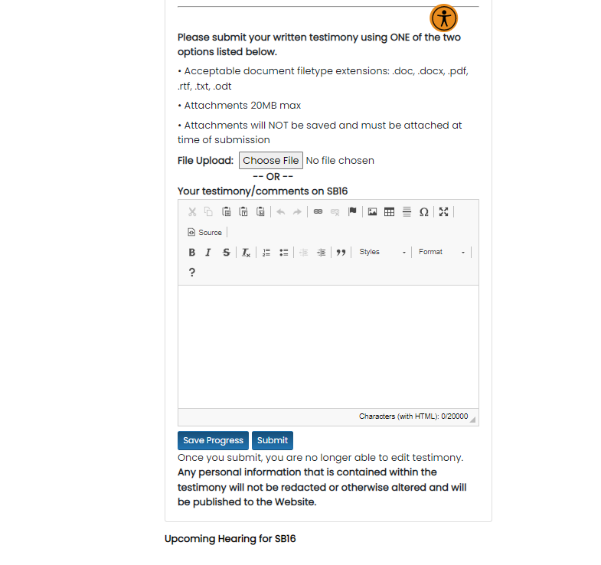
You can then “attach” your written testimony file.
Notes:
Then you can attach or upload your testimony file to the form. Just click on the button “Choose File” (it may say “Browse” or “Select”) and locate the file on your computer. This is like you add a file to an email message.

Slide 76
The name of the file you uploaded will appear here
Notes:
After you’ve uploaded the file, its name appears to the right of the button.

Slide 77
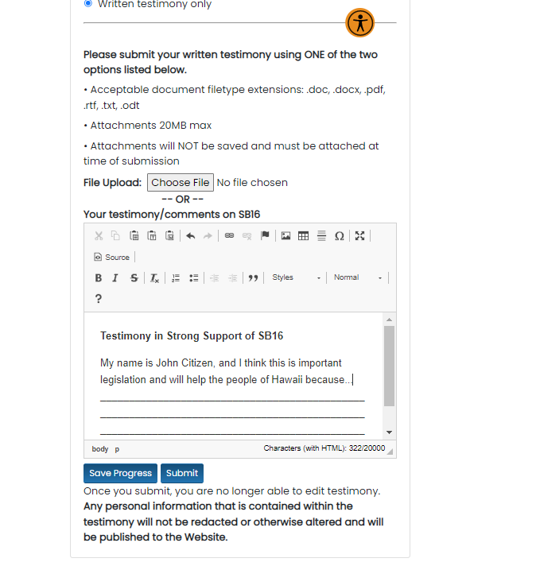
The system will not allow you to do both!
Either upload a file OR
type your testimony in the box
OR you can select “Comments” and type your testimony here.
Notes:
Another option: You may type your testimony directly into the “Comments" box.
So, one way or the other, once you’ve either attached or typed your testimony, you’re ready to submit your testimony.
But first, review your information. Once you submit your testimony, you won’t be able to change it, so double check that you’ve uploaded the right file, have correctly identified your position, how you’ll be testifying, etc.
Since the testimony will be public and posted online, make sure you’re comfortable with the information you’ll be sharing.
When you’re ready, click “Submit.”

Slide 78
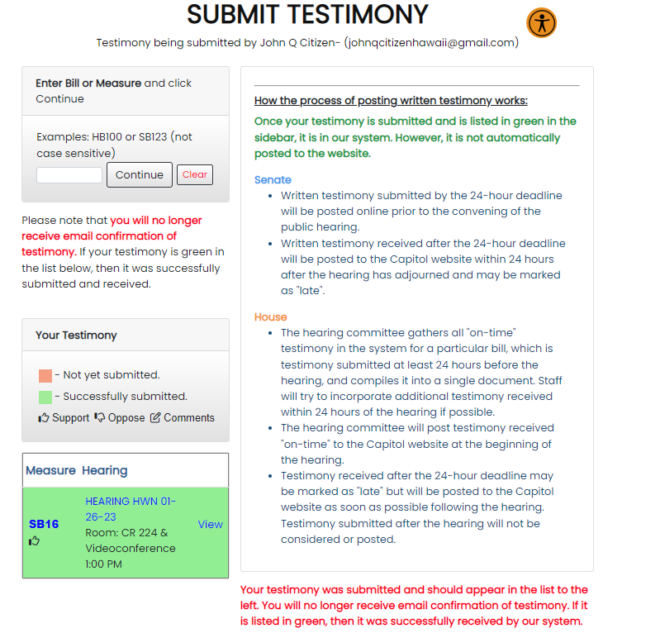
Notes:
You’ll be returned to the original “Submit Testimony” page. A green box on the left corresponding to your hearing will appear. This indicates that your written testimony has been successfully transmitted to the committee.

Slide 79
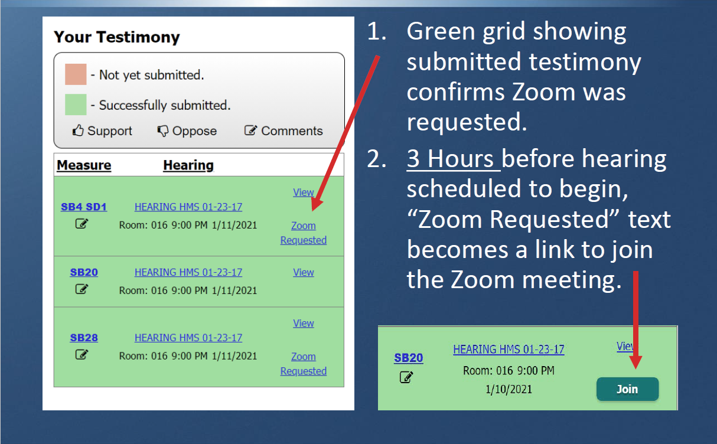
If you requested Zoom…
(If your request was accepted)
Notes:
If, in addition to written testimony, you requested the opportunity to testify via Zoom, a “Zoom Requested” notation will appear in your box. Sign back into the legislature’s website 3 hours prior to the hearing to see if your request to testify remotely was accepted. If it was, the “Zoom Requested” will have transformed into a “Join” button. At hearing time, you’ll sign into the website, click on the “Submit Testimony” button, and use the “Join” button to Zoom into the hearing.

Slide 80

So, if you’re Zooming…
when hearing time rolls around…
Sign into the website
Click “Submit Testimony” button
Click “Join” button
Keep the “Chat” panel open
Wait for your turn…
Notes:
If you’re Zooming…
Keep "chat" panel open -- this is how legislative staff will communicate with you.
Your microphone should be muted, and your video stopped, unless it is your turn to testify.
You will receive a request to share your video shortly before it is your turn. Accept the request.
When the Chair calls on you, unmute your microphone and then begin addressing the committee.
If you do not respond when the Chair calls on you, you may miss your chance to testify.

Slide 81
Oral Testimony
Let them Hear your Voice!
“Chair ___, Vice Chair ___ and members of the committee…”
Short and simple (may be a time limit)
  Introduce yourself
  State your position
  Remember to Breathe!
Become a trusted resource!
Notes:
Here are some simple guidelines
“Chair, Vice Chair and members of the committee…” is a great way to start.
Short and simple (2-3 minutes) – there may be a time limit, honor it.
Introduce yourself and the group or organization (if any) you represent.
Clearly state your position – in favor? Opposed? Alternatives?
Be courteous, respectful, and professional
Remember to Breathe!
Don’t just read your testimony – the committee has your written words. Instead, summarize your position, provide a point you’d like to emphasize. A short story can be very effective.
Tell the truth and don’t exaggerate. Become a trusted resource!

Slide 82
Find others who agree with you to amplify your voice
Notes:
Now that you know how easy it is to testify, spread the word! Find allies. Don’t forget to get help from and collaborate with people who share your perspective on the issue.
And don’t forget to pay attention to your opponents. They can teach you a lot and help you to sharpen your own message.

Slide 83
After all the testimony has been heard…
Notes:
So now what? You’ve offered testimony, now you wait to see what the committee will do.

Slide 84

The Committee may…
  Vote
    pass the bill without changes
    pass the bill with changes
  Not vote! Defer or hold
Notes:
The committee may vote to pass the bill just as it is, without any changes.
The committee may vote to pass the bill “as amended,” with changes.
The committee may choose not to vote – instead, the chair announces that they will “defer” or “hold” the bill. If they haven’t set a date for decision making, this means the bill will stay in the committee and miss the upcoming deadlines.
If the committee votes to pass the bill, the bill survives and moves forward in the legislative process.
The person who decides which of these paths to go on? The chair of the committee.
NOTE: On rare occasions, the committee may vote on the bill and the bill fails to win the vote; the bill would then be dead. It is much more common for a vote to be avoided if the chair knows there will not be enough support to pass it.

Slide 85

If changes have occurred…
Changes may be minor or significant
Notes:
If they passed the bill with changes, they can be minor changes like correcting punctuation and other technical changes, or major changes affecting what the bill does.

Slide 86
Bill must conform to its title
?
2 Common Changes
Effective date: “1/1/2099”
Appropriate/fund: $__________
Notes:
The thing that constrains how much a bill can change is its title, which never changes. The bill must always conform to its title.
Two common changes:
Effective date may be far in future “to ensure further discussion”: The “defective” effective date is a mechanism to ensure that the bill goes into the conference committee process near the end of session. There is no intention of it going off to the governor like that.
Dollar amounts may be blanked out: If they want to keep a dollar amount associated with the bill, they’ll make note of it in the committee report. The final dollar amount or appropriation details will usually be determined during the conference committee process.
Any changes will be summarized in the committee report, published whenever a bill moves forward out of committee.

Slide 87
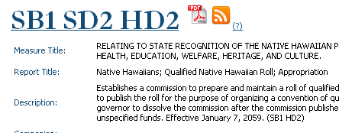
If changed, it gets a new draft number…
Notes:
The amended bill will be given a new draft number.
It has still got its bill number, but now there is a new suffix indicating which draft (or version) of the bill we’re looking at. HD = House Draft, SD = Senate Draft – the number indicates the number of times it’s been changed by that chamber. This can look a bit confusing at first, but it really does help to make sure we’re looking at the same version of the bill.

Slide 88
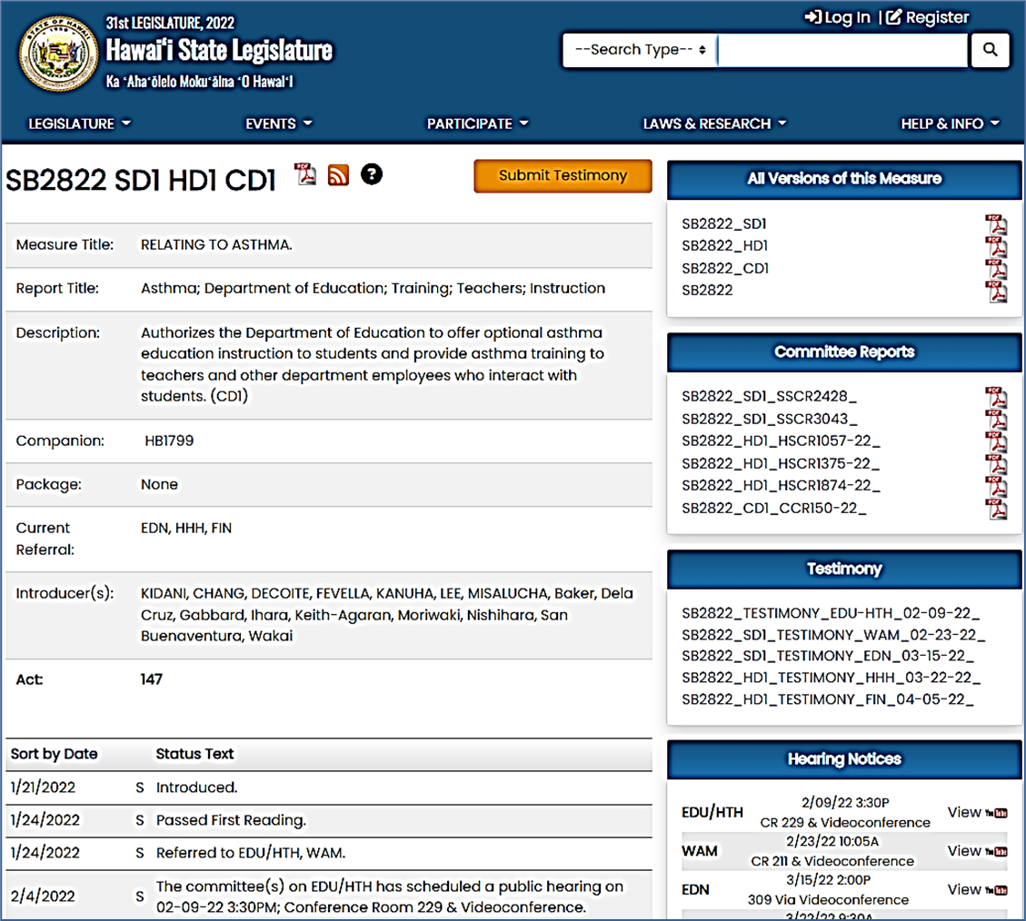
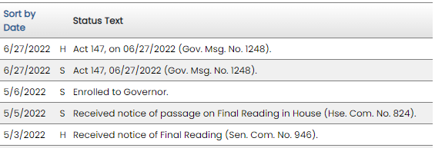
Notes:
Here’s a status page of a bill that’s been changed three times. Click on the bill number at the top of the page to view the latest version of the bill itself. (Use the .pdf symbol to view the same draft but showing page and line numbers.)
On the right side of the page, you’ll find links to previous versions of the measure. To get a quick glimpse of what changes were made, check out the committee reports that are published as the committees move the bill forward. Each committee report will summarize the changes, if any, that were made.
You can also view the written testimony that was received at each hearing. Just click on the links, and you’ll be able to view .pdf files that present one page of testimony after another.
Under Hearing Notices, you can view the hearing notices as well as watch the proceedings – in real time, or after the fact – by clicking on the YouTube logo.
Everything that happens to the bill gets listed on its website under “Status Text”. (Unfortunately, the site will not say “this bill is dead because it has now missed a crucial deadline.” To determine that, you’ll need to know your calendar of deadlines – or call or email PAR, and we’ll be happy to help you out.)

Slide 89
Second Reading
Constitutional requirement: Bills must pass 3 readings (votes) on the floor of each chamber
Notes:
Yay! Your bill passed its first (or first and second) committees… Now it’s back to the floor for Second Reading! A majority of the members present vote ‘aye.’ And now we go on to our next committee if there is one…

Slide 90
Your Voice
If your bill moves forward…
do it again!
Ask to have it heard at the next committee
Offer testimony at the next committee
Repeat as necessary!
Notes:
If the bill moves forward, you can ask that it be heard by the next committee. If a public hearing is scheduled, come and testify again. You don’t have to worry about a whole new creative writing project, instead you can use virtually the same testimony you provided at the previous hearing. Just make sure that if the bill has changed, your testimony is still relevant. And you may want to emphasize the parts of your testimony that address the committee’s purview.

Slide 91
Third Reading = by the
Crossover Deadline
Constitutional requirement: Bills must pass 3 readings (votes) on the floor of each chamber
Notes:
After it’s made it through all the committees (which it must do by the First Decking deadline), it comes back to the floor for the Third Reading. The members of the House or Senate are given 48-hours notice of all bills coming up for Third Reading. This ensures that they’ve had time to review them before this critical vote. The bill has to survive Third Reading by the First Crossover deadline.

Slide 92
Your Voice
On Occasion,
Advocate to Entire Chamber
Ask for their vote
Get others to join you
Notes:
During the bill’s path through the legislature, it must be voted on 3 times in the full chamber of both the House and the Senate. On rare occasions, whether the bill will pass the vote may be in question. (Most bills die in committee, rather than on the floor of the House or Senate.) In such cases, you may want to use your voice to let your own representative or senator know how you would like them to vote. In some cases, you may want to call all of the members to let your opinion be known. Know a member is on the fence? Try to find one or more of their constituents to chime in.

Slide 93




House bills go to the Senate
Senate bills go to the House
Notes:
If your bill survives all three readings, then it ‘crosses over’ and attempts to go through the same process in the other chamber!
This time it will be the non-originating chamber that passes it on First Reading and then assigns committees, and you’ll ask for the bill to be heard, just like before. Deadlines come quickly during this part of session, and a bill must get through all three readings in the non-originating chamber by the Second Crossover deadline.

Slide 94
And the bills go through the same process in the other chamber
Notes:
So, we’ve gone down one side of the diagram, and now we start down the other side. Now the Senate will be considering the House bills that survived First Crossover, and the House will be considering the Senate bills that survived.
(Note: If we were following a Senate bill, it would have to pass the Senate committees it was referred to and three readings on the Senate floor before First Crossover – it would then be transmitted to the House for its journey there.)

Slide 95

Session moves even faster after First Crossover…
Bills must get through their non-originating chamber by
Second Crossover
Notes:
Things move quickly after First Crossover! They must get through their committees and three readings by the Second Crossover deadline.

Slide 96

To find agreement, leadership appoints members to Conference Committees
Members from Senate
Bill #HB123 HD3 SD2
Members from House
Notes:
We now come to what is often the tricky part – coming to an agreement on the final version of the bill that will pass the legislature. If the bill wasn’t changed while it was away at its second chamber, no problem, both chambers voted on the same version of the bill and off it can go to the governor. But most bills are changed while they’re in their non-originating chamber, and so we enter the period called “Conference.”
If the House has passed one version of the bill, and the Senate has passed another, the Conference Committees appointed by House and Senate leadership for that particular bill will try to iron out the differences and come to an agreement on the final version of the bill to be presented to their chambers. Bills can still die here. Conference committees may not be named, may fail to convene, or may not come to an agreement. The fate of your bill may be tied to the fate of other bills being negotiated by other conference committees. The meetings are open to the public, but usually only the chairs speak to one another and often the dialogue is simply, “Do we have an agreement?” and, if not, whether to give up or agree on the date and time for the next meeting.
This is when they may correct those crazy effective dates. It’s also when the money committees determine which bills get funded, and those blank dollar amounts get filled in.

Slide 97
Your Voice
Advocate to Conferees
… and any other legislators you’ve developed a relationship with…
Notes:
While the meetings are open to the public, no testimony is received. Instead, advocates contact the conference members and anyone else they think may have some influence over the outcome. Advocates may focus on which particulars they want to see in the final bill.
The conferees need to come to agreement by the Final Decking deadline. For the budget and other appropriations bills, you’ll see that there’s a “Final Decking (Fiscal Bills)” deadline.

Slide 98

Final Reading
Both chambers must vote on final version of bill
by the end of session
Notes:
Finally, if the bill emerges from conference committee with a conference draft (CD1), that new version of the bill must be voted on by both the House and the Senate. The Final Reading must take place by the end of session (adjournment sine die) and members must be given 48 hours notice before the vote.

Slide 99

Your Voice
ACT
Let the Governor know your view
Notes:
But it’s not over yet! The Governor has a say in whether the bill becomes law. You may want to let the Governor know that he should sign the bill into law – or let him know if you want it vetoed! If it does get signed (or not vetoed by a certain date), the bill becomes an act of law that governs the state of Hawaii. The date the law goes into effect is specified in the last section of the bill.
Note: If the bill is vetoed, there’s still an opportunity for it to become law – the House and Senate can reconvene in special session, and if both chambers override the veto with a 2/3 vote, the bill is enacted. The legislature also has the option of amending a vetoed bill to meet the governor’s objections; it then becomes law if the governor signs it.

Slide 100

Notes:
100
Did your bill pass? Did you get what you wanted out of the committee hearings you submitted testimony for? Were the changes made to the bill acceptable compromises that still move your issue forward?
Amazing. Take time to thank the people who heard you and others who helped along the way!

Slide 101

Notes:
101
Throughout session, though, this is more likely for a lot of folks. Often, they’re disappointed to see their bill die, right there in front of them. It helps to remember the bright side – Did a hearing spark good discussion on an issue? Raise awareness? Identify potential allies? Often, you can take a step back and find some progress that’s been made.
Even though the process of making a law may seem slow (it can take years) and is often frustrating, the process keeps a lot of “bad” legislation from coming into law. Just read through the descriptions of all the bills introduced at the start of session – you’re sure to see some things you disagree with!

Slide 102

Don’t give up –
get ready for next year’s session!
Notes:
If your bill dies…keep at it and remember that “many hands make light work.” The process is often long and complicated, so having other people involved will both increase your chances and keep you from burning out. Go over what happened during this year’s session and get ready for next year.

Slide 103

“The Interim”
May be easier to find time with legislators
Notes:
And remember how important the interim is – the time between legislative sessions.
If your bill dies, the following interim is a good time to start stirring up interest in reviving it. Debrief and consult with allies about what worked and what didn’t during session. Work with other stake holders to find points of acceptable compromise. Teach the legislators and/or the community more about your issue. Perhaps ask a legislator to draft a new bill that may stand a better chance of passage.
After the flurry of session, you’ll find the capitol so much more relaxed during interim! It’s a great time to talk with legislators and their staff.

Slide 104
Before you know it…
It’ll be the 3rd Wednesday in January,
And the whole process begins again*…
*Actually, it’s a two-year cycle that follows the elections...
Notes:
We didn’t want to confuse you at the outset, but if your bill dies in an odd-numbered year, the first year of the 2-year legislative cycle (a biennium), it’s not really dead(!).
In the first year of a biennium, any bill that didn’t pass out of the legislature actually just goes into a coma. We say that it “died” but it’s actually a potential “zombie” that could come back to life. In the 2nd year, in addition to all the new bills legislators will introduce, bills from the 1st year can be revived at exactly the same place they “died.”
BUT at the end of the even-numbered year, the 2nd year of the biennium, if it hasn’t passed into law, it is really truly finally absolutely totally DEAD.
We’ll have elections in November of the even-numbered year, and a new biennium begins the following January with all new bills introduced.
That’s no reason to stop your campaign, though. Remember, more than just a specific bill, you’re advocating for an idea! You can make a list of what you’d like a bill to do, take it to a legislator, ask that person to introduce a bill for you the following year… and it starts all over again.

Slide 105
Add Your Voice
Talk with legislators
Suggest a bill
Ask for a hearing
Testify
Lobby the chamber
Contact the governor
Keep at it!
Notes:
So, as we’ve seen, there’s a lot you can do at the legislature…

Slide 106
Confused?
Not to worry!
PAR’s happy to help!
Notes:
We know it all can seem a bit overwhelming and confusing. This is a lot of information! But the Public Access Room was established by the legislature as a resource to help to answer any of your questions and help you understand and learn more about the process.

Slide 107

Public Access Room (PAR)
Help, information, and training at no charge
Non-partisan
Lots of resources!
  Guidance on process
  Computers with internet
  Wireless access & recharge station
  Copies of testimony
  Helpful handouts
  Website (lrb.hawaii.gov/par)
  Workshops and tutorials
Notes:
We are non-partisan, dealing exclusively in process and never in policy considerations. There is never a fee for our services – we’re supported by your tax dollars. You can come to PAR to use one of the public computers or the printer, have a small meeting, get copies of your testimony, or watch a hearing remotely. We have tables for you to work on your laptop (there’s free wifi throughout the building) or recharge your devices. Or perhaps just sit and relax a while. We can answer your questions and point you to resources. We also offer workshops and tutorials so you can learn more.
Our office is one of the five divisions of the (also non-partisan) Legislative Reference Bureau (LRB), a legislative service agency. A brief overview of the other divisions of the LRB:
LRB Library has extensive holdings that cover legislative matters, some of which date all the way back to the days of the Kingdom. The research librarians can be very helpful and are a resource available to the public. They’re located in the Chamber level of the Capitol in Room 005 and can be reached at 808/587-0690.
The Research Division is one of five drafting agencies in the Capitol; they are available to assist any of the 76 legislators. The staff provides research, drafts legislation and committee reports, and publishes specific studies as requested by the legislature.
The Statute Revision Division integrates the newly-passed Acts into the fourteen volumes of the Hawaii Revised Statutes (the HRS), the codified book of laws governing the state of Hawaii.
The Information Systems Offices maintains a data base of relevant legislative information for internal legislative use. The staff also provide technical support for the division.
More information on LRB can be found on the website: https://lrb.hawaii.gov/par/

Slide 108
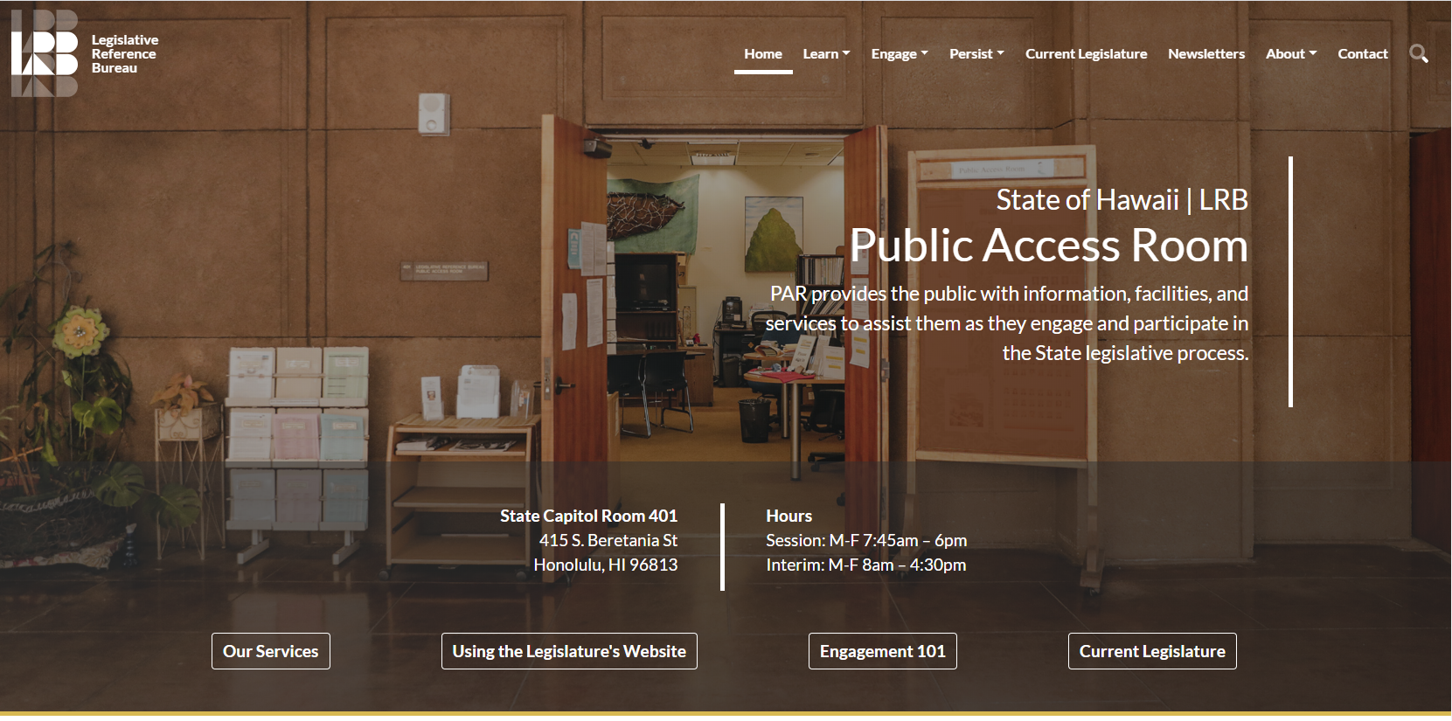
For helpful handouts,
and to learn more, head to the Public Access Room’s website
lrb.hawaii.gov/par/
Notes:
There are many helpful handouts on the PAR website, https://lrb.hawaii.gov/par/ .

Slide 109


lrb.hawaii.gov/par
Notes:
Our website has a lot of helpful information! Check out the “Engagement 101” shortcut, or find it under the “Engage” tab. You’ll find “How To” handouts and videos on using the legislature’s website’s interactive features.

Slide 110

lrb.hawaii.gov/par
Notes:
The “Current Legislature” shortcut or tab gives you up-to-date lists of deadlines, committees, and legislators. It’s where you’ll find everything from office managers to district maps to who serves on which committees.

Slide 111

lrb.hawaii.gov/par
Notes:
There’s a wealth of information – check out “Learn,” “Engage,” and “Persist.” This workshop can be found under the “Learn” tab – just select “Workshops” and scroll down to the resources on the bottom.

Slide 112

Links to PAR Social Media at Bottom of Website
Notes:
And there are links to our social media at the bottom of the page.

Slide 113
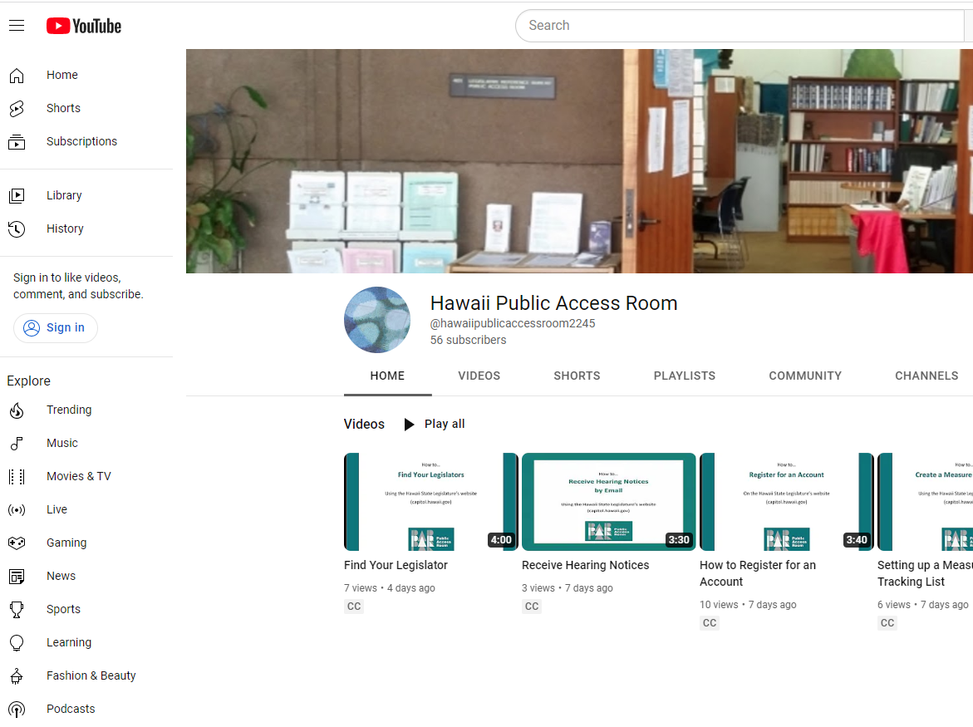
Hawaii Public Access Room: YouTube page
Notes:
Our YouTube page will walk you through everything from how to use the interactive features, to how to read a bill, to this workshop itself.

Slide 114


If you can’t find what you’re looking for…
room 401
(808) 587-0478
par@capitol.hawaii.gov
???
Notes:
If you can’t find what you’re looking for, contact the Public Access Room (PAR)… room 401, 808/587-0478, par@capitol.hawaii.gov.

Slide 115
Whew!
Notes:
Whew!

Slide 116

Keep it up!
Warning:
No known cure for the advocacy virus
Notes:
Keep it up! If you’re reading this, you’ve obviously contracted the virus –

Slide 117
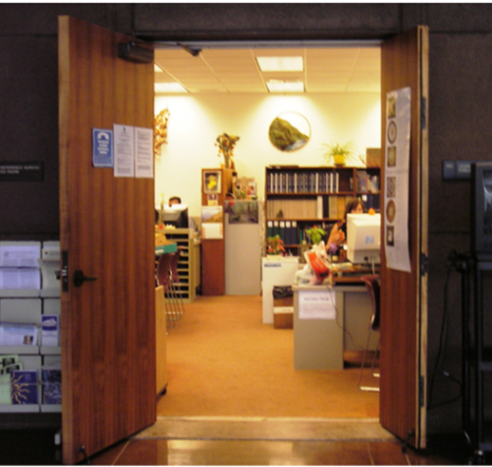

However, treatment is available…
Participate in your democracy
Notes:
Treatment is available – Participate in your democracy. You’re always welcome in the Public Access Room!

Slide 118
Of course, we live in the real world…
And this is how others might depict the process –
Notes:
We’ve talked about how bills become laws, but of course, we live in the real world. Here’s how others might describe the process…

Slide 119










Notes:
119
We get a legislator to introduce a bill for a double-decker tree swing. Wonderful.
But then, it gets changed in one of the committees. They insist it should be double-wide instead. Fine. We can live with that.
It then gets changed again, this time on the floor during second reading (this can happen – though it doesn’t very often). Strange change, though, as now it’s not going to be of any use to anyone! It’s blocked by the tree trunk!
Luckily, before the bill is enacted they’ve fixed it, sort of – they’ve dissected the tree trunk, put up support braces – it’s not very pretty, but I guess it’s something. Someone’s going to hit their head though…
Unfortunately, along the way the funding provision got stripped from the bill so there was no money allocated to do anything.
So, the state agency does what it can, which isn’t much help – it’s a useless swing, lying on the ground.
Along the way, the media’s reported on all of this, but at times they seem to have things completely upside down.
As for the public, it’s not even on their radar! Not at all.
And what was actually needed, was a tire swing. That would have been the best solution.
So, this is to illustrate a couple of things: 1) Keep your sense of humor. Helping to shape laws is a serious thing but keeping your sense of humor will help to keep you sane. 2) Don’t be too wedded to your initial vision. If we were sure the double-decker tree swing was the only answer, we would be blind to a much better solution!

Slide 120




Public Access Room (PAR)
(808) 587-0478
room 401
par@capitol.hawaii.gov
Hawaii Public Access Room
@PublicAccessRoom
@Hawaii_PAR
https://lrb.hawaii.gov/par
Notes:
Contact us with any questions, or if you’d like more information.
Public Access Room (PAR)
(808) 587-0478
room 401
par@capitol.hawaii.gov
YouTube: Hawaii Public Access Room
Facebook: @PublicAccessRoom
Twitter: @Hawaii_PAR
Website https://lrb.hawaii.gov/par

Slide 121
Supplement: Measure Tracking

Slide 122

Set up a Measure Tracking List

Slide 123
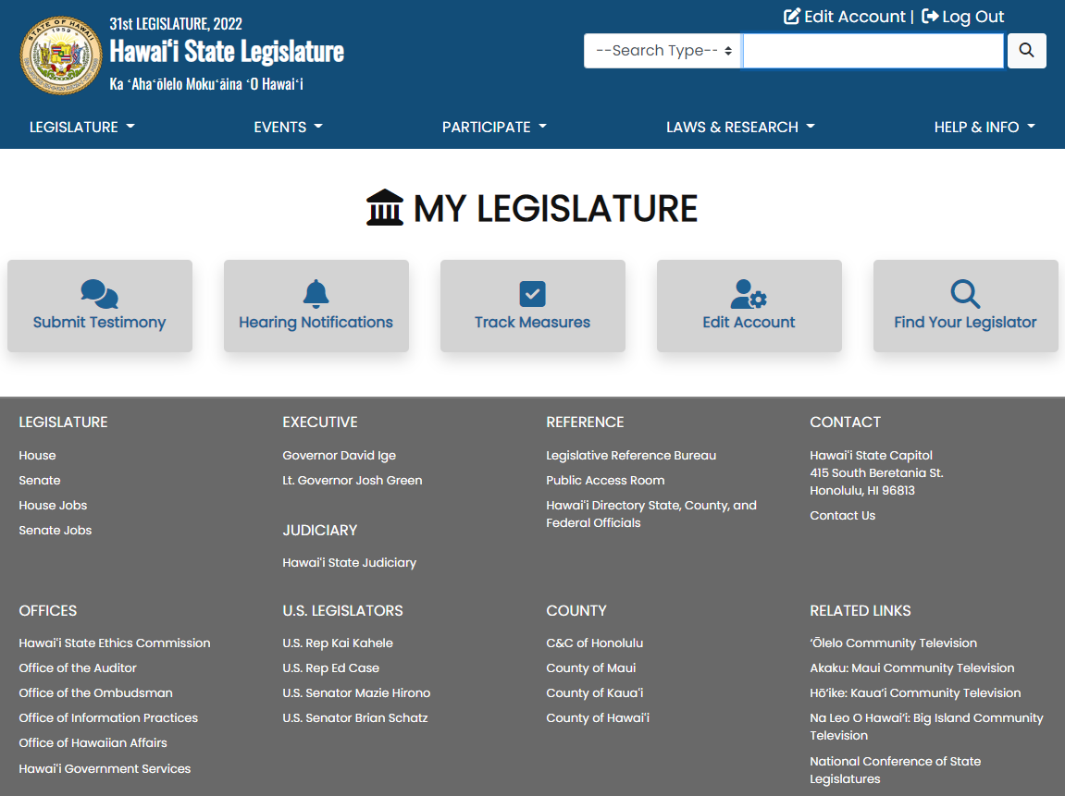
Notes:
Once you sign in, you can use the interactive features.

Slide 124
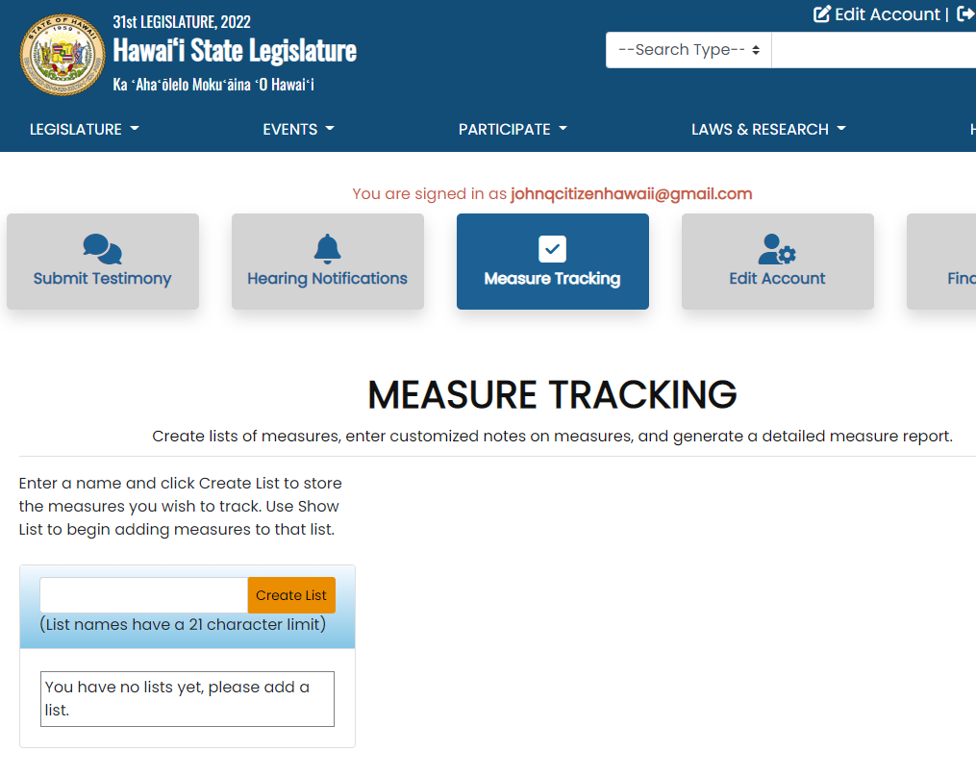

Slide 125


Slide 126


Slide 127


Slide 128


Slide 129


Slide 130


Slide 131


Slide 132


Slide 133


Slide 134


Slide 135


Slide 136


